Slide 1
#851-25-000031-PLNG: Zone Variance Request
#851-25-000030-PLNG: Property Line Adjustment
Involving Property in Unincorporated Neskowin (South Beach Area)
T5S R11W 36BC-220 owned by Seabreeze Associates LP, et. al.
And
T5S R11W 36BC-231 owned by Heather Gobet-Pomeroy, et. al.

Slide 2
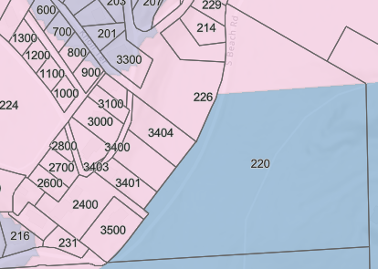
Zoning Context
Zoning Map (County GIS)
36BC-220 has two areas of mixed zoning—it’s northern and its southwestern areas and this is likely due to legacy considerations decades old
Property proposed to be shifted from 36BC-220 to 36BC-231 circled in red
Zoning for this portion of 36BC-220 is Nesk-R1
Unfortunately, South Beach Road isn’t emphasized on this map, but runs to the east of parcels 36BC-229, 214, 226, 3404, 3401, and 3500 and is included in 36BC-220 as an easement area

Slide 3
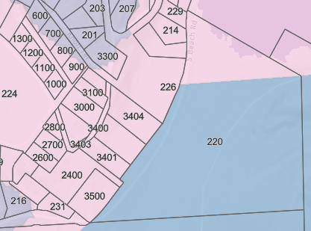
Flood Overlay Context
Flood Overlay Map (County GIS)
36BC-220 northern most part is in Flood Overlay area (green line)
Neither 36BC-231 nor the area proposed to be adjusted are in the Flood Overlay area

Slide 4
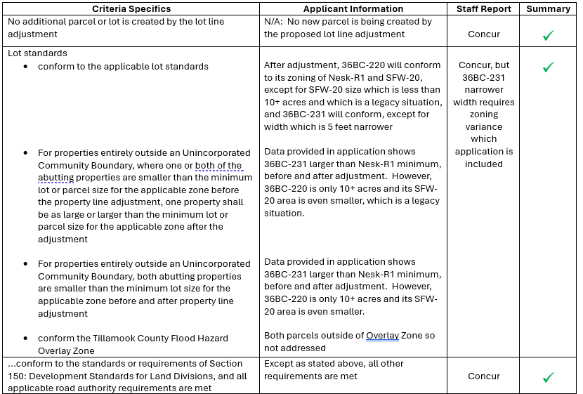
Property Line Adjustment Criteria Summary

Slide 5
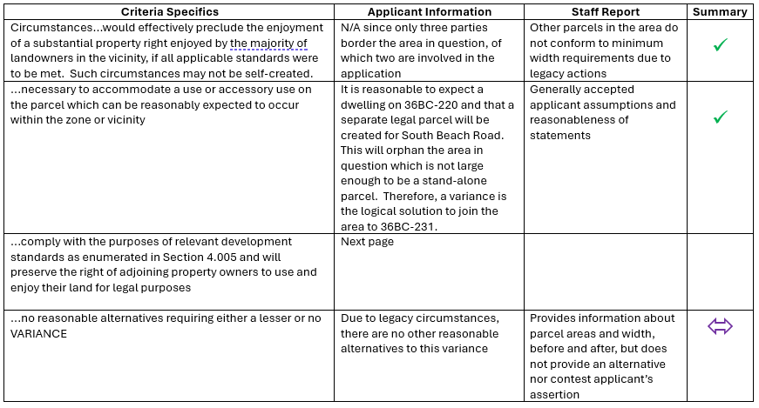
Zoning Variance Criteria Summary

Slide 6
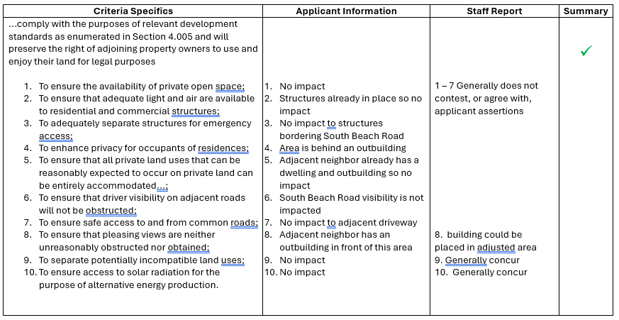
Zoning Variance Criteria Summary (cont’d)

Slide 7
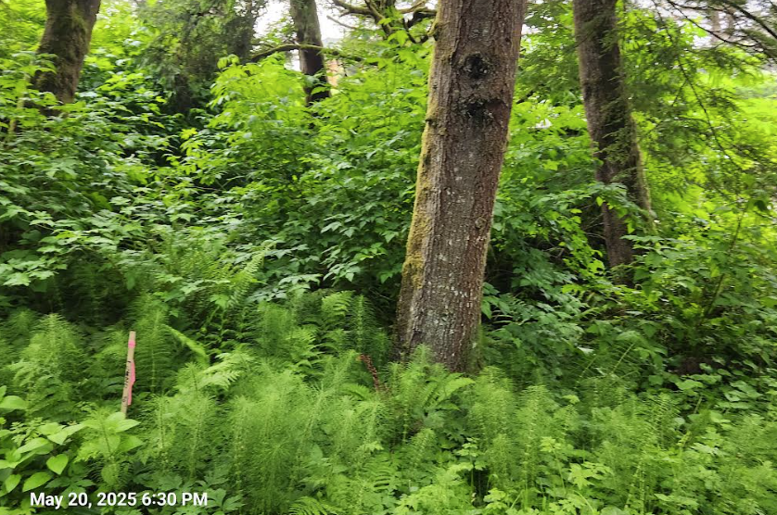
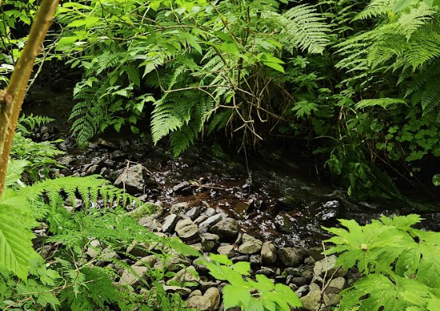
Addressing 4.005, Point 8
A Possible Reason for Lack of Public Comment

Slide 8
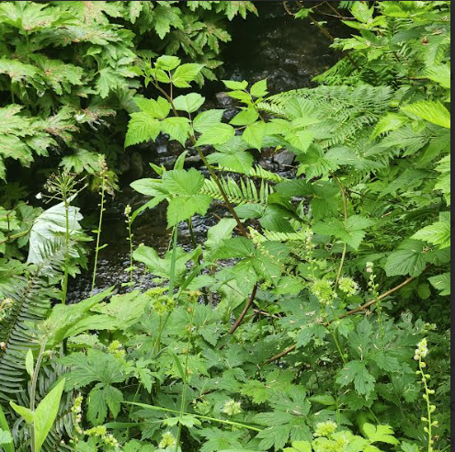
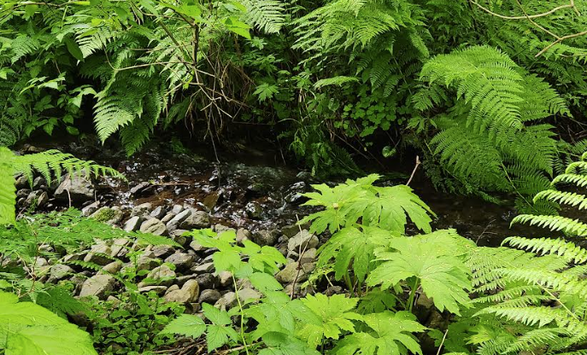
Addressing 4.005, Point 8 (cont’d)

Slide 9
Conditions for Approval
Conditions for PLA, bullet 2:
  Please note that the southwestern portion of 36BC-220, in the Nesk-R1 zone, is South Beach Road and that this is intended to be placed into a separate legal tax lot at some point in the future. Therefore, we recommend not including the exact language in bullet 2, as stated in the staff report, as the existence of an easement roadway precludes creation of a buildable parcel anyway.
Conditions for Variance: No comments
Timing requirements harmonization:
  All applicant parties accept a 1-year time horizon for both requests, as long as the phrase “construction/division of approved plans” refers to only the requested property adjustment and zoning variance

