Slide 1
PRELIMINARY SUBDIVISION PLAT REVIEW
REQUEST FOR “RIVERVIEW MEADOWS PHASE 2”
#851-26-000055-PLNG
TOGETHER WITH
CONDITIONAL USE REQUEST
# 851-26-000139-PLNG &
GEOLOGIC HAZARD REPORT REVIEW
#851-26-000056-PLNG
Presented by
SARAH ABSHER, CFM, DIRECTOR

Slide 2
BACKGROUND
APPROVED BY TILLAMOOK COUNTY PLANNING COMMISSION AS PHASES 2 AND 3 OF RIVERVIEW MEADOWS SUBDIVISION
  PHASE 2 #851-21-000414-PLNG OCTOBER 2022
    38-LOT SUBDIVISION
  PHASE 3 #851-23-000009-PLNG JUNE 2023
    36-LOT SUBDIVISION
  GEOLOGIC HAZARD REPORT PHASES 2 & 3 #851-21-000414-PLNG

Slide 3
NOTABLE DIFFERENCES
  PHASES 2 & 3 CONSOLIDATED FOR 2026 REVIEW PROCESS
    PHASE 2 CONSISTING OF 74 LOTS & 3 TRACTS
  CITY OF NEHALEM ZONING & SUBDIVISION ORDINANCE UPDATES
    PROPERTY REZONED TO MIXED DENSITY RESIDENTIAL (NH_RM)
    RIPARIAN SETBACKS & BUFFER REQUIREMENTS
      CONDITIONAL USE APPROVAL REQUIRED FOR ENCROACHMENTS IN RIPARIAN BUFFER ZONES (DISTURBANCE AREA = 45 SQUARE FEET OR 3-FOOT BY 15 FOOT AREA)
      SPECIFIC CRITERIA FOR RIPARIAIN BUFFER ZONE ENCROACHMENTS
  FLOODPLAIN DEVELOPMENT PERMIT REQUIREMENT
  ORDINANCE FRAMEWORK OVERHAUL
    CHAPTERS & SECTIONS RENUMBERED, NEW SECTIONS ADDED

Slide 4
MULTI-JURISDICTIONAL COORDINATION
TILLAMOOK COUNTY DEPT. COMMUNITY DEVELOPMENT
TILLAMOOK COUNTY PUBLIC WORKS DEPARTMENT
TILLAMOOK COUNTY SURVEYOR’S OFFICE
CITY OF NEHALEM
  WATER
  INFRASTRUCTURE
  FLOODPLAIN DEVELOPMENT PERMIT REVIEW
NEHALEM BAY WASTEWATER AGENCY
NEHALEM BAY FIRE DISTRICT

Slide 5
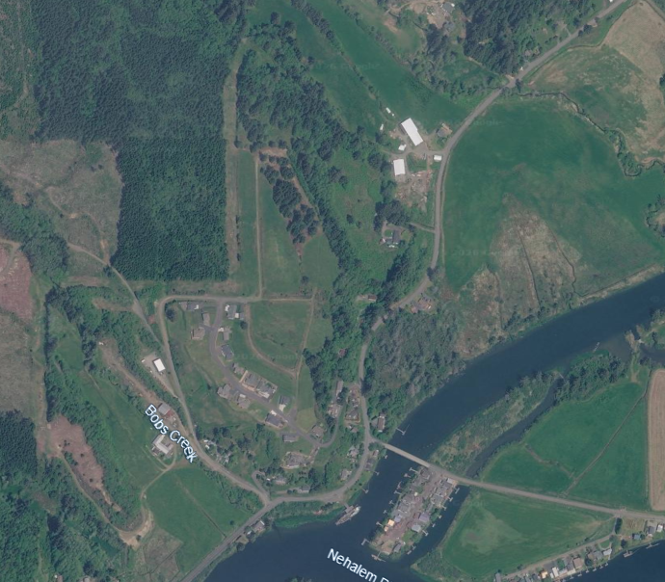

Slide 6
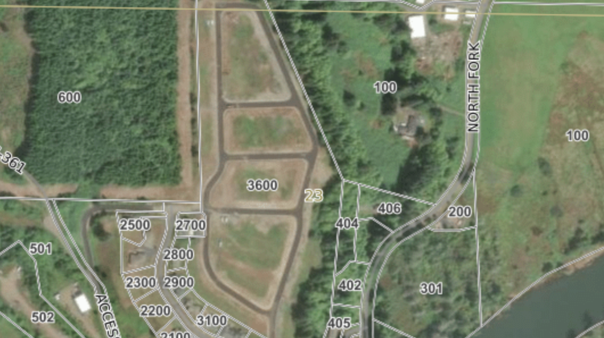

Slide 7
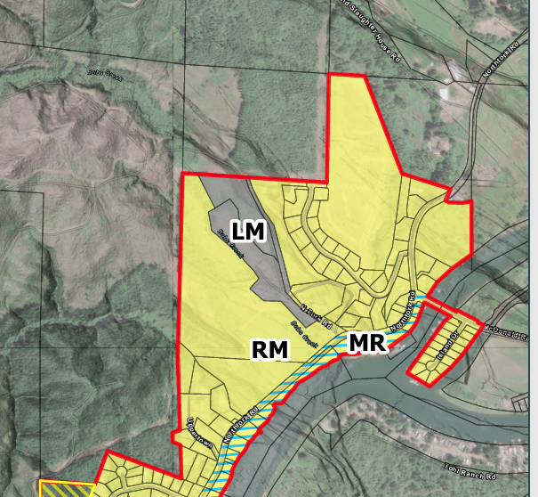

Slide 8
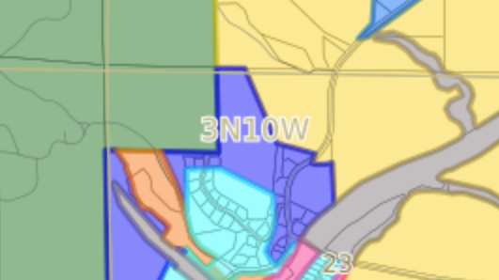
FOREST (F)
FARM (F-1)

Slide 9
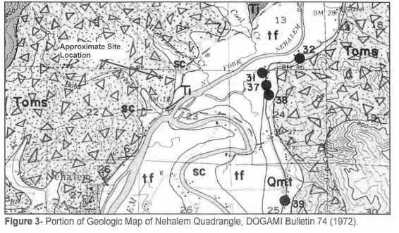

Slide 10
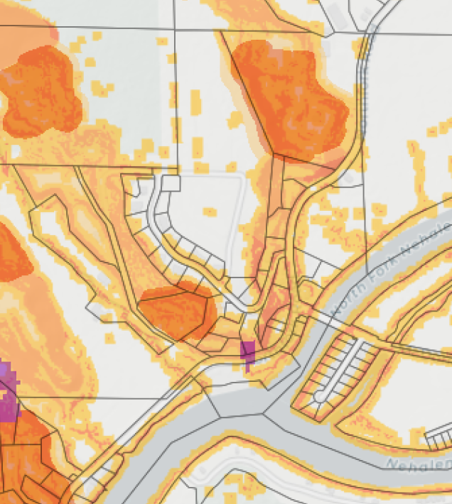

Slide 11
APPLICABLE STANDARDS
Nehalem Development Ordinance Section 157.205: Mixed Density Residential (RM) Zone
Nehalem Development Ordinance Section 157.402: Street Standards
Nehalem Development Ordinance Section 157.404: Land Divisions
Nehalem Development Ordinance Section 157.407: Stormwater Drainage and Grading
Nehalem Development Ordinance Section 157.408: Utility Lines and Facilities
Nehalem Development Ordinance Section 157.440: Geological Hazards
Nehalem Development Ordinance Section 157.442.01: Riparian Vegetation and Small Streams
Nehalem Development Ordinance Section 157.442.02: Buffers Adjacent to EFU Zoned Property
Nehalem Development Ordinance Section 157.507: Conditional Use Permits
Nehalem Development Ordinance Section 157.510: Subdivisions and Planned Developments

Slide 12
APPLICABLE CRITERIA
Nehalem Development Ordinance Section 157.507.05: Conditional Use Decision Criteria
Nehalem Development Ordinance Section 157.510.05: Subdivision and Planned Developments Decision Criteria

Slide 13
157.205: MIXED USE RESIDENTIAL
(RM) ZONE
(A) Minimum Lot Size
  1. Single Family Home
    a. Attached – 4,000 square feet.
    b. Detached – 5,000 square feet.
  (B)Minimum Lot Dimensions:
1. Lot Width - 40 feet; corner lot - 60 feet along each street frontage.
2. Lot Depth – 85 feet.
Notes:
Example objectives
At the end of this lesson, you will be able to:
Save files to the team Web server.
Move files to different locations on the team Web server.
Share files on the team Web server.

Slide 14
157.507: CONDITIONAL USE PERMITS
157.507.05 Decision Criteria
A Conditional Use shall be approved if the applicant provides supporting evidence that all the requirements of this Ordinance relative to the proposed use are satisfied, and demonstrates that the proposed use also satisfies the following criteria:
The use is listed as a conditional use in the underlying district and complies with the development requirements of the underlying zone.
The characteristics of the site are suitable for the proposed use considering size, shape, location, topography, and location of improvements and natural features.
The proposed development is timely, considering the adequacy of transportation systems, public facilities and services, existing or planned for the area affected by the use.
The proposed use will not alter the character of the surrounding area in a manner which substantially limits, impairs, or precludes the use of surrounding properties for the primary uses listed in the underlying zone.
Decision criteria for special buffers are found in Section 157.442.

Slide 15
157.442: SPECIAL BUFFERS & SETBACKS
157.442.01 Riparian Vegetation and Small Streams
(A) Riparian vegetation along small streams shall be protected by a 15-foot riparian zone for all creeks. This zone shall be run parallel to the mean high-water line of the subject creek.
Any development within the 15-foot riparian zone, including the removal or replacement of vegetation, shall require a Conditional Use application pursuant to Section 157.507. In addition to the Conditional Use criteria in Section 157.507, a conditional use permit within the riparian vegetative area shall indicate how: (1) the proposal will not affect the following factors; (2) the proposal can be mitigated in some manner to minimize or eliminate potential harmful impacts regarding the following factors; or, (3) the factors do not apply to the request. The factors include:
Development or improvements shall be directed away from adjacent streams and drainage corridors to the greatest possible extent.
The development, change, or intensification of use shall provide the maximum possible landscaped area, open space, or vegetation between the activity and adjacent streams or drainage corridors.
The fringe along streams and drainage corridors shall be maintained to the maximum extent practical in order to assure scenic quality, protection of wildlife habitat, and protection from erosion.
Areas of annual flooding, flood plains, and wetlands shall be preserved in their natural state to the maximum possible extent to protect water retention, overflow and other natural functions. The development shall comply with the flood plain or floodway development requirements of the Development Ordinance.

Slide 16
157.440 GEOLOGICAL HAZARDS
A Geologic Hazard Report (GHR) is required prior to approval of a subdivision, per Section 157.440.03(A).
GHR has been prepared and included in the application submittal (Exhibit B). Soils and geology of the site is discussed in the Geologic Hazard Report (GHR) dated February 25, 2020, prepared by R. Warren Krager, R.G., C.E.G., (Exhibit B). In addition to the Krager February 25, 2020, report, the Geologic Hazard Report also includes the following:
  May 12, 2022, addendum prepared by Morgan Civil Engineering, Inc.
  December 15, 2022, Engineering Portion of Geologic Hazard Report for Road and Utility Development prepared by Morgan Civil Engineering Inc.
  November 21, 2022, Engineering Geologic Hazard Report prepared by R. Warren Krager, R.G., C.E.G.,
Updated report memorandums dated December 19, 2025, and January 6, 2026, confirming all on-site activities for construction of “Riverview Meadows Phase 2” were completed in compliance with the Geologic Hazard Report for Riverview Meadows Phases 2 and 3, approved by the Tillamook County Planning Commission as #851-21-000414-PLNG (Exhibit B).

Slide 17
STAFF FINDINGS
FINDINGS IN RESPONSE TO APPLICABLE DEVELOPMENT STANDARDS CONTAINED IN STAFF REPORT DATED JUNE 4, 2026
REQUIRED INFORMATION CONTAINED IN APPLICANT’S SUBMITTAL (EXHIBIT B)
APPLICANT WORKING WITH CITY OF NEHALEM AND TILLAMOOK COUNTY PUBLIC WORKS ON INFORMATION REQUIRED TO DEMONSTRATE IMPROVEMENTS HAVE BEEN INSTALLED TO SATISFACTION OF JURISDICTIONAL AUTHORITIES AND IN COMPLIANCE WITH CITY OF NEHALEM ZONING & SUBDIVISION ORDINANCE
APPLICANT HAS SUBMITTED PERFORMANCE CONFORMANCE LETTERS FROM SERVICE PROVIDERS, INCLUDING LETTER OF SATISFACTION OF COMPLETION OF INSTALLATION OF UTILITIES FROM NEHALEM BAY WASTEWATER AGENCY.
RECOMMENDED CONDITIONS OF APPROVAL CONTAINED IN STAFF REPORT SHOULD PLANNING COMMISSION CHOOSE TO APPROVE THESE REQUESTS.

Slide 18
TILLAMOOK COUNTY PUBLIC WORKS COMMENTS
DIRECTOR CHRIS LAITY, PE
BRIAN OLLE, PE, ENGINEERING PROJECT SUPERVISOR

