Slide 1
Pine Beach Combined Application for Shoreline Protection Tillamook County Planning Commission May 27, 2021
Presented by:
Wendie L. Kellington, Kellington Law Group, PC
P.O. Box 159, Lake Oswego, Or 97034

Slide 2
Presentation organization
Explain the subject properties;
Explain why this request is unique;
Explain the legal framework and why the requested exception is precautionary;
Explain the proposed shoreline protection;
Explain the dangers the properties face without the BPS;
Explain how the exception standards are met.

Slide 3
Subject Properties
For efficiency and avoid piecemeal approach, owners of 15 properties working together seek shoreline protection.
Proposal is supported by the Pine Beach HOA
Pine Beach Loop (Pine Beach Subdivision – first platted 1932; replatted 1994) and Ocean Blvd. (George Shand tracts platted 1950).
South of Rockaway Beach (directly south of Shorewood RV Resort).
North of Camp Magruder and Barview Jetty.
Zoned CR-2 (Community Medium Density Residential) with Beach and Dune Overlay (BD) and Flood Hazard Overlay (FH); in Barview/Watseco/Twin Rocks unincorporated community.
TL 2900 between the RV Park and other George Shand Tracts is supportive but not participating because they have an undisputed right to BPS - their house was built in 1974.
Engineering analysis - proposed BPS does not adversely affect the TL 2900 property; ocean will continue to approach as now.

Slide 4
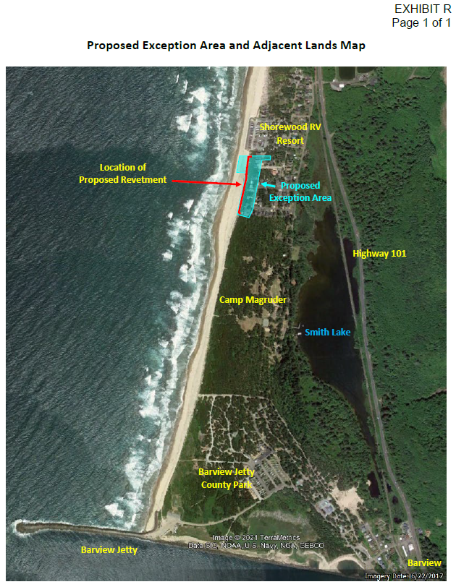

Slide 5
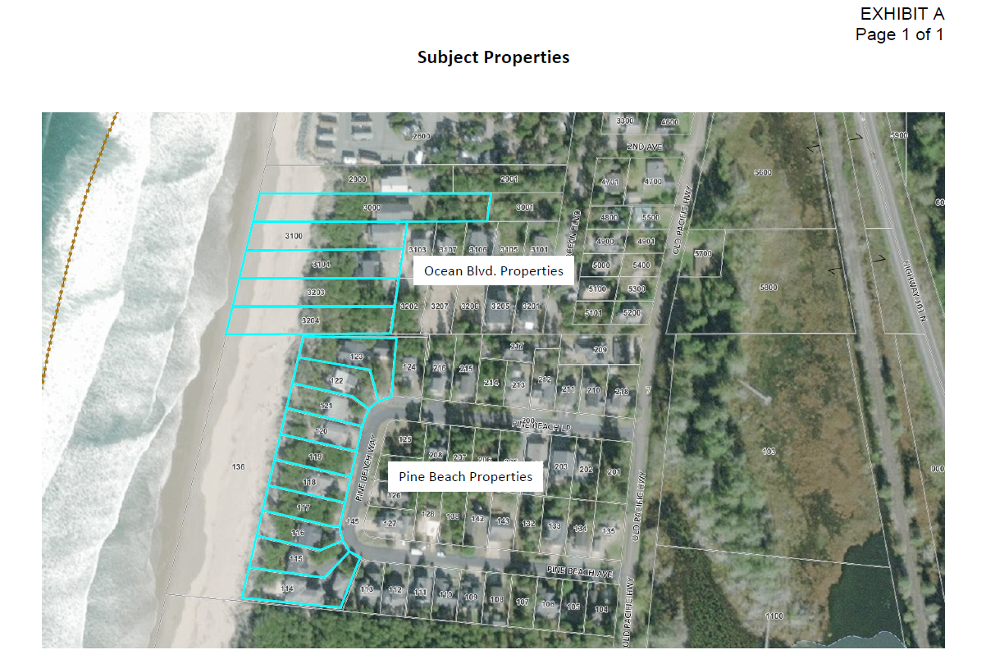

Slide 6
General Principles to Keep in Mind –Proposal is Unique
The proposed beachfront protective structure (“BPS”) is entirely east of the line of established vegetation; Oregon Parks and Recreation Department (OPRD) has jurisdiction only up to the line of established vegetation.
The BPS will be east of that. Therefore, OPRD is not involved.

Slide 7
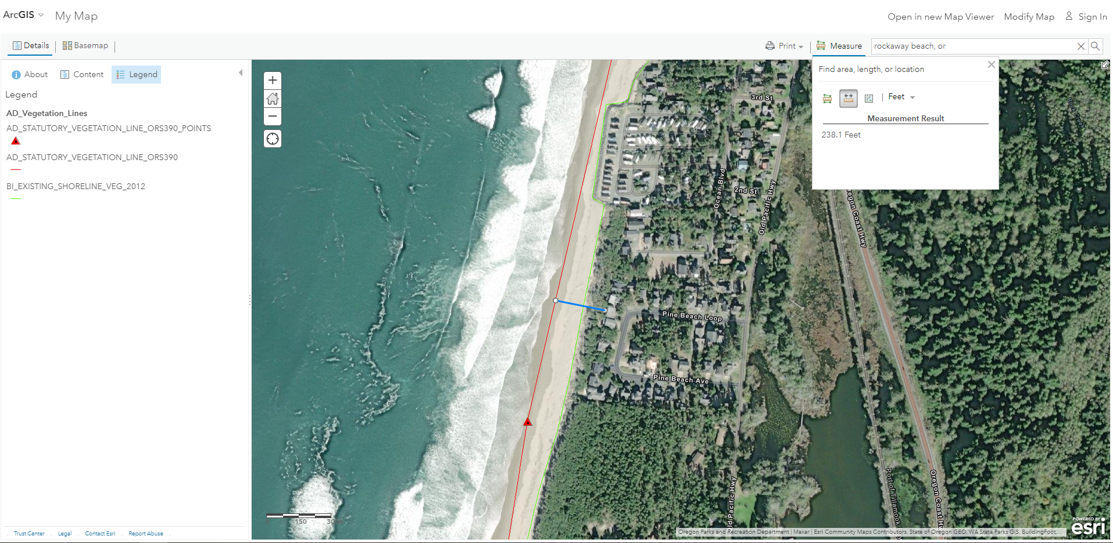
From State website

Slide 8
Goal 18 Exception Framework
Goal 18, Implementation Measure (5):
“Permits for beachfront protective structures shall be issued only where development existed on January 1, 1977. Local comprehensive plans shall identify areas where development existed on January 1, 1977. For the purposes of this requirement and Implementation Measure 7 ‘development’ means houses, commercial and industrial buildings, and vacant subdivision lots which are physically improved through construction of streets and provision of utilities to the lot and includes areas where an exception to (2) above has been approved. The criteria for review of all shore and beachfront protective structures shall provide that:
“(a) visual impacts are minimized;
“(b) necessary access to the beach is maintained;
“(c) negative impacts on adjacent property are minimized; and
“(d) long-term or recurring costs to the public are avoided.”

Slide 9
The “(2) Above”
Goal 18, “(2) above” says:
“Local governments *** shall prohibit residential developments *** on beaches, active foredunes, on other foredunes which are conditionally stable and that are subject to ocean undercutting or wave overtopping and on interdune areas (deflation plains) that are subject to ocean flooding.”
The requested exception will allow the existing residential development to be where it is, on a beach or dune subject to ocean undercutting and wave overtopping.
Goal 18(5) says that residential development that is allowed to be on dunes subject to ocean overtopping/undercutting under an exception, is entitled to shoreline protection.

Slide 10
Why this Exception Request is Precautionary
The residential development is already allowed to be on the dunes they are on, under an existing “built and committed” exception.
The dunes they are on are now subject to ocean overtopping/undercutting.
Therefore, it seems like these residences are entitled to shoreline protection under the express terms of Goal 18, because they have an exception allowing them to be where they are – on a dune subject to overtopping/undercutting.
The odd thing is that when the subdivisions were established, and when the houses were built, there was no danger of ocean flooding or wave overtopping. The “(2) above” requirement did not apply.
Now, that has changed (probably due to climate change and perhaps jetty changes also have a role). Now, the dunes are subject to ocean flooding and wave overtopping. So “(2) above” now applies.
Query: Since all of the houses to be protected are allowed under existing built and committed exceptions allowing them to be exactly where they are - in fact they are on land zoned and planned for medium density residential use - doesn’t that mean they already have an exception to Goal 18’s “(2) above” that says without an exception no houses “shall” be allowed on dunes subject to ocean overtopping/undercutting?
That should mean that the properties are in fact eligible for shoreline protection under Goal 18(5) because an “exception to (2) above has been approved.”

Slide 11
That is the main reason why the requested Goal 18 exception is precautionary
In case the existing exception that allows the residential development to be where it is, is not good enough.
The Applicants do not have the luxury of time for an academic debate on the fine points of Goal 18.
Their homes are in significant danger.

Slide 12
Other Reasons why this Exception is Precautionary
If the existing exception is not good enough under Goal 18, “(2) above” then the homes would be lawful nonconforming uses that are allowed to be continued and maintained in good repair (ORS 215.130(5)) and the proposed BPS should be allowed without a goal exception on that basis. But the homes are not nonconforming uses since they are consistent with their zoning. However, it may be the niceties of Goal 18 could drive that result.
Property is already committed to residential development and the owners have the right to maintain their homes.

Slide 13
Final Reasons why a Goal 18 Exception seems Unnecessary
The Goal 18 version in effect when the subdivisions were platted (until 1984) said shoreline protection was allowed on property “developed” on January 1, 1977;
“developed” just meant the property had to be in a platted subdivision lot or partition parcel.
All the properties were “developed” – platted subdivisions - under that rule:

Slide 14
Until 1984, the Goal 18 term “develop”, meant the following:
Pine Beach and Ocean Blvd. properties were “developed” – divided into subdivision lots to “bring about growth or availability to construct a structure” on January 1, 1977.

Slide 15
Last reason that a new Goal 18 exception may be unnecessary
The version of Goal 18 now in effect says shoreline protection is allowed for property that was “developed” on January 1, 1977 “means houses *** and vacant subdivision lots which are physically improved through construction of streets and provision of utilities to the lot ***.”
George Shand Tracts and Pine Beach subdivision meet this definition - water from the Watseco Water District predecessor was available and streets ran by GS tracts and Pine Beach subdivision lots, as you can see:

Slide 16
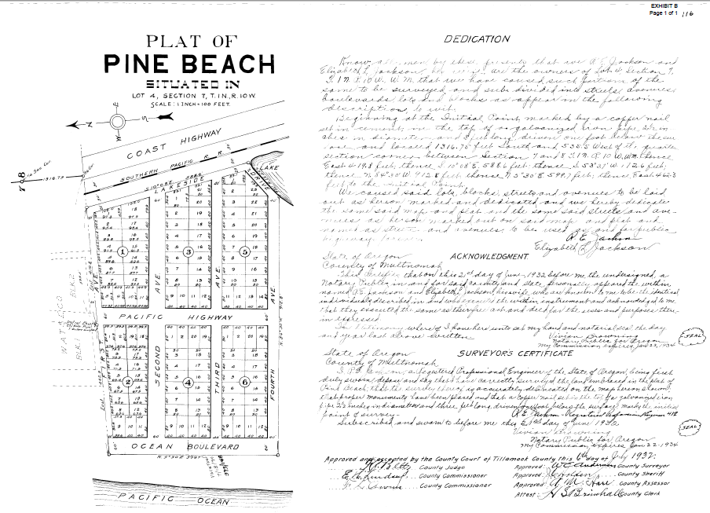
1932 Pine Beach Subdivision

Slide 17
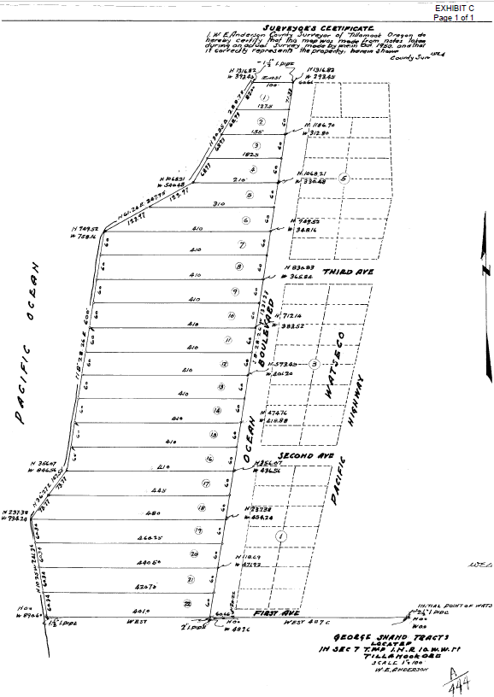
1950 George Shand Tracts (Ocean Blvd. properties)

Slide 18
Potential Planning Commission Actions
The Planning Commission can recommend approval of the Goal 18 exception
AND
The Planning Commission can find in the alternative that no Goal 18 exception is required because:
The existing built and committed exception is an adequate exception to Goal 18 “2 above”
The properties were subdivisions that met the definition of “developed” under Goal 18 in effect until 1984;
The properties meet the current definition of developed in the current Goal 18 rule;
The houses are allowed to be maintained under their existing built and committed exception;
The houses have at least a nonconforming use right under ORS 215.130(5) to continue and be maintained with shoreline protection.

Slide 19
Test in Two Recent Coos County and City of Coos Bay LUBA Cases About Goal Exceptions Needing to be based on Exceptional Circumstances, is Met
Approving the requested exception does not set a precedent for BPS’s everywhere else.
There is a unique situation here - when the subdivisions were platted and the houses were built the ocean had for 70 years or more been PROGRADING. No one was rolling the dice.

Slide 20
This Request is Unique
At the time that the Pine Beach subdivision was replatted (1994) and the George Shand tracts were initially platted (1950) and at the time when all the houses were built, the ocean was PROGRADING – depositing sand, not taking it away.
Instead, the homes were more than 237 feet away from the surveyed statutory vegetation line and further still from the ocean.
Now the statutory vegetation line is at the ocean.
A large vegetated “common area” was platted oceanward of the Pine Beach lots.
That “common area” is now entirely a dry sand beach.
Shoreline protection is only necessary because the ocean has dramatically shifted course from where it had been for more than 70 years.

Slide 21
Subject properties’ developers did everything right
George Shand Tracts (Ocean Blvd. properties) platted in 1950.
Pine Beach replatted in 1994.
Homes seeking BPS here were constructed beginning in 1989.
When constructed, there had been a 70-year period of ocean progration – depositing of sand and adding land.

Slide 22
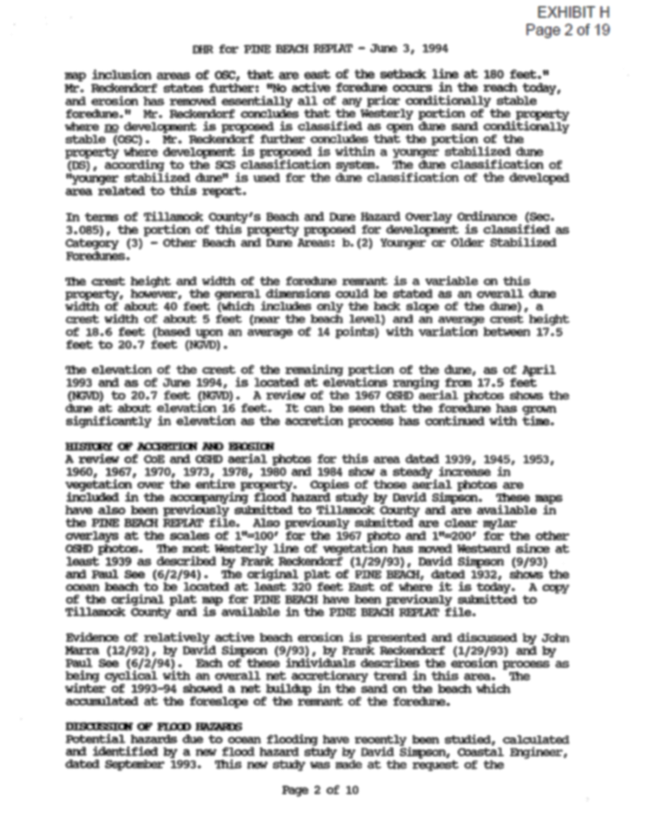
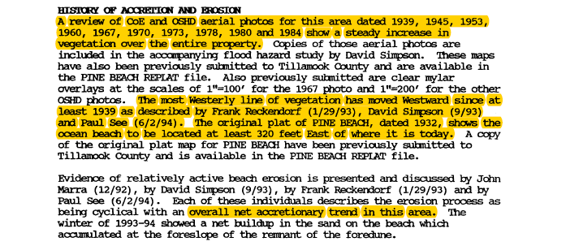

Slide 23
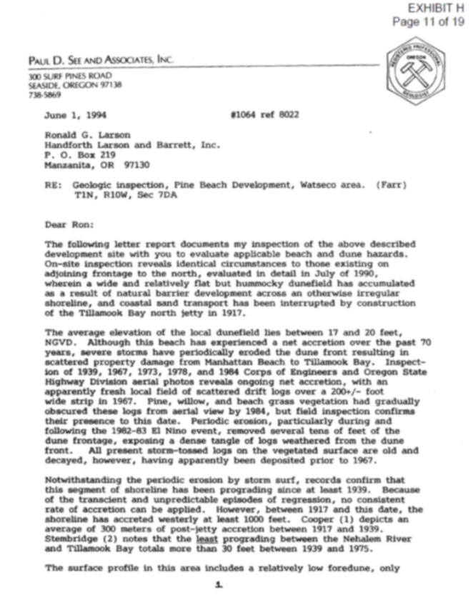

Slide 24
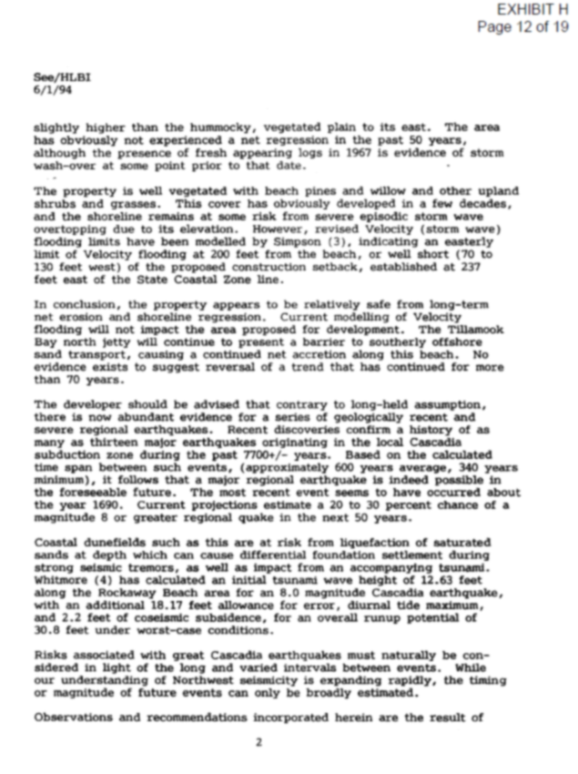

Slide 25
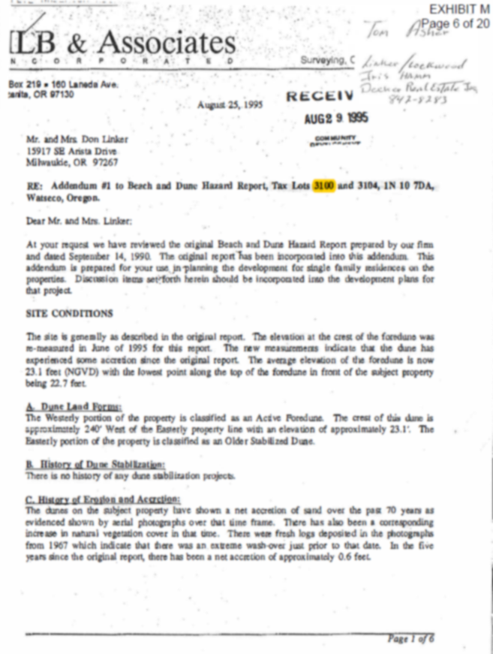

Slide 26
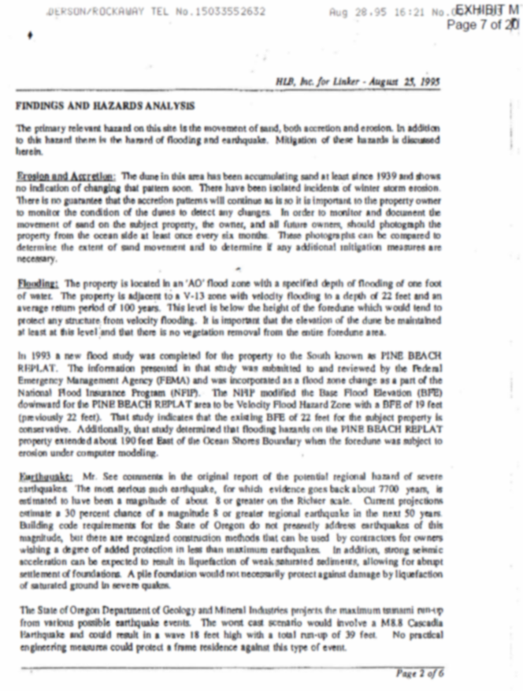

Slide 27
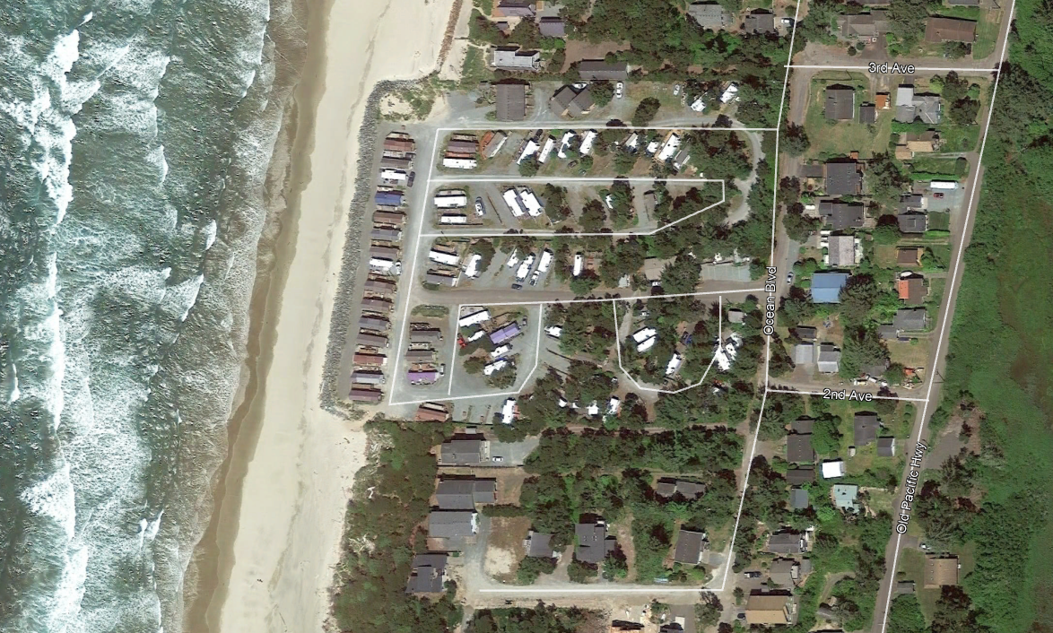
The Details of the Proposed BPS – the proposed BPS will be directly south of Shorewood RV Resort that is protected with rip rap.

Slide 28
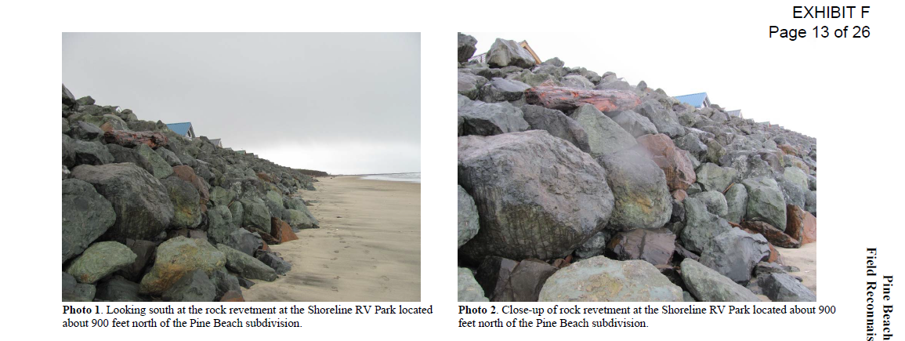

Slide 29
Pine Beach’s BPS will blend into the natural coastal landscape
Pine Beach BPS is in owners’ backyards.
Will not be on the beach.
The BPS will be covered in excavated sand and replanted with native beach grasses, shrubs and trees.
Will be maintained annually by owners.
Will be periodically replenished with sand and replanted with native vegetation because the owners want to look at a beautiful seascape.

Slide 30
Revetment Details
BPS will be entirely on private property → backyards of Pine Beach and Ocean Blvd. homes
10’ landward of existing vegetation line
185’ landward of Oregon Ocean Shore Line (aka statutory vegetation line (“SVL”)
Approx. size: 6’ thick 30’ wide rock revetment; maximum height 3’ above ground level
Covered in excavated sand, replanted with native beach grasses
Maintains existing beach accesses

Slide 31
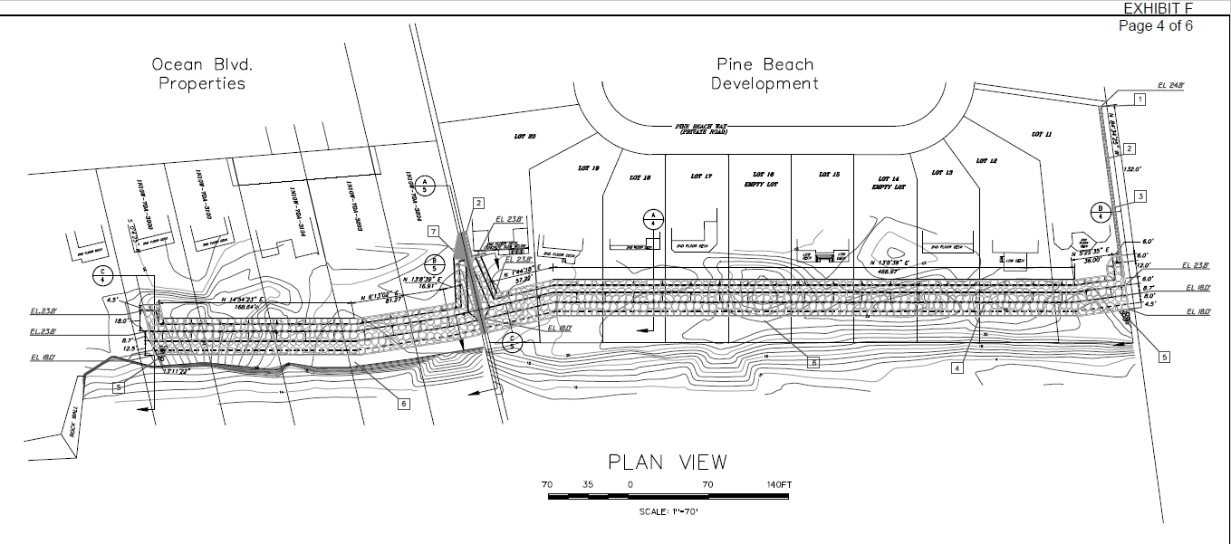

Slide 32
Why the BPS is Sought: the properties and infrastructure are in imminent peril
Retrograding beach since 1994
King Tides in 2020 and 2021 reached oceanfront homes
Continued threat of flooding
At risk is not only the homes, but also the water and sewer infrastructure that serves them.
BPS protects the public and private investments in the area and avoids significant environmental hard from the potential for ocean broken and claimed sewer and water pipes.
Water and sewer district costs of repair may be beyond the capacity of the districts to repair or at least would cause significant strain those district’s resources.

Slide 33
Properties and infrastructure are now in imminent peril
Between 1994-2021, the shoreline has receded 142 feet.

Slide 34
The problem explained by graphics

Slide 35
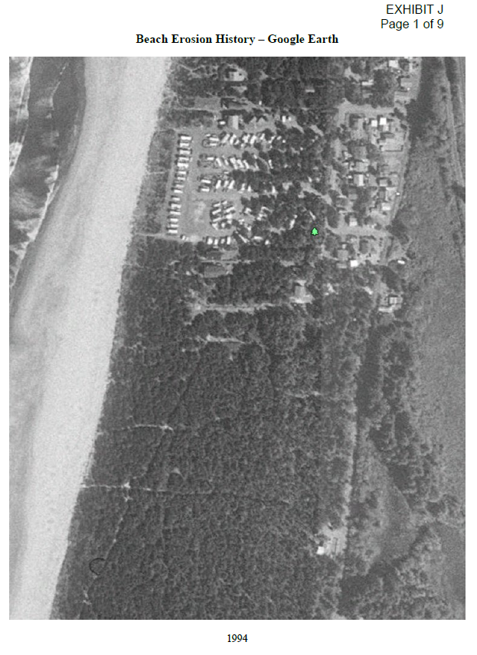
1994

Slide 36
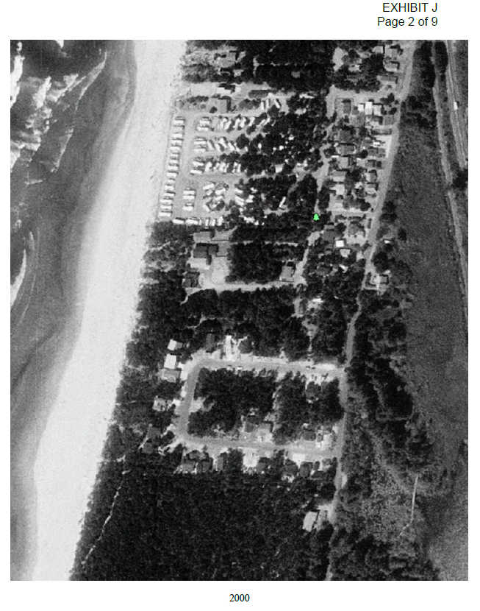
2000

Slide 37
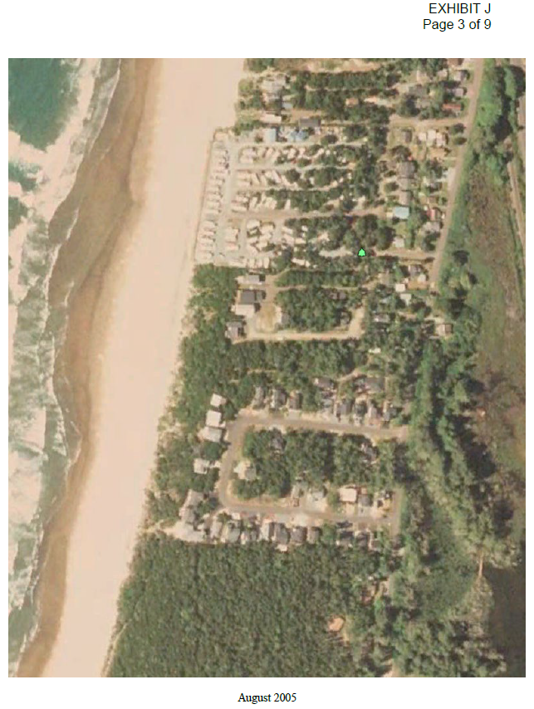
8/2005

Slide 38
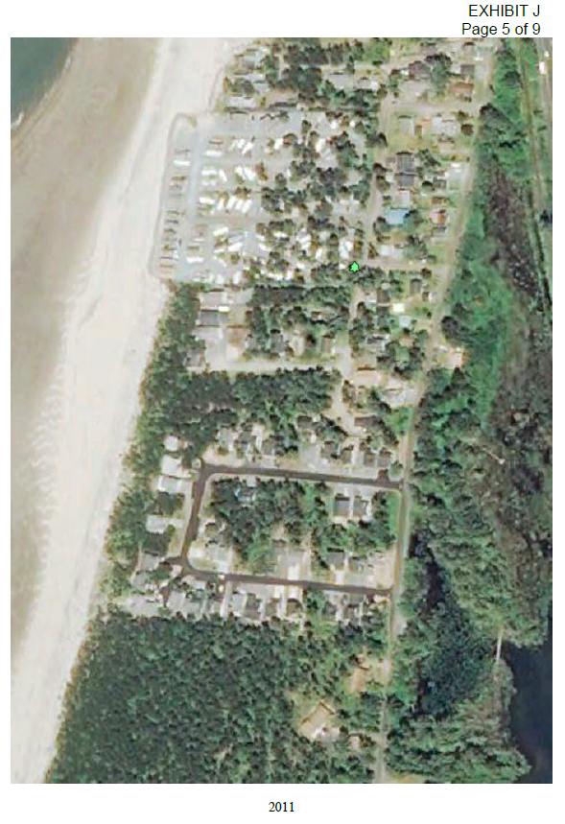
2011

Slide 39
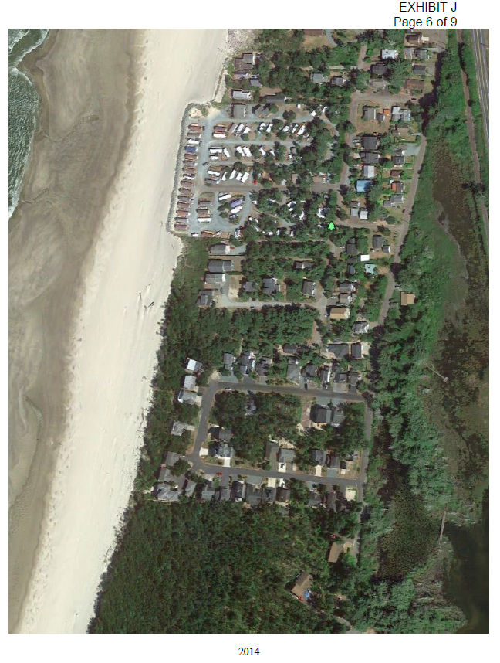
2014

Slide 40
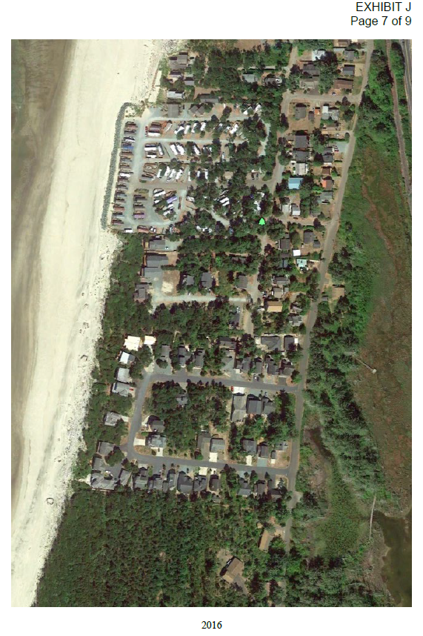
2016

Slide 41
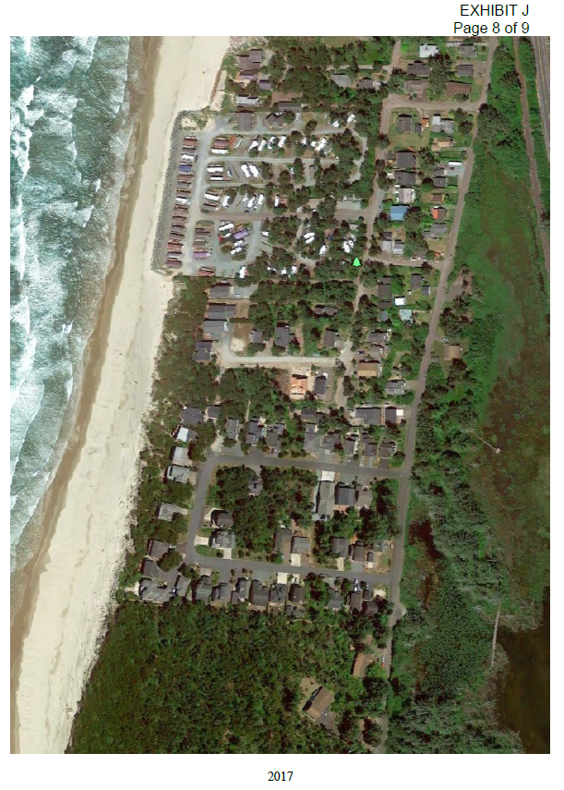
2017

Slide 42
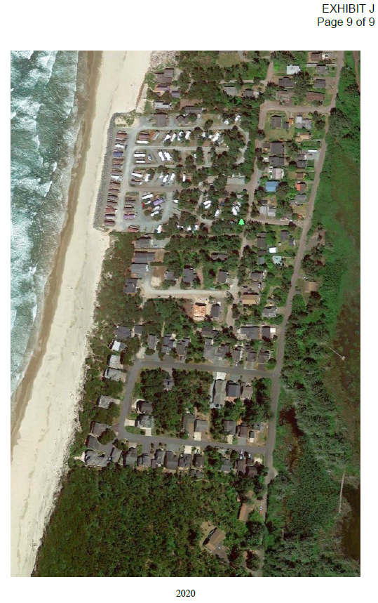
2020

Slide 43
January 12, 2021 Tides Flooding Pine Beach Properties

Slide 44
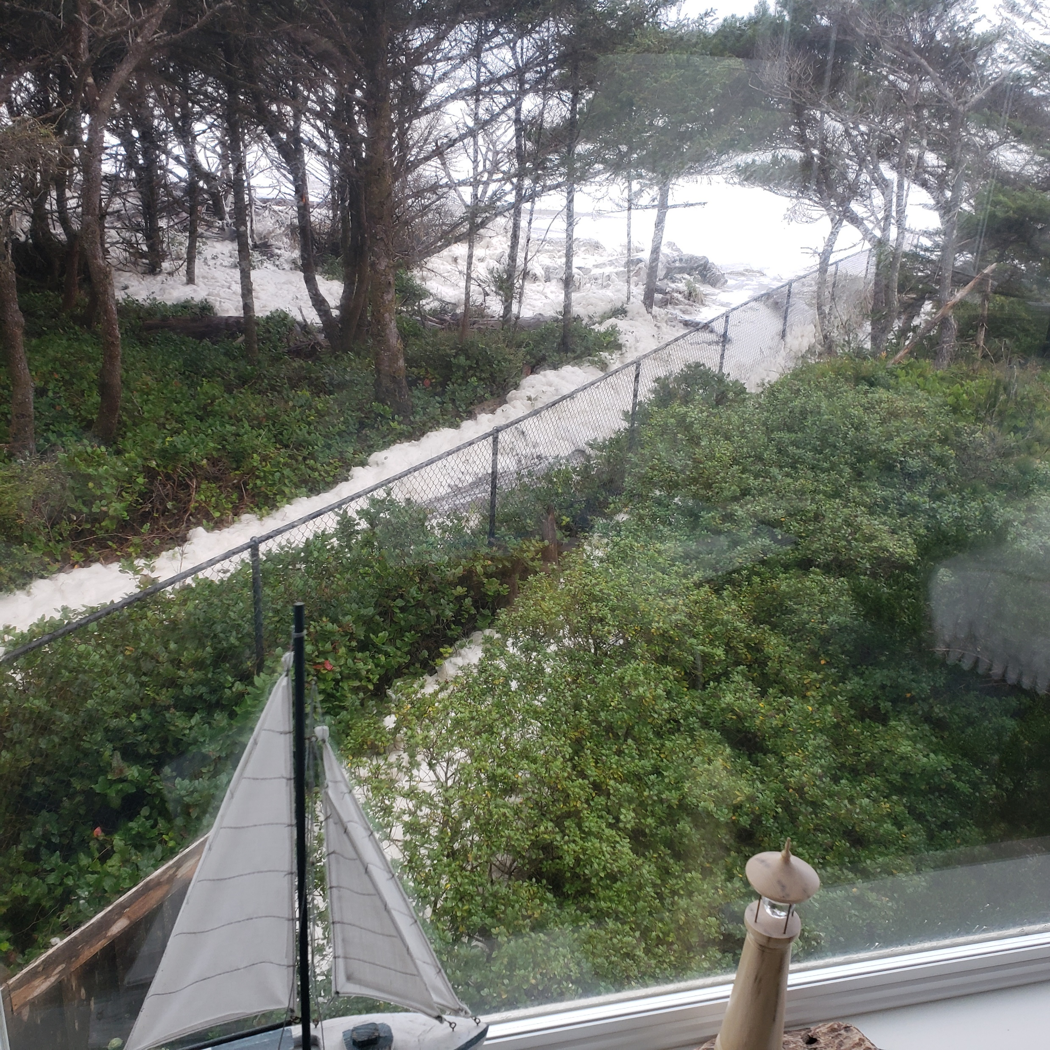

Slide 45
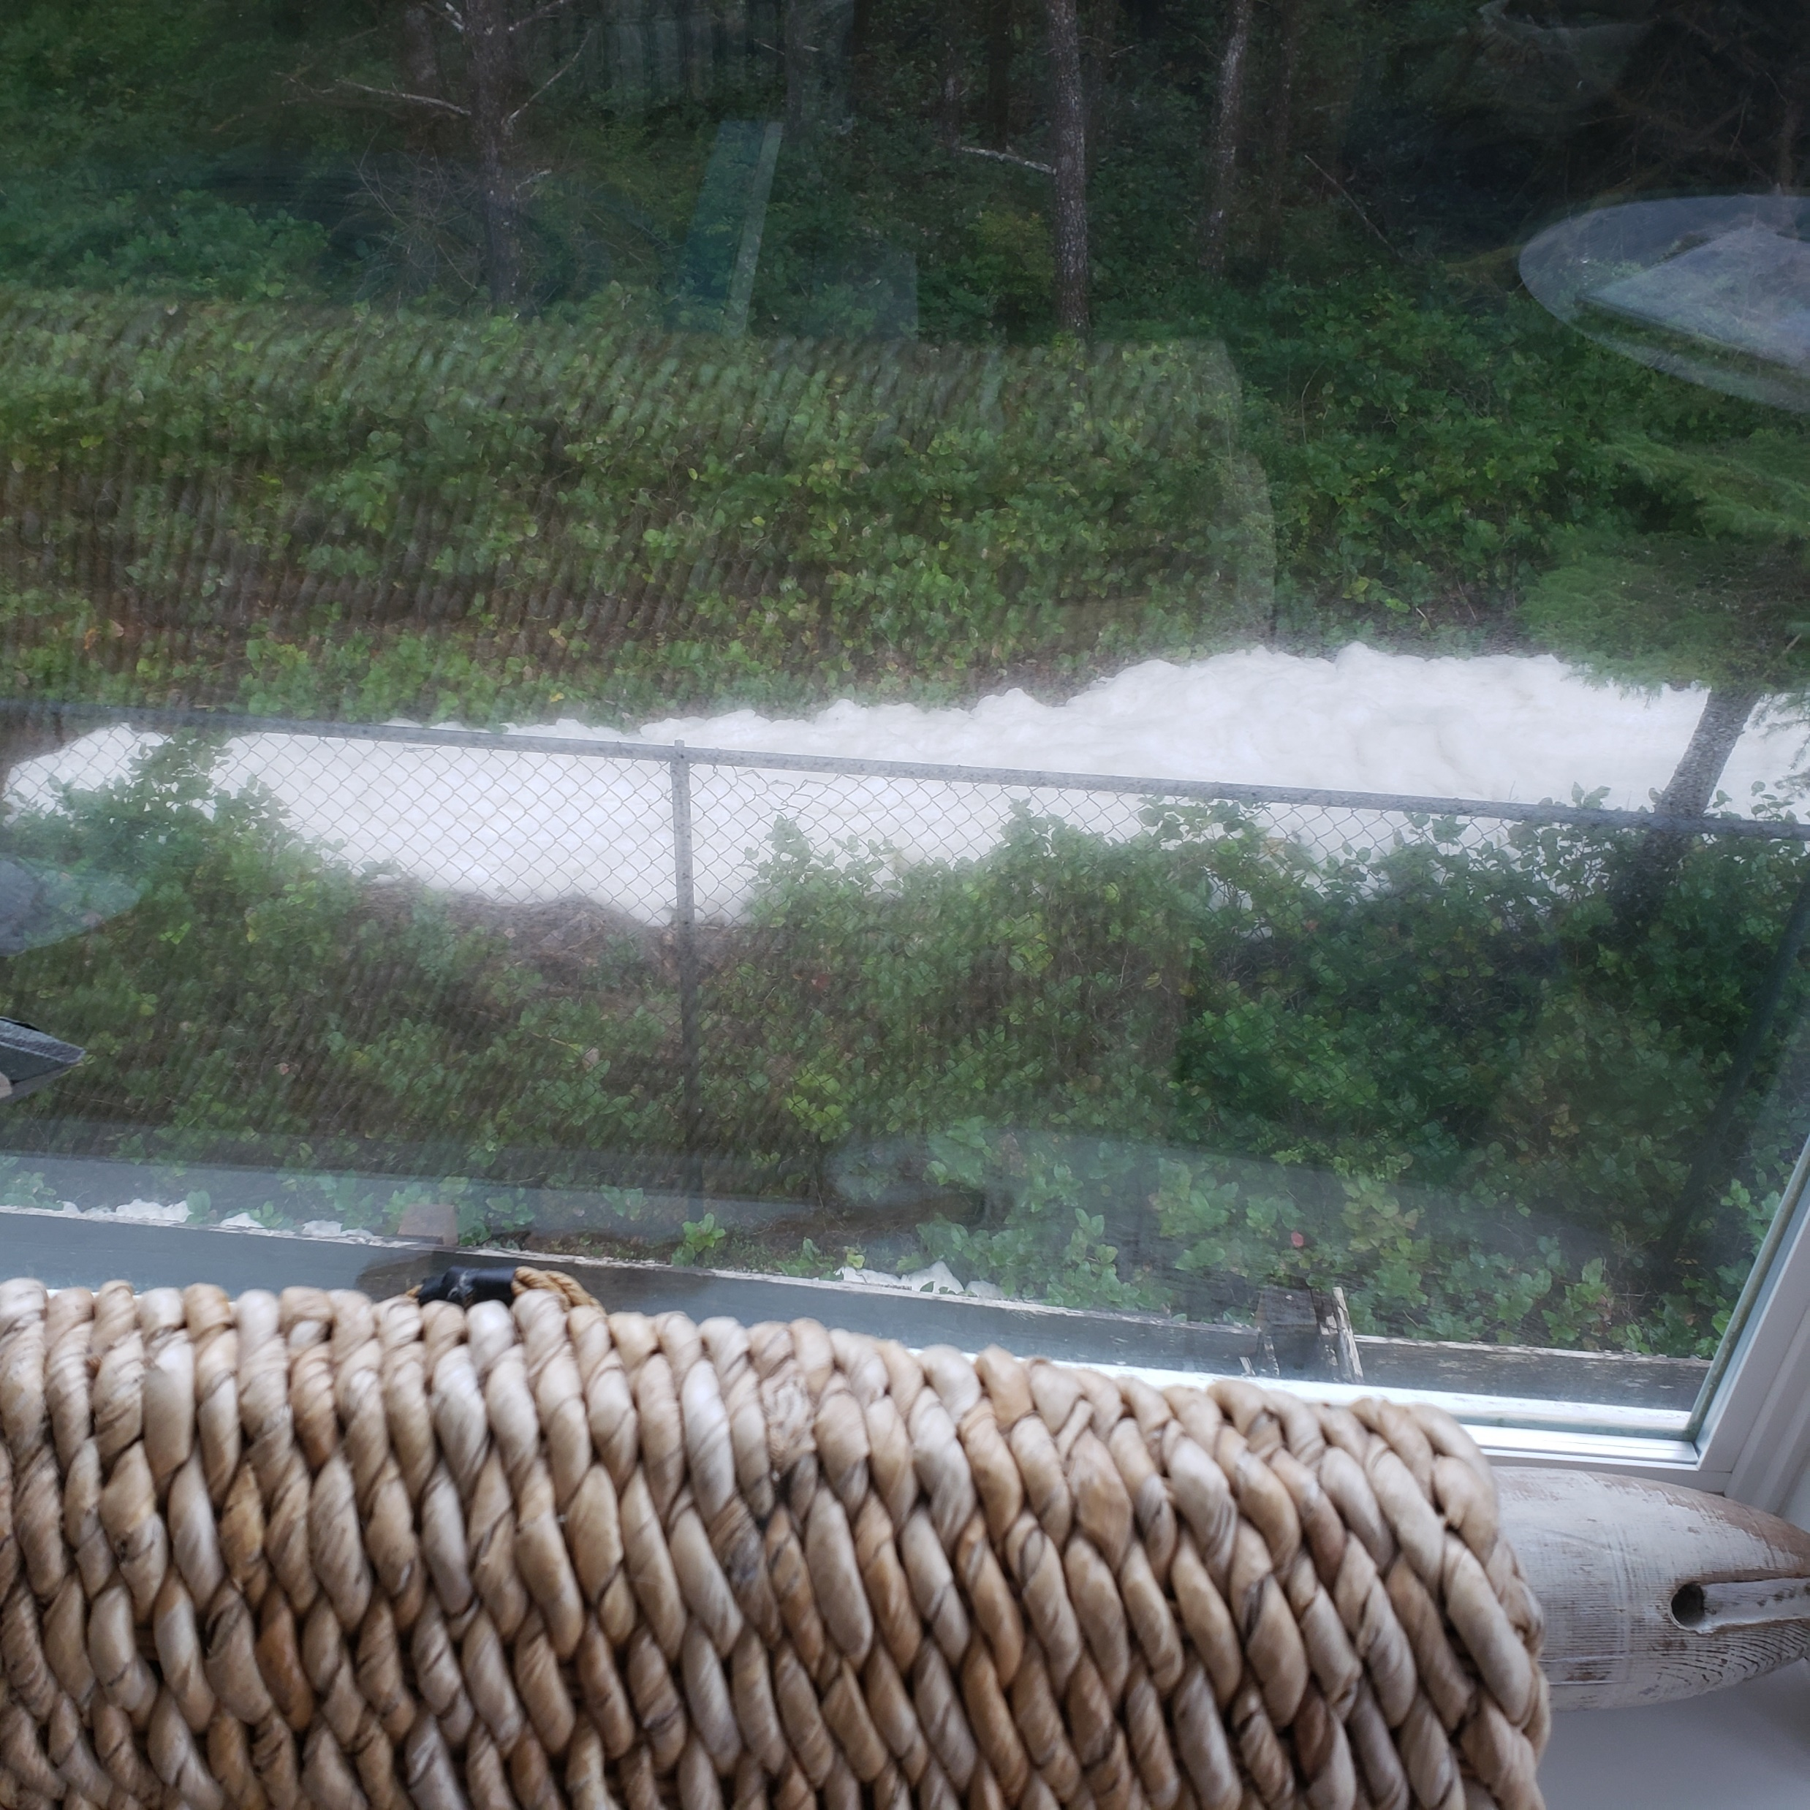

Slide 46
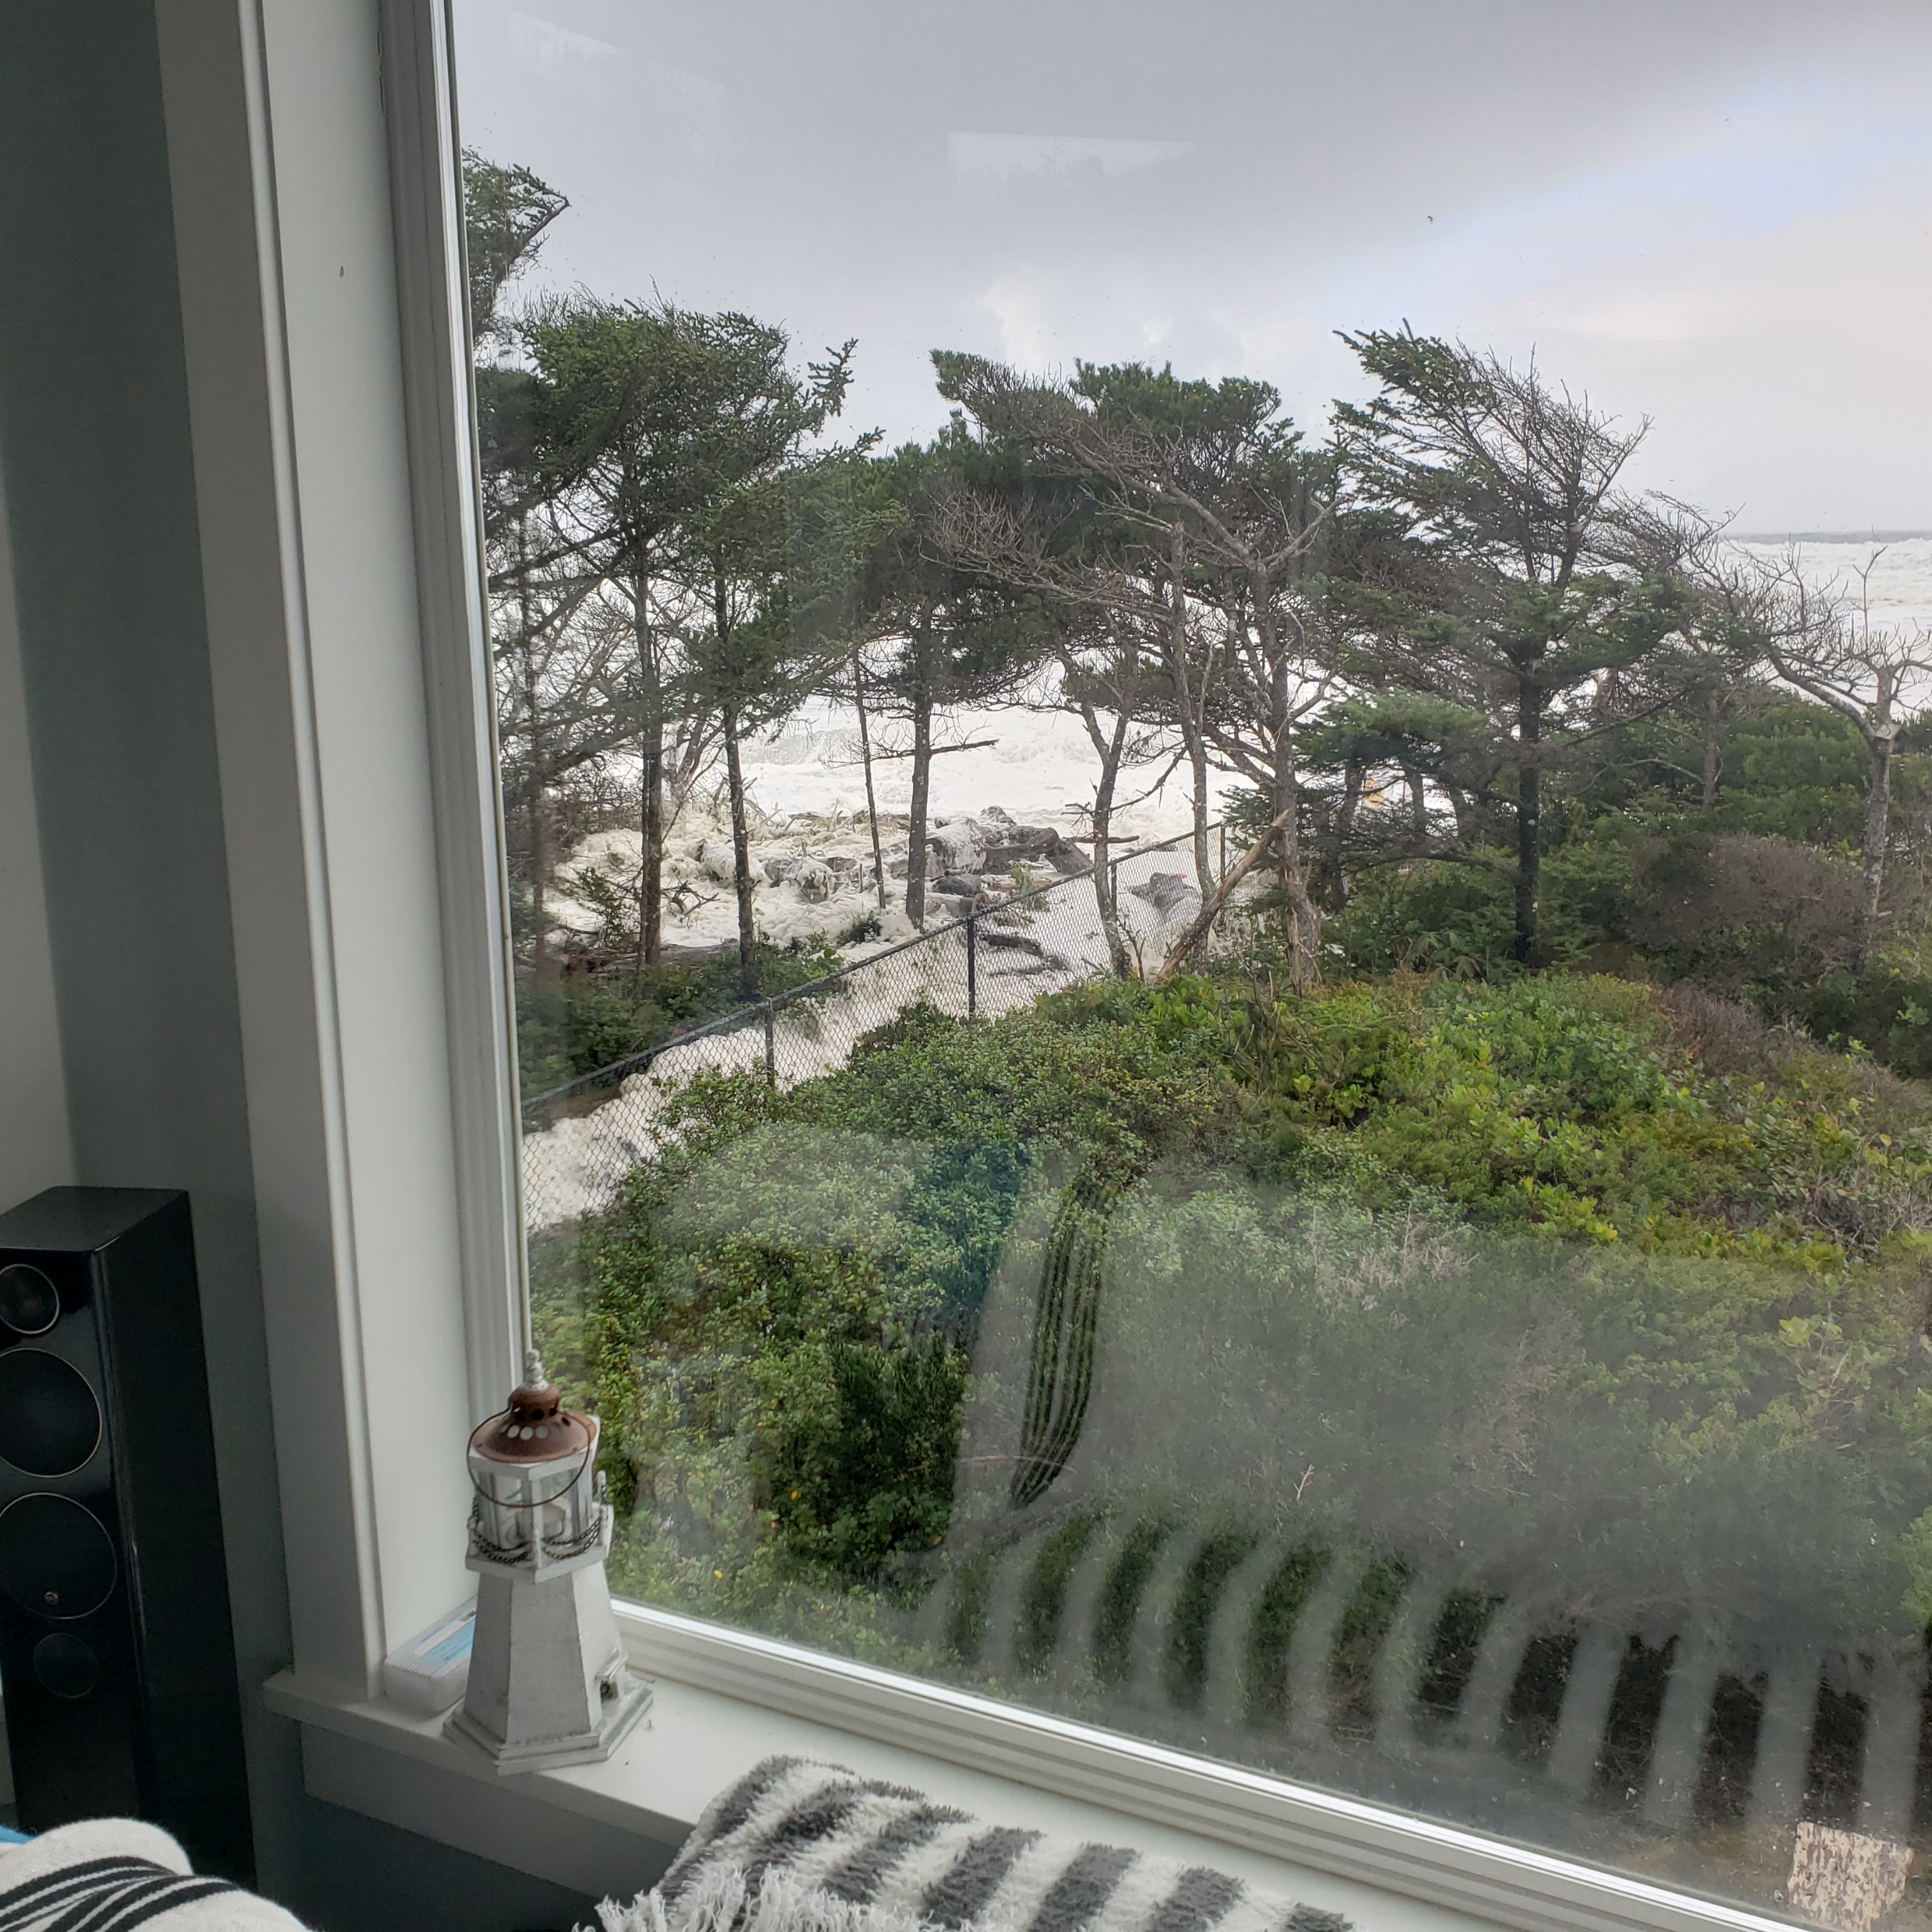

Slide 47
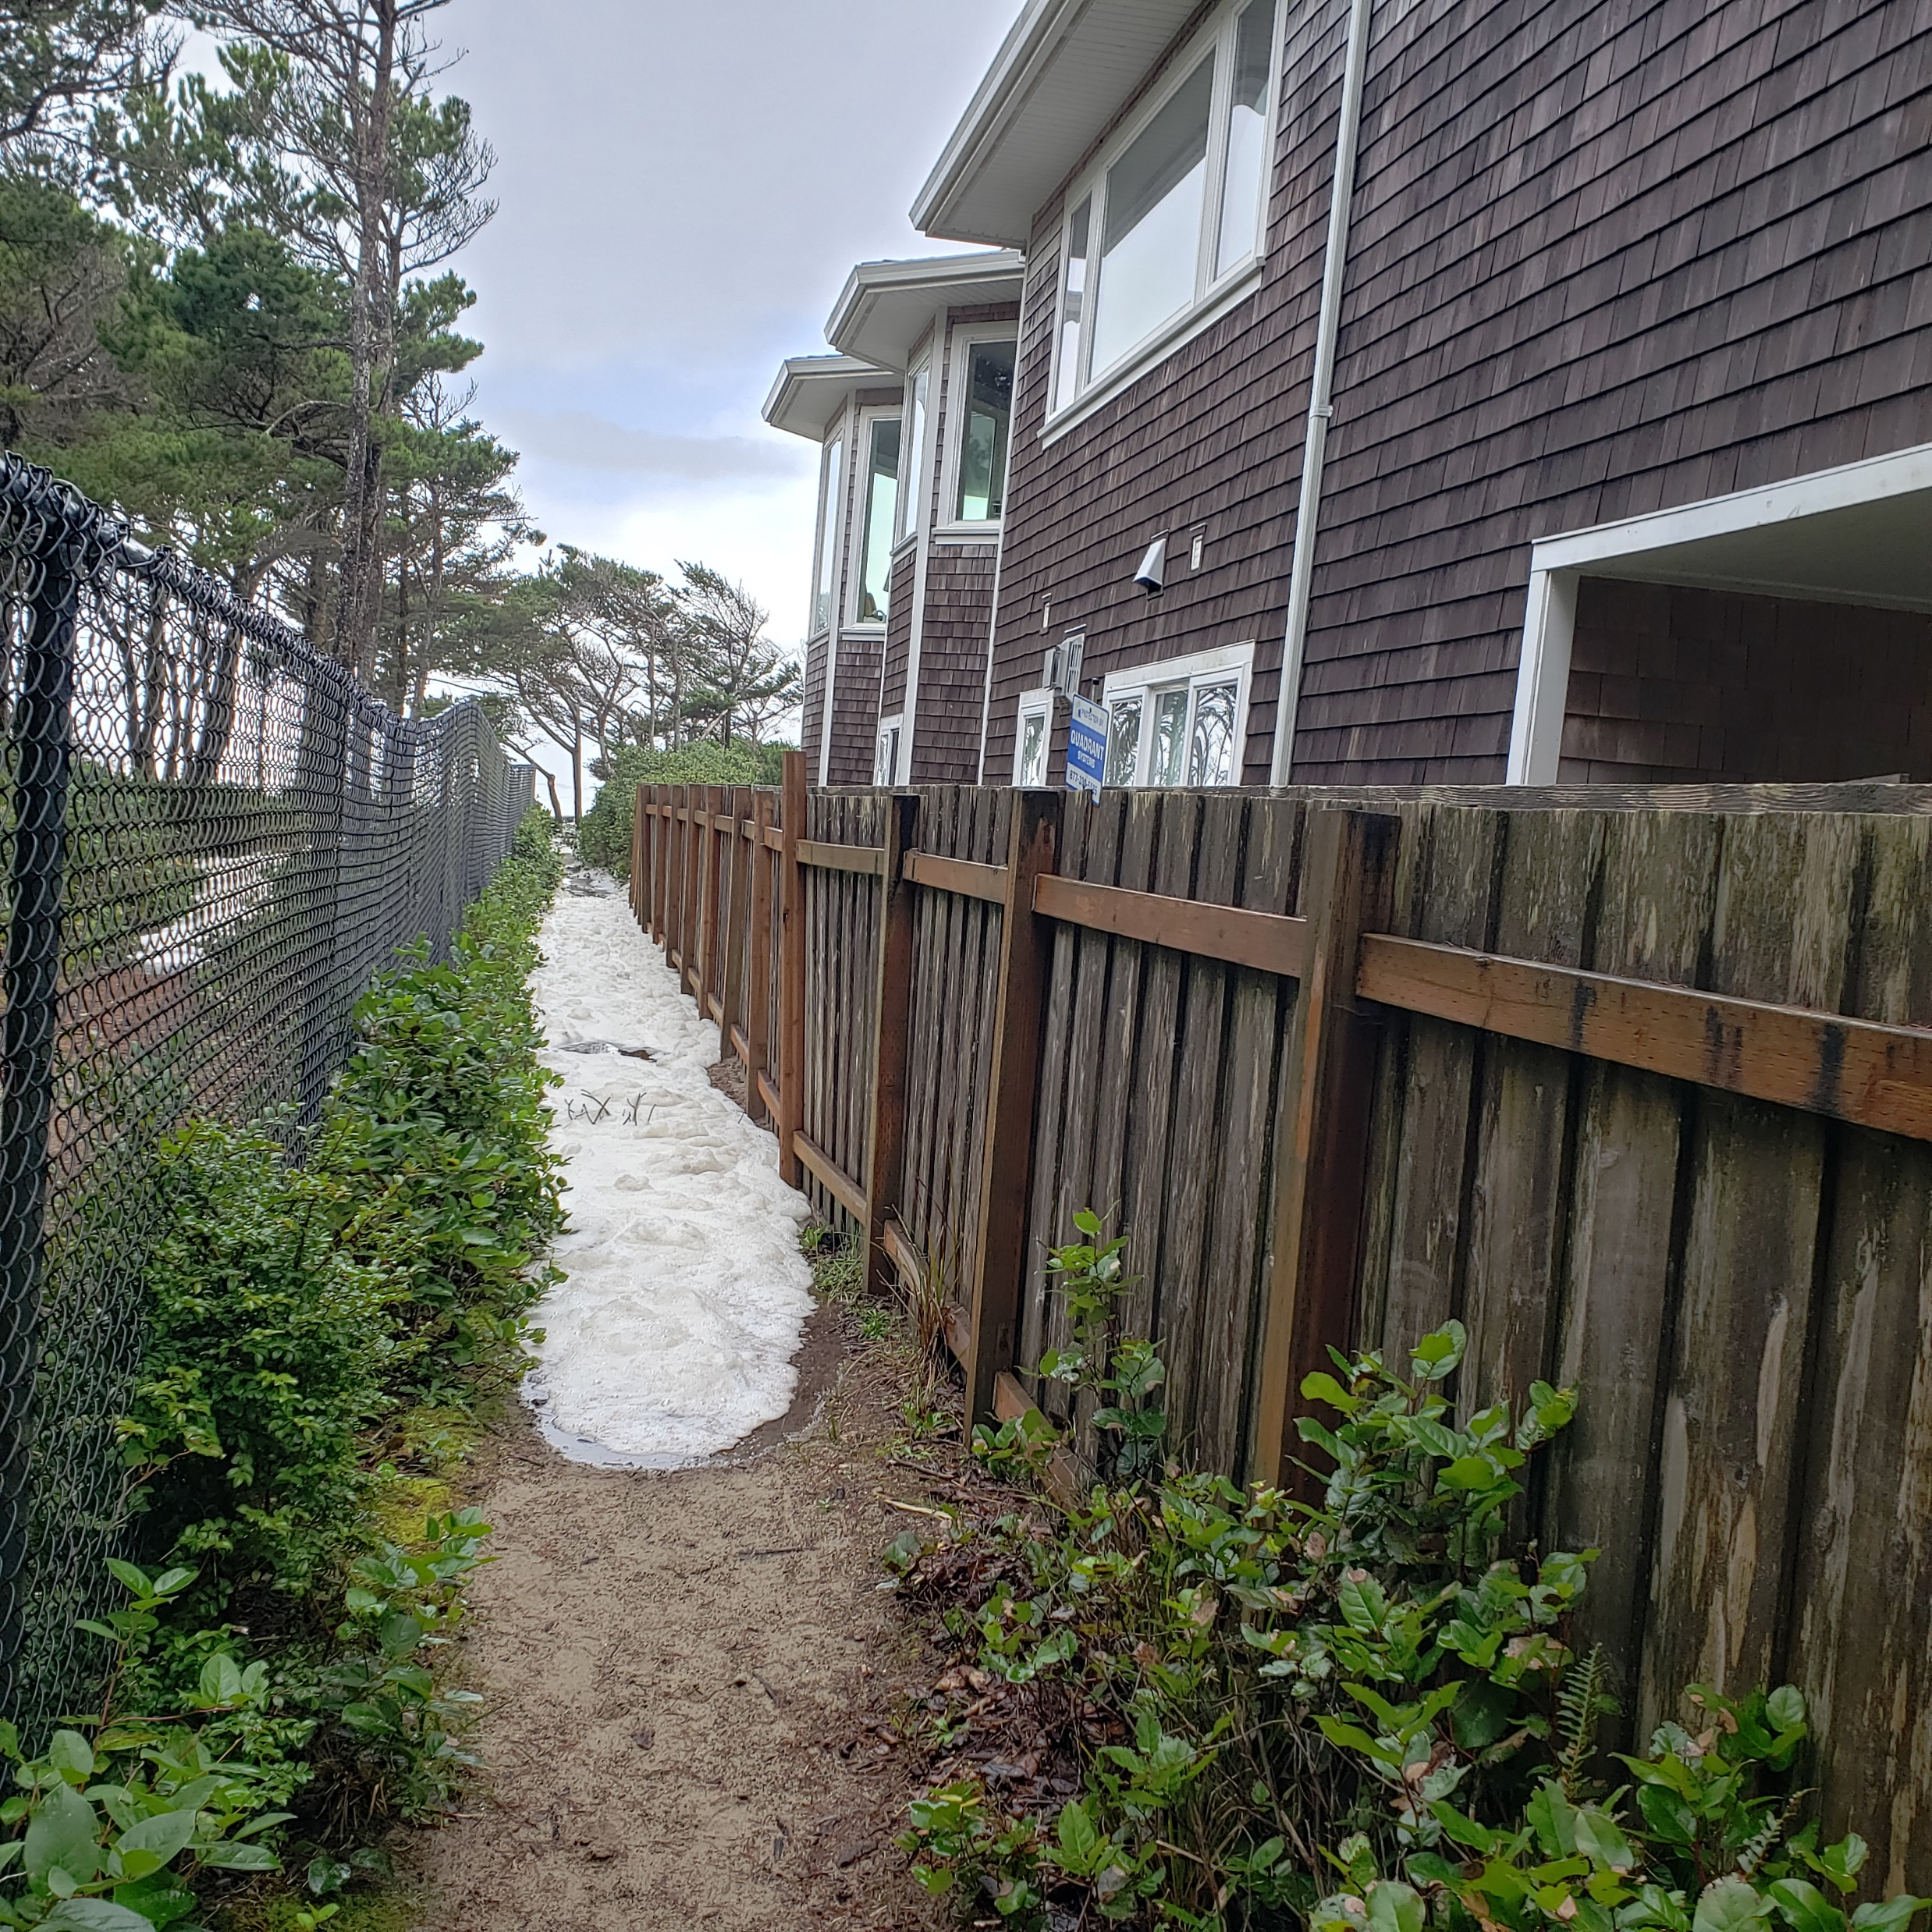

Slide 48
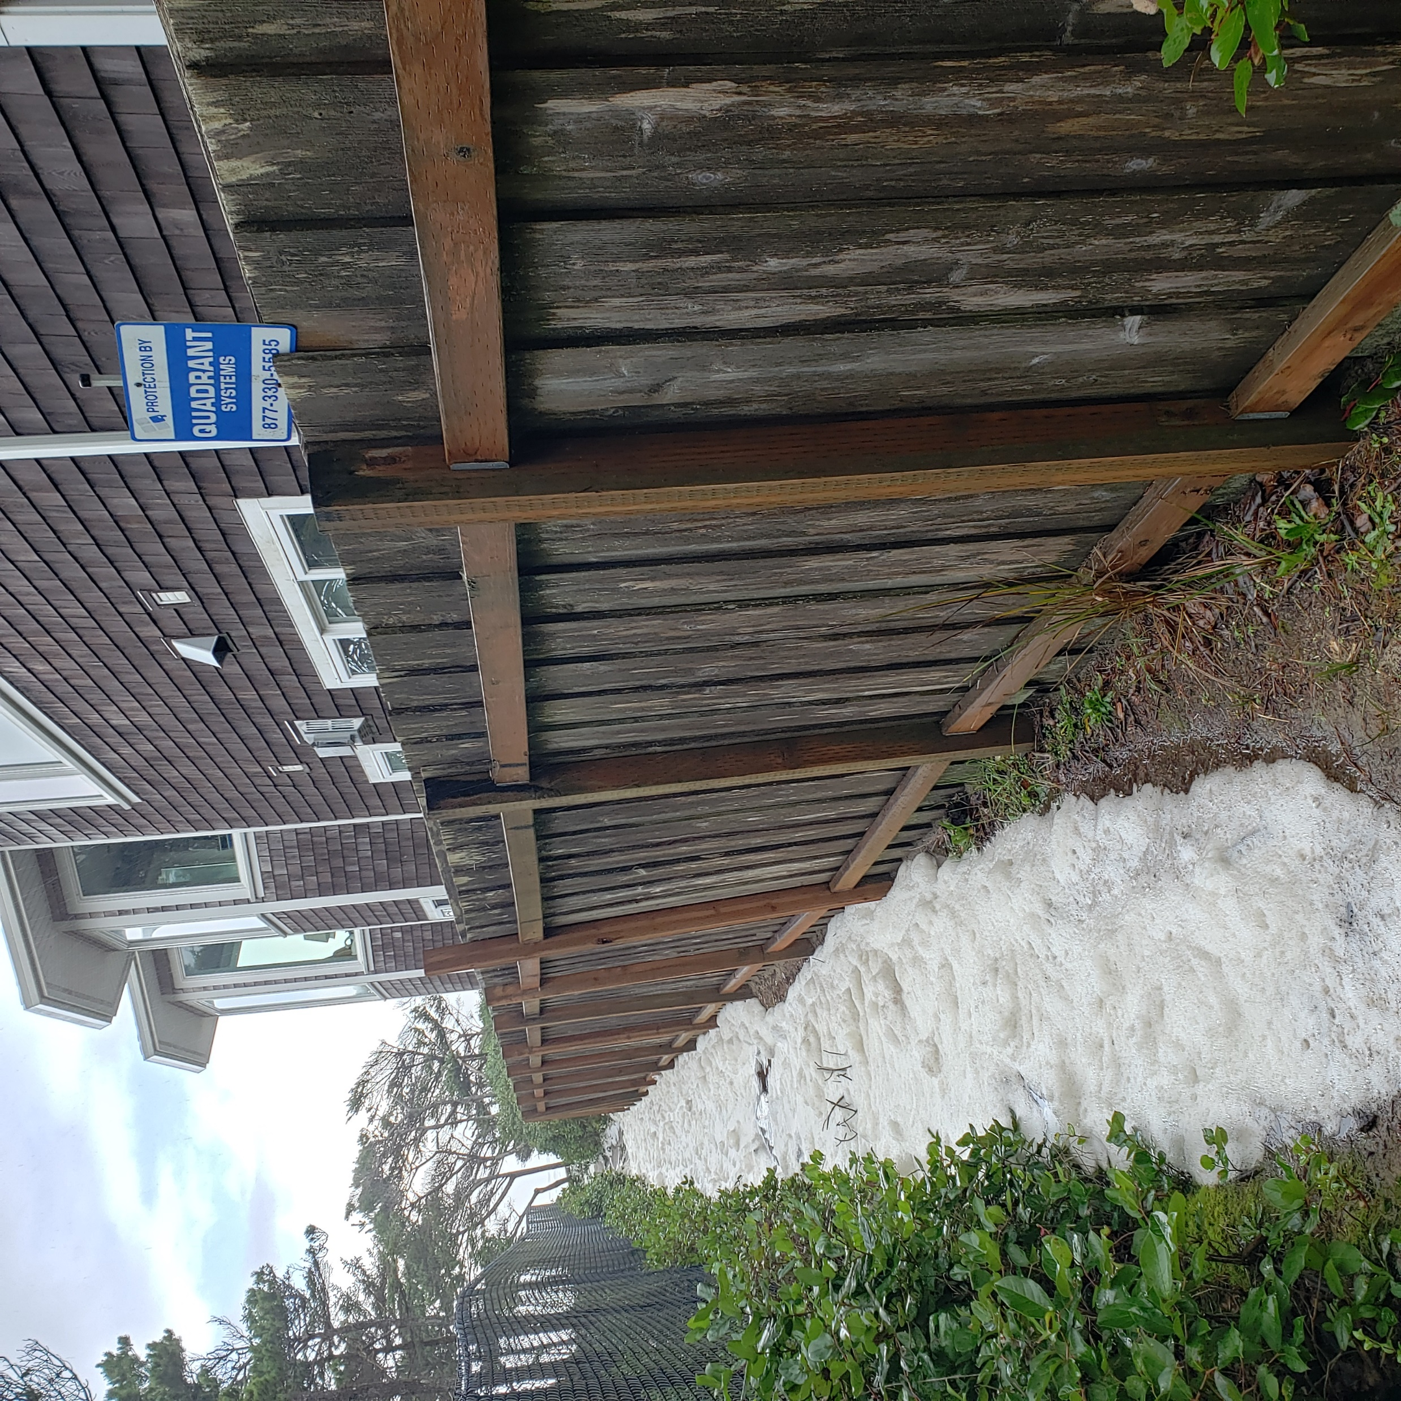

Slide 49
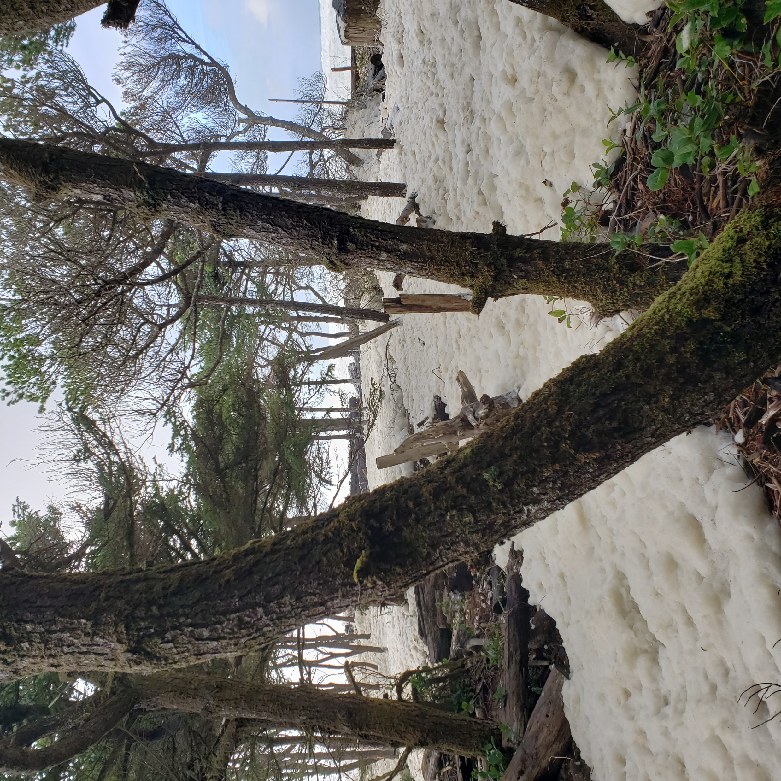

Slide 50
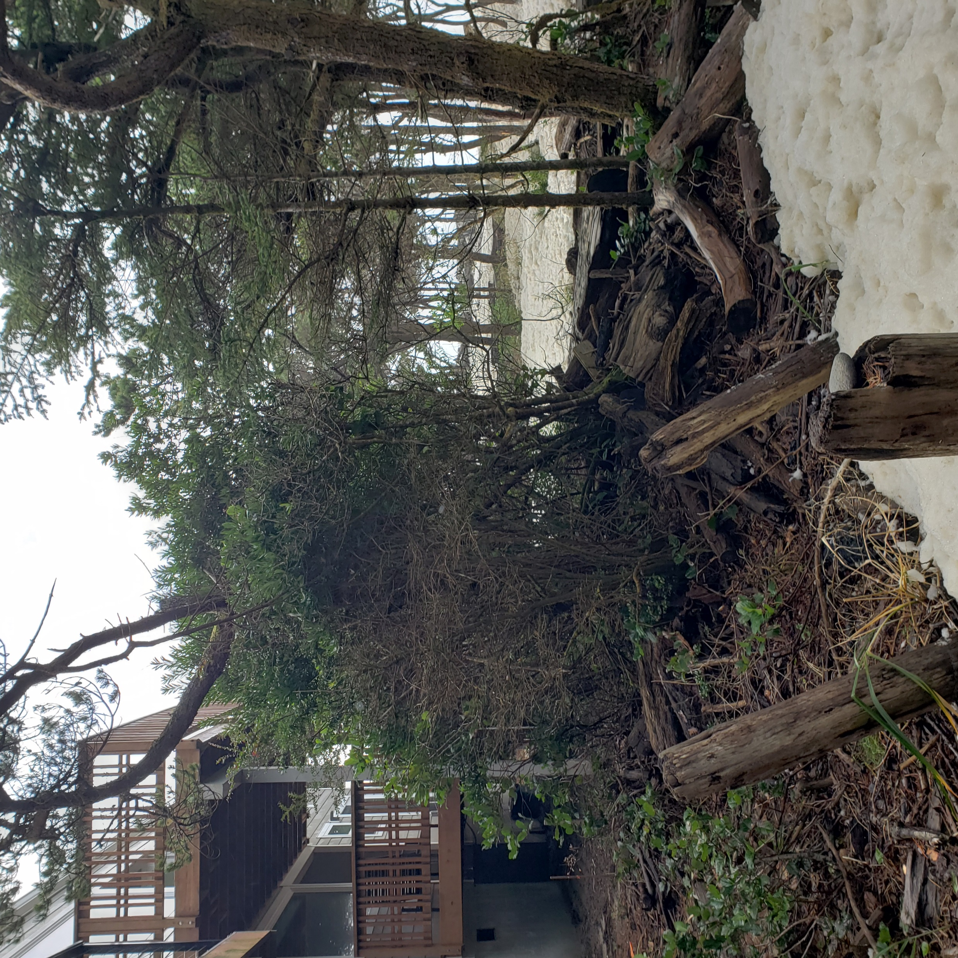

Slide 51
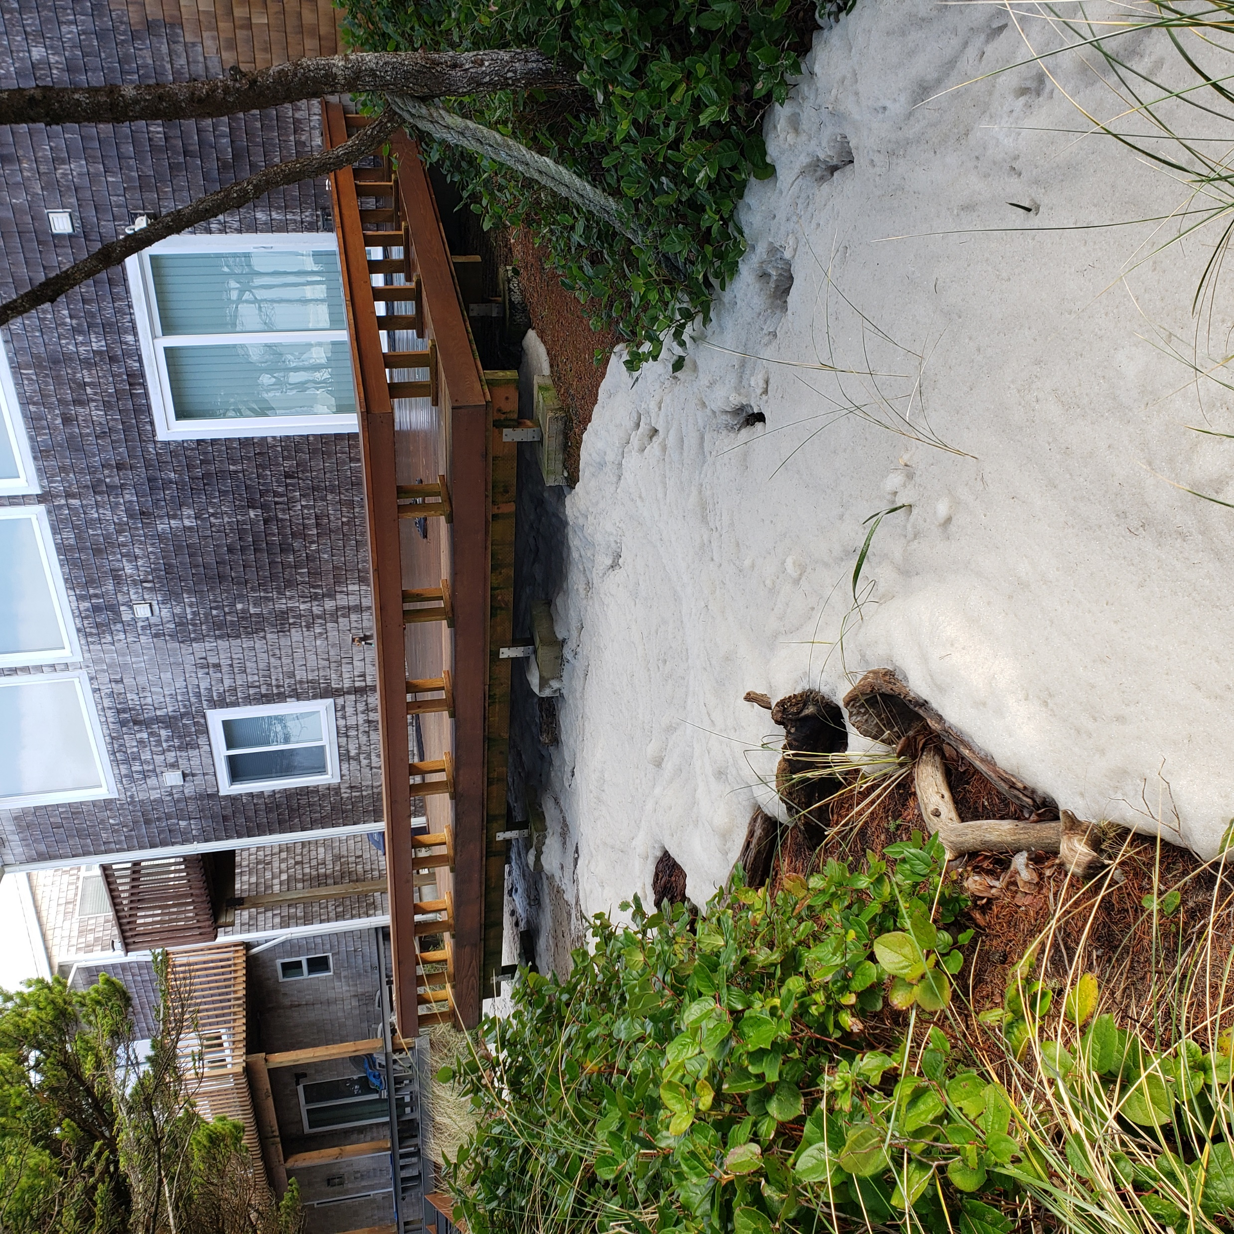

Slide 52
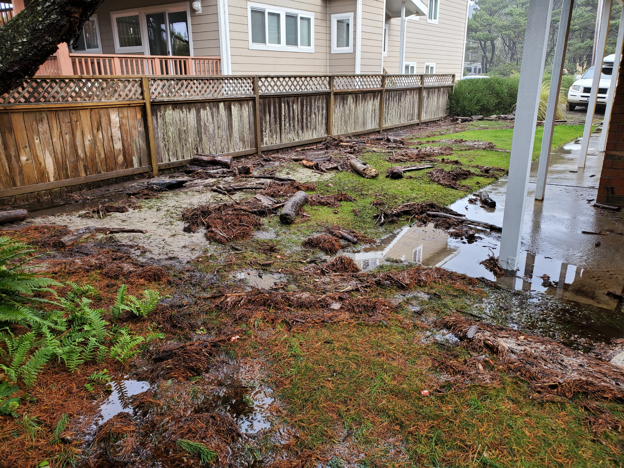

Slide 53
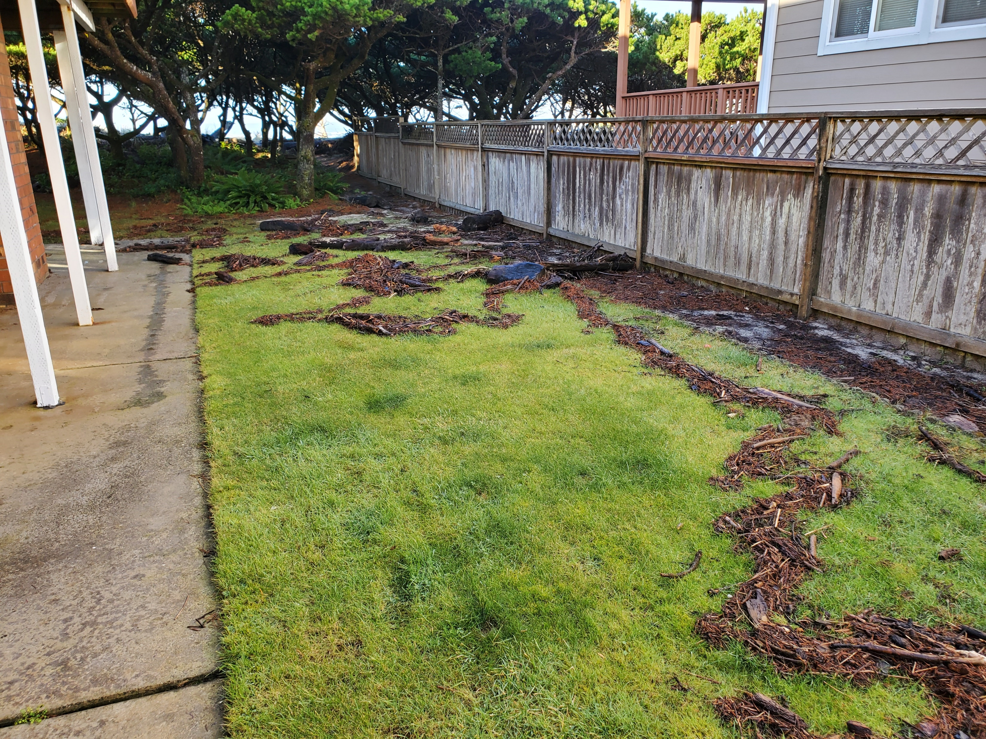

Slide 54
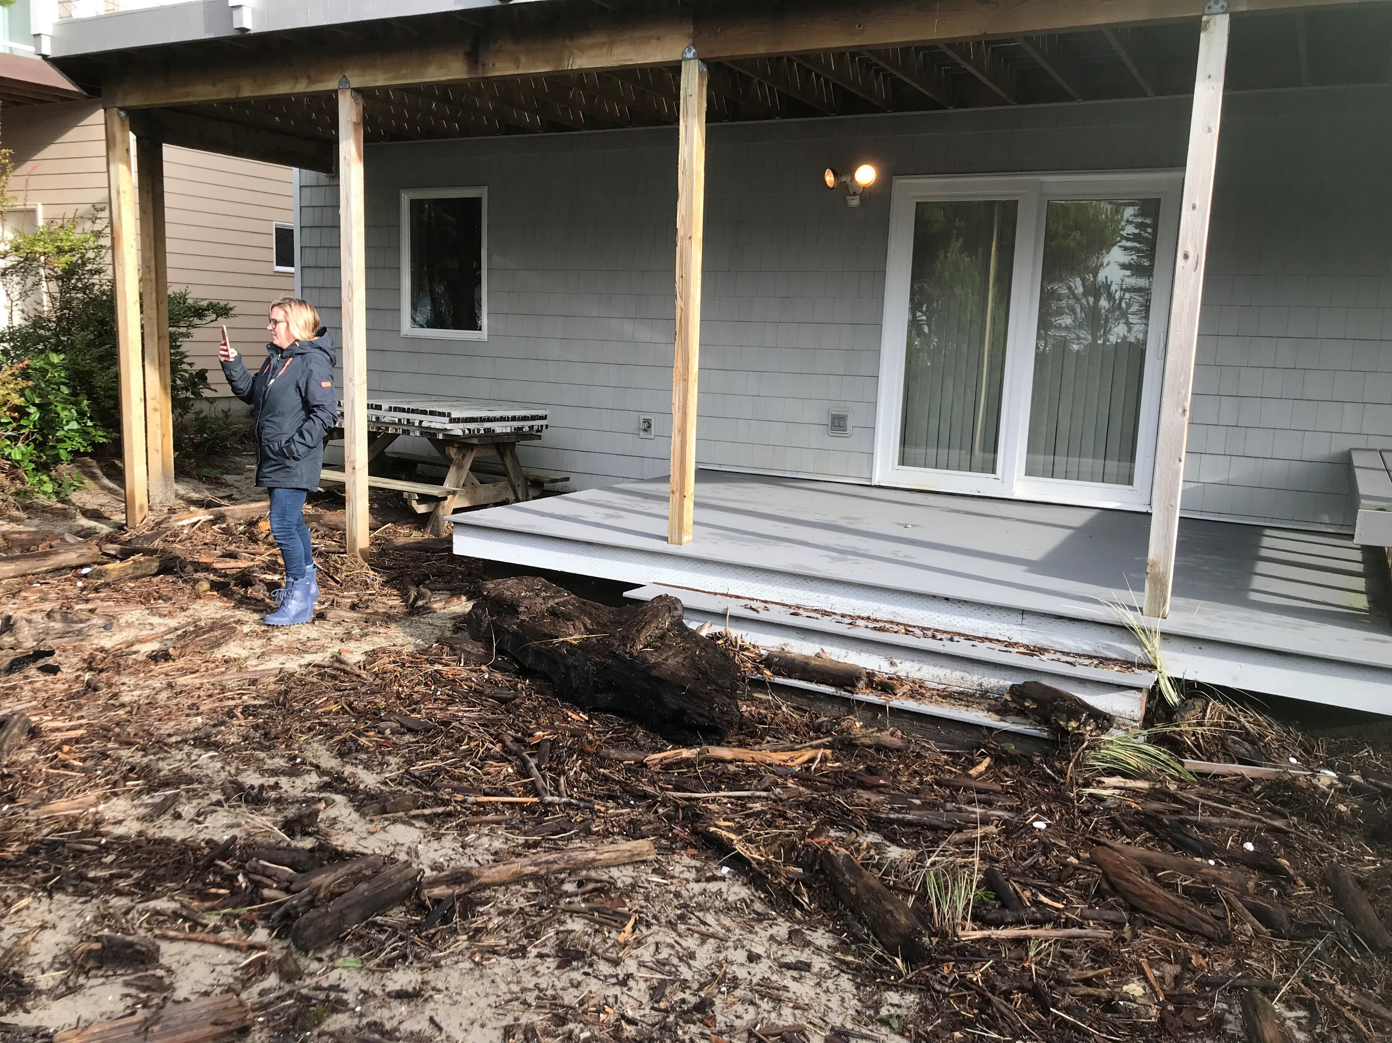

Slide 55
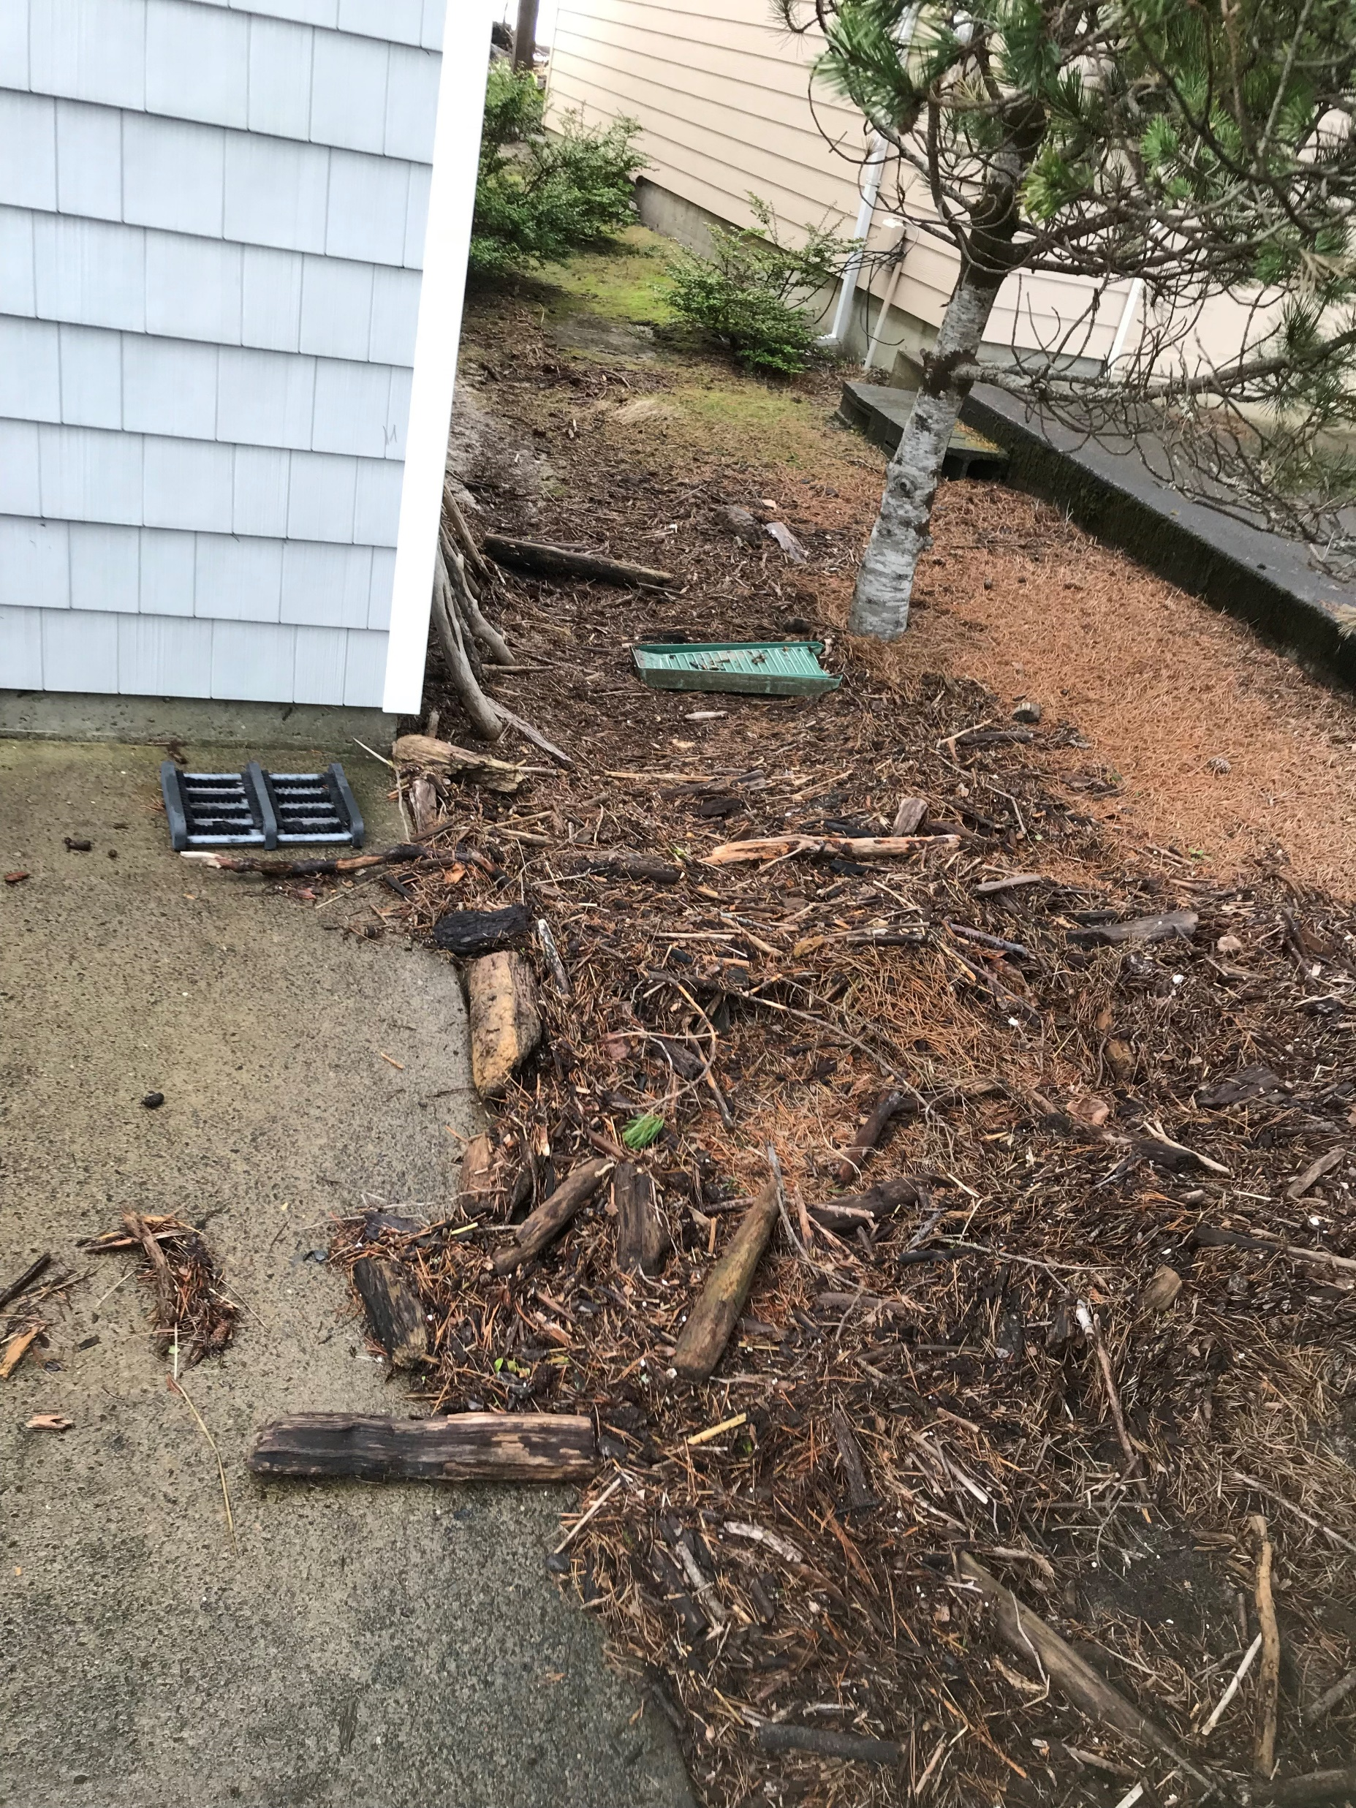

Slide 56
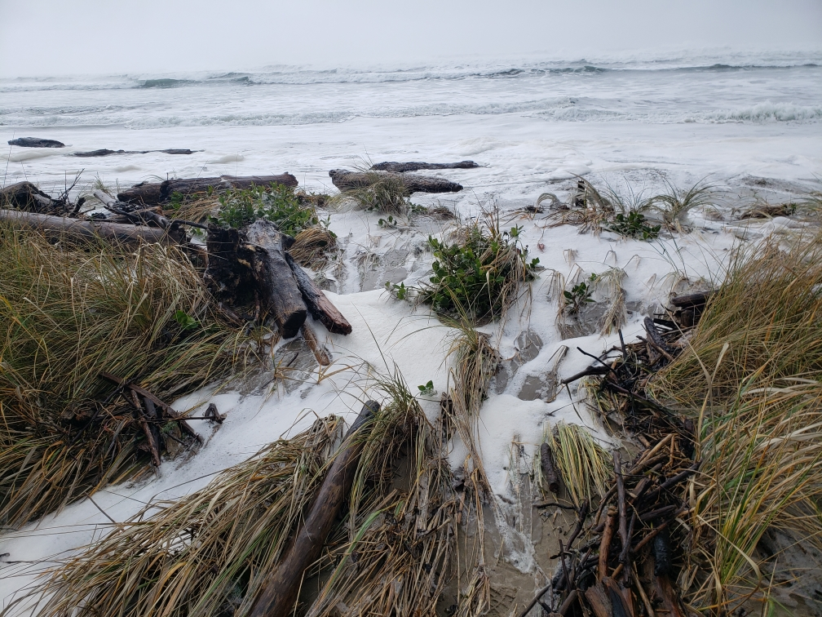

Slide 57
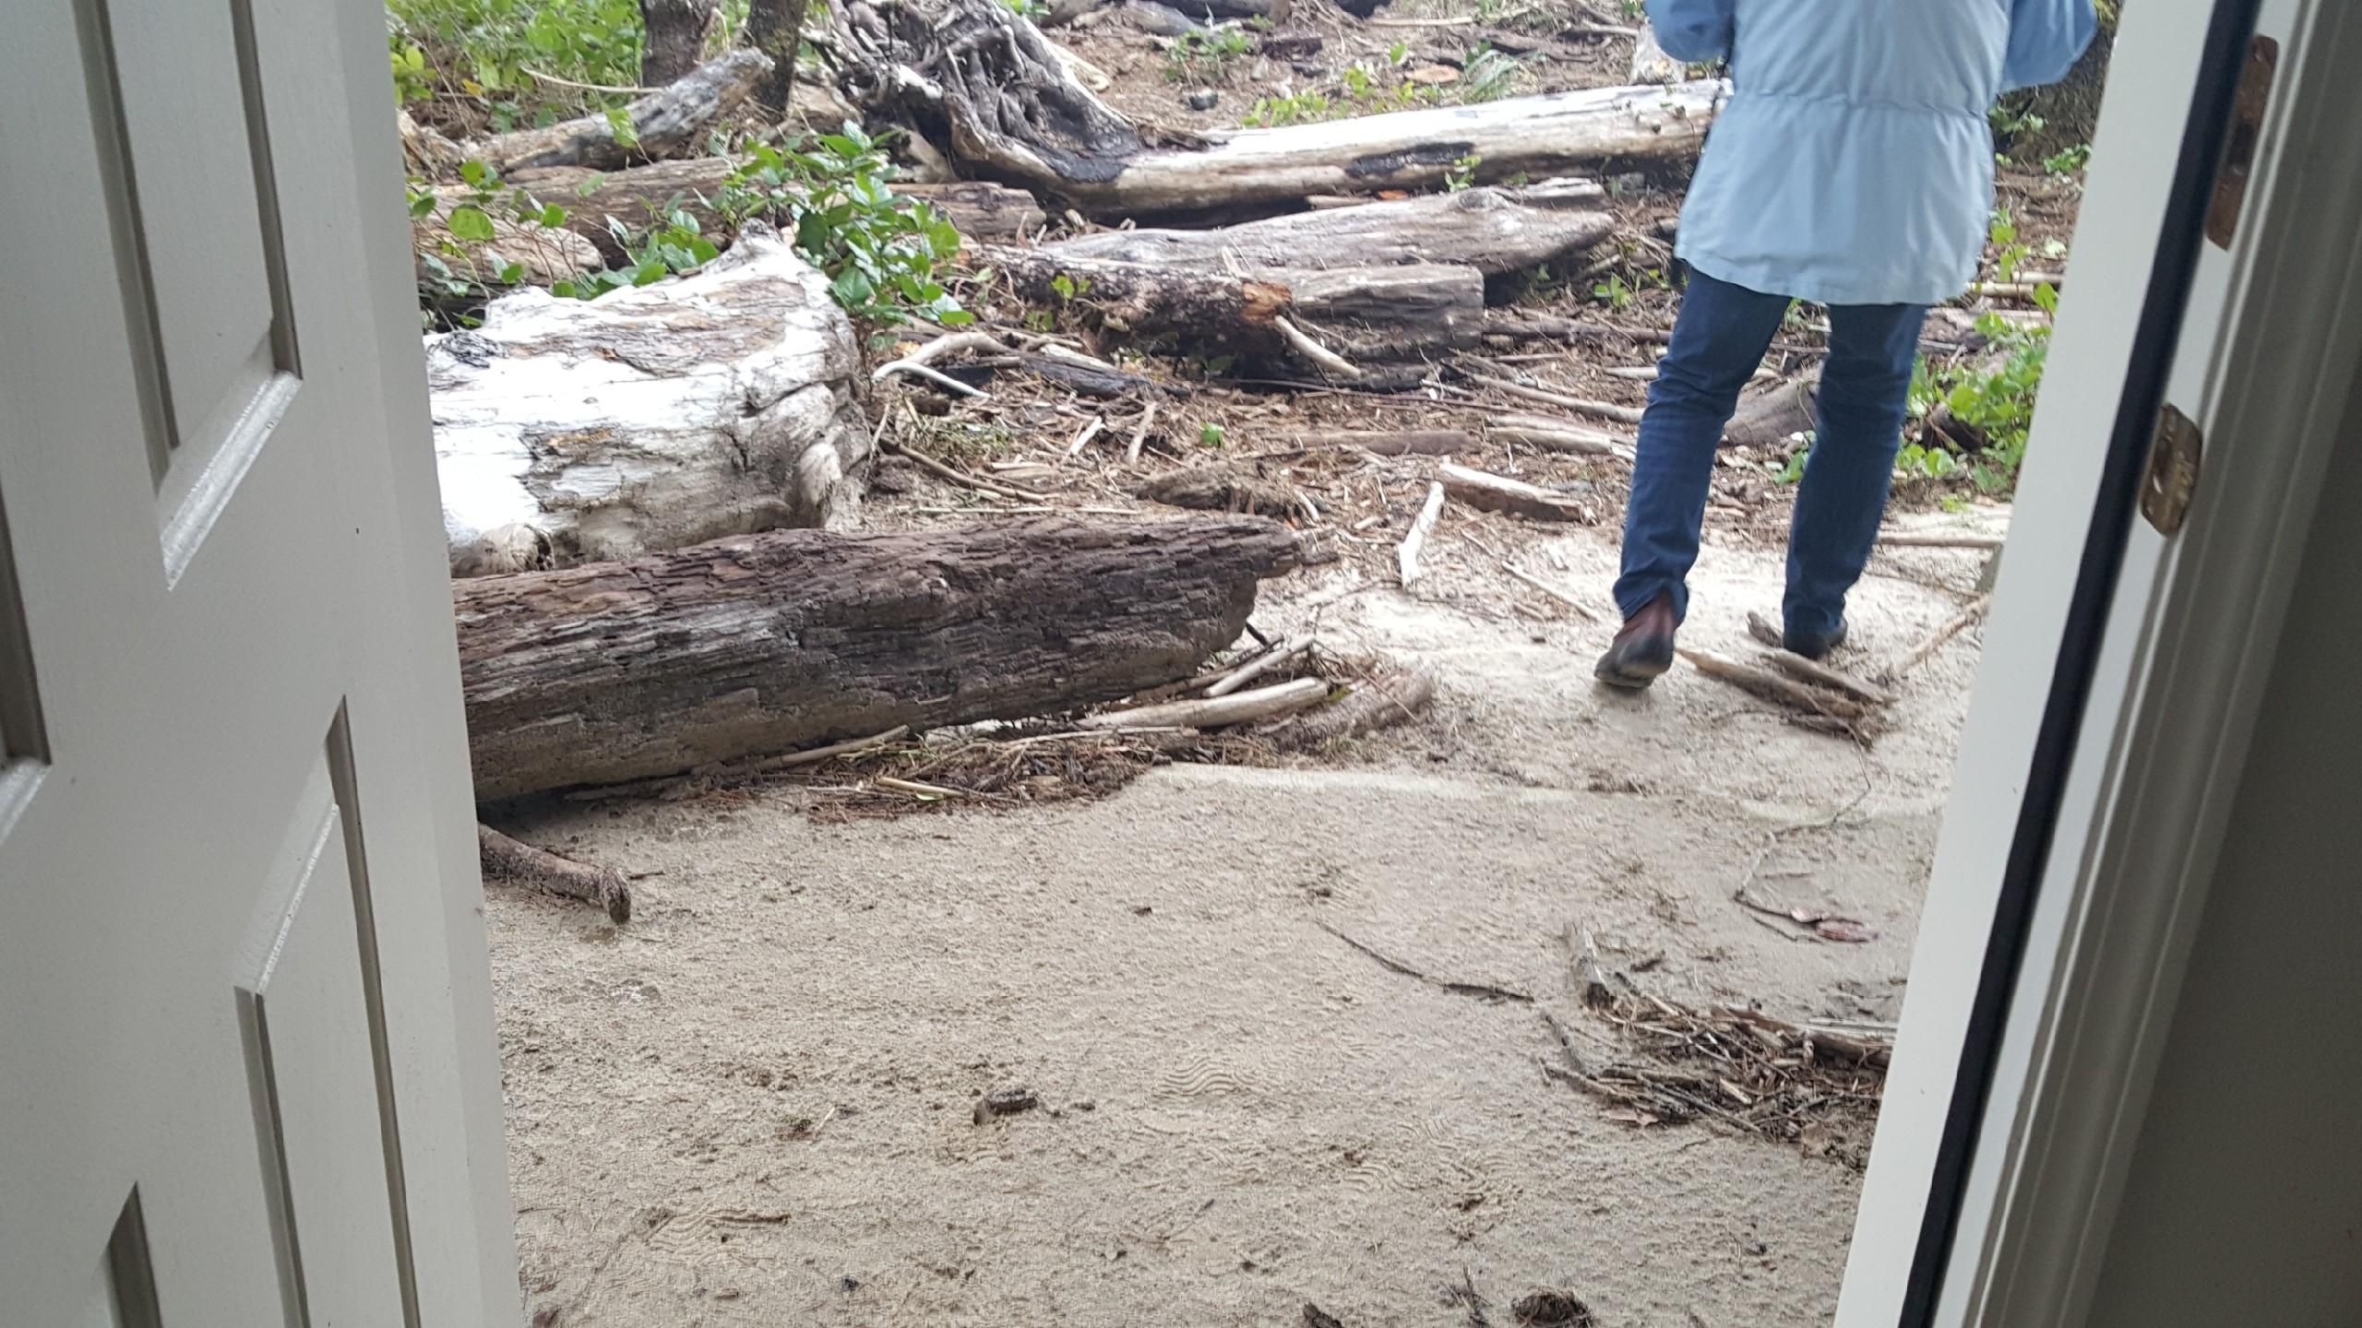

Slide 58
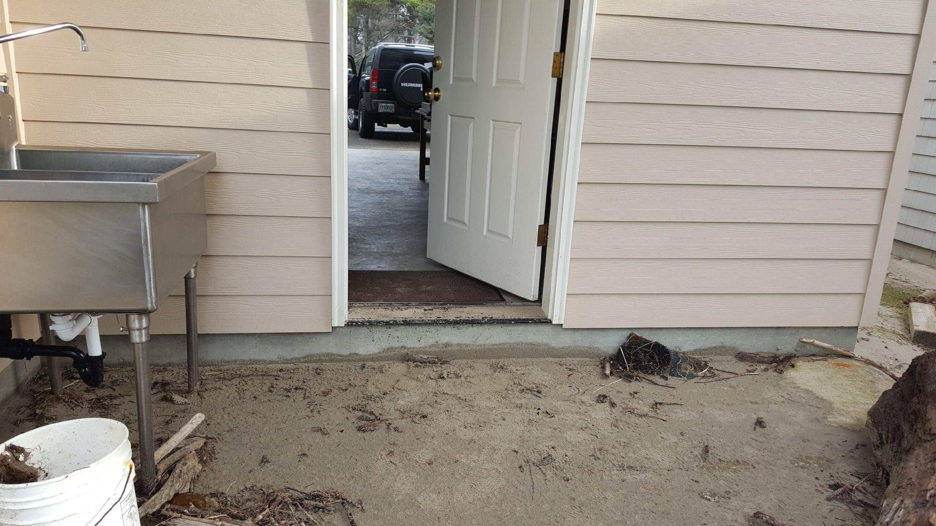

Slide 59
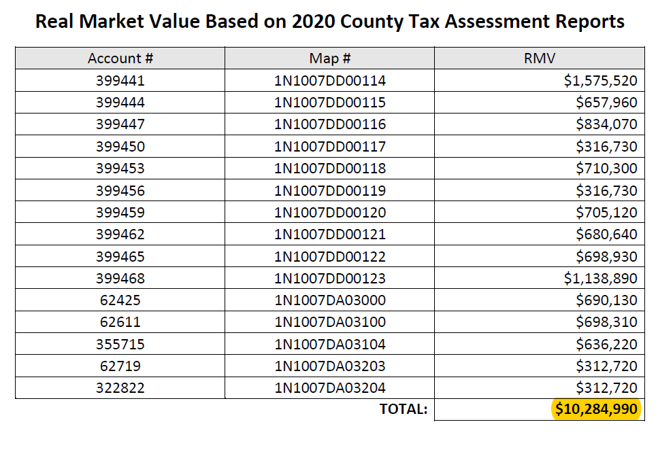
Properties and infrastructure are now in imminent peril
More than $10 million in property value at risk of being lost.
In addition to
infrastructure
(public water and sewer,
roads, utilities)

Slide 60
The Goal 18 Exception Request
Applicants seek a “Committed” Exception (ORS 197.732(2)(b); OAR 660-004-0028)
The proposal meets all relevant state standards and criteria for a “committed” exception
and seeks a
A “Reasons” Exception (ORS 197.732(2)(c); OAR 660-004-0020–22)
The proposal meets all relevant state standards and criteria for a “committed” exception “reasons” exception.
NOTE: Not seeking a “catch all” reasons exception at issue in the two new Coos County LUBA cases.

Slide 61
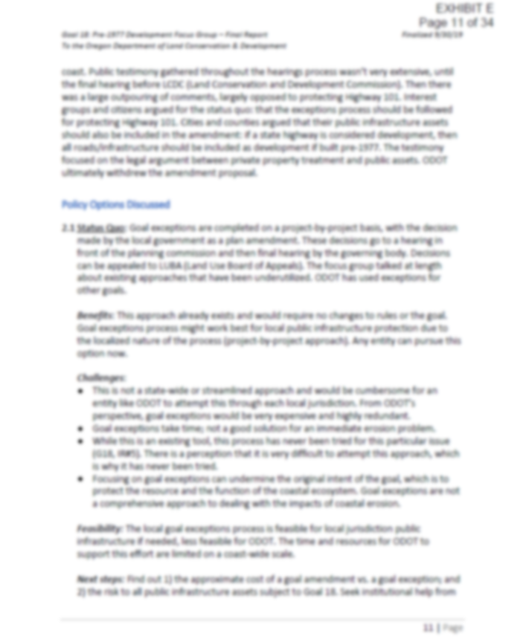
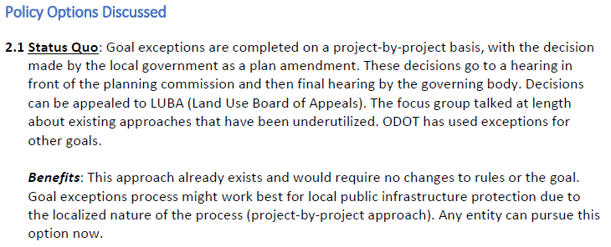
2019 DLCD Goal 18 Focus Group recognized that Goal 18 exception process exists and that anyone can pursue this option.

Slide 62
Committed Exception
“Committed” Exception (ORS 197.732(2)(b)):
“(2) A local government may adopt an exception to a goal if:
“(b) The land subject to the exception is irrevocably committed as described by Land Conservation and Development rule to uses not allowed by the applicable goal because existing adjacent uses and other relevant factors make uses allowed by the applicable goal impracticable[.]”

Slide 63
Committed Exception Standards
(OAR 660-004-0028):
“(2) Whether land is irrevocably committed depends on the relationship between the exception area and the lands adjacent to it. The findings for a committed exception therefore must address the following:
“(a) The characteristics of the exception area;
“(b) The characteristics of the adjacent lands;
“(c) The relationship between the exception area and the lands adjacent to it; and
“(d) The other relevant factors set forth in OAR 660-004-0028(6).”

Slide 64
Standards for Committed Exception
Standards for “Committed” Exception (OAR 660-004-0028):
“(3) Whether uses or activities allowed by an applicable goal are impracticable * * * shall be determined through consideration of factors set forth in this rule[.] * * * It is the purpose of this rule to permit irrevocably committed exceptions where justified so as to provide flexibility in the application of broad resource protection goals. It shall not be required that local governments demonstrate that every use allowed by the applicable goal is ‘impossible.’”

Slide 65
Standards for Committed Exception
Standards for “Committed” Exception (OAR 660-004-0028):
“(6) Findings of fact for a committed exception shall address the following factors:
“(a) Existing adjacent uses;
“(b) Existing public facilities and services (water and sewer lines, etc.);
“(c) Parcel size and ownership patterns of the exception area and adjacent lands:
“* * *
“(d) Neighborhood and regional characteristics;
“(e) Natural or man-made features or other impediments separating the exception area from adjacent resource land. * * *;
“(f) Physical development according to OAR 660-004-0025; and
“(g) Other relevant factors.

Slide 66
BPS meets Exception Standards
Subject properties are irrevocably committed to urban levels of residential use.
Area proposed for exception can be put to no other practical use than residential use and to protect the existing homes and infrastructure – to include public sewer and water facilities.
The properties and area are zoned for residential use, in unacknowledged unincorporated community. It is not “practical” to demand the area – homes and infrastructure - be wiped out by ocean action.

Slide 67
BPS Meets Committed Exception Standards
“(a) Existing adjacent uses; – residential – in peril without exception
“(b) Existing public facilities and services (water and sewer lines, etc.) – existing public infrastructure investment in peril, without requested exception.
“(c) Parcel size and ownership patterns of the exception area and adjacent lands:
“* * * Lot size and ownership patterns are consistent with their existing built and committed exception zoning.
“(d) Neighborhood and regional characteristics; – the community is Barview/Watseco/Twin Rocks and its character is outlined in the county plan as a vibrant unincorporated community to be protected and preserved.
“(e) Natural or man-made features or other impediments separating the exception area from adjacent resource land. * * *; – existing goal exceptions already decided the land is not suitable for resource use.
“(f) Physical development according to OAR 660-004-0025; and – The properties are physically developed or are entitled to be physically developed at urban levels, under their existing zoning.
“(g) Other relevant factors. – The developer did everything right – at the time of development, the land was prograding for 70+ years.

Slide 68
Reasons Exception Standards
“Reasons” Exception (ORS 197.732(2)(c)):
“(2) A local government may adopt an exception to a goal if:
“(c) The following standards are met:
“(A) Reasons justify why the state policy embodied in the applicable goals should not apply;
“(B) Areas that no not require a new exception cannot reasonably accommodate the use;
“(C) The long term environmental, economic, social and energy consequences resulting from the use of the proposed site with measures designed to reduce adverse impacts are not significantly more adverse than would typically result from the same proposal being located in areas requiring a goal exception other than the proposed site; and
“(D) The proposed uses are compatible with other adjacent uses or will be so rendered through measures designed to reduce adverse impacts.”

Slide 69
Reasons Exception Standards – Specific to Goal 18
Goal 18-Specific Standards for “Reasons” Exception (OAR 660-004-0022):
“(11) Goal 18 — Foredune Development: An exception may be taken to the foredune use prohibition in Goal 18 ‘Beaches and Dunes’, Implementation Requirement. Reasons that justify why this state policy embodied in Goal 18 should not apply shall demonstrate that:
“(a) The use will be adequately protected from any geologic hazards, wind erosion, undercutting ocean flooding and storm waves, or the use is of minimal value;
“(b) The use is designed to minimize adverse environmental effects; and
“(c) The exceptions requirements of OAR 660-004-0020 are met.”

Slide 70
BPS Meets Reasons Exception Standards
“(A) Reasons justify why the state policy embodied in the applicable goals should not apply; – property is subject to existing exception that already allows the homes; property owners did not roll the dice. Significant public and private investment at stake. No harm to public interest, BPS not on the beach. Goal 18 purposes met. Goal 18 would only prohibit the BPS in the first place without an exception if the property were not already developed. Property developed in an acknowledged unincorporated community. Small Goal 18 variation if at all.
“(B) Areas that no not require a new exception cannot reasonably accommodate the use; – BPS must be located where it is proposed in order to protect the threatened homes and infrastructure it’s designed to protect; no other location can serve this site-specific purpose.
“(C) The long term environmental, economic, social and energy consequences resulting from the use of the proposed site with measures designed to reduce adverse impacts are not significantly more adverse than would typically result from the same proposal being located in areas requiring a goal exception other than the proposed site; and – EESE impacts will not be more adverse than if locating BPS elsewhere; BPS will reduce adverse environmental impact of coastal erosion/destruction of native vegetation; will provide economic benefit – protecting investment in properties/homes/infrastructure; will provide social benefit – protect human life and property from natural hazards; will maintain/improve beach accesses and enjoyment of beach. Avoids environmental devastation of broken sewer and water infrastructure if not protected.
“(D) The proposed uses are compatible with other adjacent uses or will be so rendered through measures designed to reduce adverse impacts.” – uses of property will remain residential, consistent with adjacent
uses and residential zoning; will blend into shoreline; will not deflect wave energy
onto or cause flooding on adjacent properties.

Slide 71
BPS Meets Reasons Exception Standards
“(a) The use will be adequately protected from any geologic hazards, wind erosion, undercutting ocean flooding and storm waves, or the use is of minimal value; - BPS designed to protect it from geologic hazards, wind erosion, undercutting ocean flooding and storm waves; launchable toe to prevent undermining by ocean scour; ecology blocks ensure that wave runup does not flow around structure and flood homes; replating with native vegetation will minimize erosion and increase stability.
“(b) The use is designed to minimize adverse environmental effects; and – BPS will have no impact on adjacent shorelines; covered in sand and replanted with native vegetation for natural appearance; will be monitored and periodically resanded/replanted; will have environmental benefit – prevent coastal erosion and protect native coastal vegetation/habitat.
“(c) The exceptions requirements of OAR 660-004-0020 are met.” – meets requirements of OAR 660-004-0020 (previous slide).

Slide 72
Goal 18 Standards for BPS
(a) visual impacts are minimized; BPS to be covered in sand and replanted and maintained.
(b) necessary access to the beach is maintained; Existing beach access is maintained and improved
(c) negative impacts on adjacent property are minimized; Engineering report establishes that the BPS will not cause negative impacts on adjacent property; BPS avoids harm to adjacent property if their needed infrastructure destroyed by wave action attacking beachfront.
(d) long-term or recurring costs to the public are avoided. BPS avoids long term or recurring costs to the public associated with FEMA losses; public infrastructure losses; losses of needed access to highway.

Slide 73
Comprehensive Plan Amendment
Proposal is consistent with Statewide Planning Goals.
Key Goals:
Goal 7 (Hazards): “To protect people and property from natural hazards. - BPS will protect existing development and persons from natural hazards that did not exist and were not anticipated at time of development which had seen trend of 70+ years of beach progration.
Goal 17 (Coastal Shorelands): “To conserve, protect, where appropriate, develop and where appropriate restore the resources and benefits of all coastal shorelands, recognizing their value for protection and maintenance of water quality, fish and wildlife habitat, water dependent uses, economic resources and recreation and aesthetics. * * * and To reduce the hazard to human life and property, and the adverse effects upon water quality and fish and wildlife habitat, resulting from the use and enjoyment of Oregon’s coastal shorelands.” - Pine Beach and surrounding area has an approved exception to Goal 17. Regardless, the proposal complies w/Goal 17. Goal 17, (5) says that where shown to be necessary, structural solutions to erosion and flooding problems shall be designed to minimize adverse impacts on water currents, erosion and accretion patterns. Proposed BPS is a necessary structural solution to erosion and flooding that is designed to minimize adverse impacts (if any) to water currents, erosion and accretion patterns and will have no significant adverse impact on surrounding properties.

Slide 74
Consistent with Statewide Planning Goals Continued
Goal 11 Public Facilities and Services: “To plan and develop a timely, orderly and efficient arrangement of public facilities and services to serve as a framework for urban and rural development.” BPS protects existing framework of public facilities in Barview/Watseco/Twin Rocks unincorporated community
Goal 18: “To conserve, protect, where appropriate develop, and where appropriate restore the resources and benefits of coastal beach and dune areas; and
“To reduce the hazard to human life and property from natural or man-induced actions associated with these areas.” Proposal protects approved development including public infrastructure, on coastal dune area. It reduces hazards to human life and property.

Slide 75
Comprehensive Plan Policies
Proposal is consistent with Tillamook County Comprehensive Plan.
Key Points:
County Goal 7 (Hazards Element) – Policy 2.4(a) Erosion - Specifically allows riprap to stabilize shorelines as preventative or remedial action.
County Goal 18 (Beaches and Dunes Element) – Policy 2.4(a):
“All decisions on land use actions in beach and dune areas other than older stabilized dunes shall be based on the following specific findings unless they have been made in the comprehensive plan:
“(a) The type of use proposed and the adverse effects it might have on the site and adjacent areas; - BPS is use proposed and will not have adverse effects on site or adjacent areas.
“(b) The temporary and permanent stabilization programs and the planned maintenance of new and existing vegetation; - BPS is a permanent stabilization program; will be overlain with sand, replanted with native vegetation, will be regularly inspected and maintained by property owners and resanded/replanted when necessary.
“(c) Methods for protecting the surrounding area from any adverse effects of the development; and, - Proposed BPS is designed not to cause adverse effects to surrounding properties; launchable toe; natural appearance; will not cause increase in FEMA total water levels near the BPS.
“(d) Hazards to life, public and private property, and the natural environment which may be caused by the proposed use.” – Purpose of BPS is to protect life, public and private property and the natural environment from continued coastal erosion hazard.

Slide 76
Comprehensive Plan
County Goal 18, Policy 2.4(b): “Development in beach and dune areas shall comply with the requirements of the Flood Hazard Overlay zone.” – BPS complies with requirements of FH zone.
County Goal 18, Policy 2.4(c): “Grading and vegetation removal shall be the minimum necessary to accommodate the development proposed. Removal should not occur more than 30 days prior to the start of construction. Open sand areas shall be temporarily stabilized during construction and all new and pre-existing open sand areas shall be permanently stabilized with appropriate vegetation.” – Grading and vegetation removal will be conducted in accordance with engineer’s technical memo; sand will be retained during construction and overlain atop the BPS; BPS will be immediately revegetated and monitored.
County Goal 18, Section 4.2 recognizes: “In cases of severe erosion, it may be necessary to use some means of structural shoreline stabilization such as a revement or seawall. These structures, when properly designed, can withstand the force of ocean waves and protect the shoreline behind them. * * * Revetments, especially riprap revetments, have the least potential for visual disruption because they may be covered by summer sand build-up.” – Proposed BPS is rip rap, which will be covered in sand and replanted with native vegetation – least potential for visual disruption.

Slide 77
Comprehensive Plan Barview/Watseco/Twin Rocks Community Plan
Goal 1 - Barview/Watseco/Twin Rocks will be an attractive, safe and clean small town. The proposed BPS is designed to address a significant safety threat for this community.
Goal 2: Barview/Watseco/Twin Rocks will have safe drinking water and sanitation. The proposed BPS is designed to protect the drinking water and sanitation infrastructure from destruction due to waive action.
Buildable Lands Inventory “the Buildable Lands Inventory determined that 798 potential residential lots could be developed in Barview/Watseco/Twin Rocks.” The proposed BPS helps to ensure that the area is able to deliver the anticipated safe residential uses as the community plan and BLI anticipate.
Community Plan zoning “SECTION 3.011: COMMUNITY SINGLE FAMILY RESIDENTIAL ZONE (CSFR)
(1) PURPOSE: The purpose of the CSFR zone is to provide for the creation and use of
small-acreage residential homesites. Land that is suitable for Community Single Family
Residential use is located within an unincorporated community boundary and is
physically capable of having homesites. The proposed BPS helps to ensure this policy is realized.

Slide 78
Tillamook County Land Use Ordinance
Community Medium Density Urban Residential Zone (CR-2) (TCLUO 3.014):
USES PERMITTED OUTRIGHT:
“(a) One or two-family dwelling.”
The proposal is accessory to permitted residential uses and essential for their survival.
No prohibitions on BPS in CR-2 zone.
See page 77 of applicants’ narrative.

Slide 79
Tillamook County Land Use Ordinance
Flood Hazard Overlay (FH) (TCLUO 3.510):
The proposal meets all development standards in FH zone.
See pages 78-87 of applicants’ narrative.

Slide 80
Tillamook County Land Use Ordinance
Beach and Dune Overlay (BD) (TCLUO 3.530):
The proposal meets all development standards in BD zone.
See pages 87-93 of applicants’ narrative.

Slide 81
Summary
Applicants respectfully request that you approve the proposed BPS under a Goal 18 exception;
and
Applicants respectfully request that you also approve the requested BPS in the alternative as allowed under Goal 18 without any need for a further goal exception.
Thank you and staff for your time and consideration.

