Slide 1
Conditional Use #851-23-000525-PLNG
May 9, 2024 Planning Commission Hearing

Slide 2
Applicant: Helen O’Connor
Proposal for a six (6) site recreational campground, for RV siting.
Approximately 11.27-acres Rural Residential (RR-2) zoned land
REQUEST

Slide 3
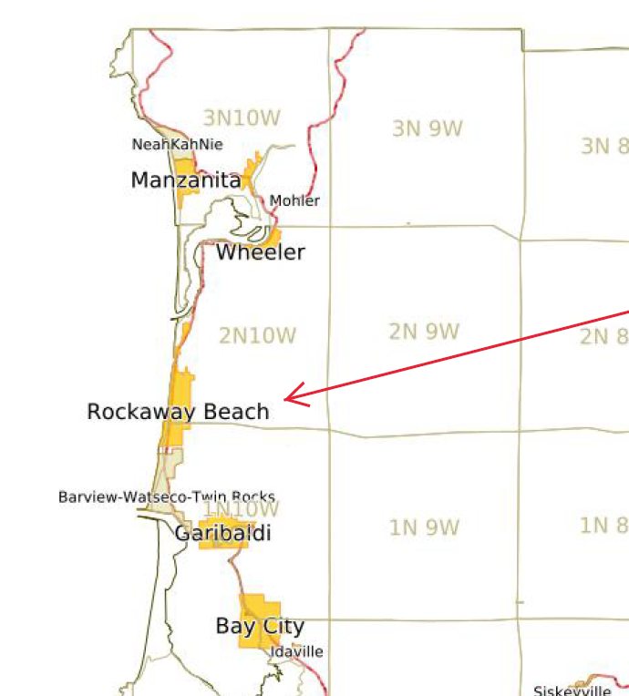
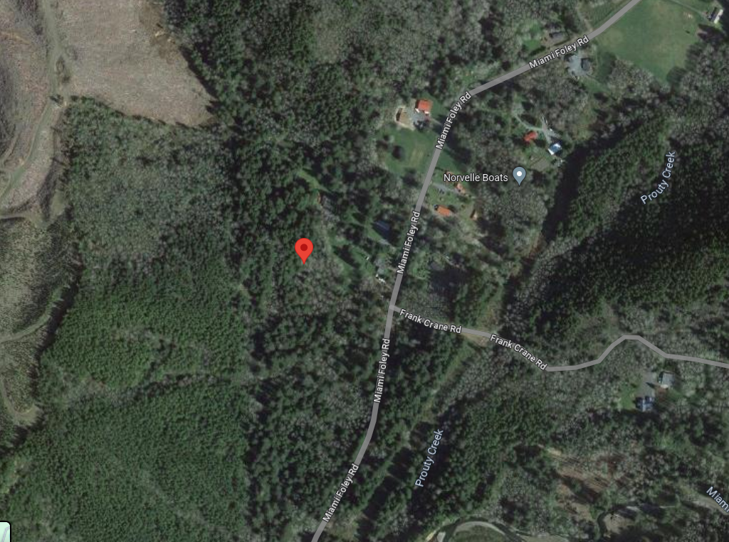
Vicinity Maps

Slide 4
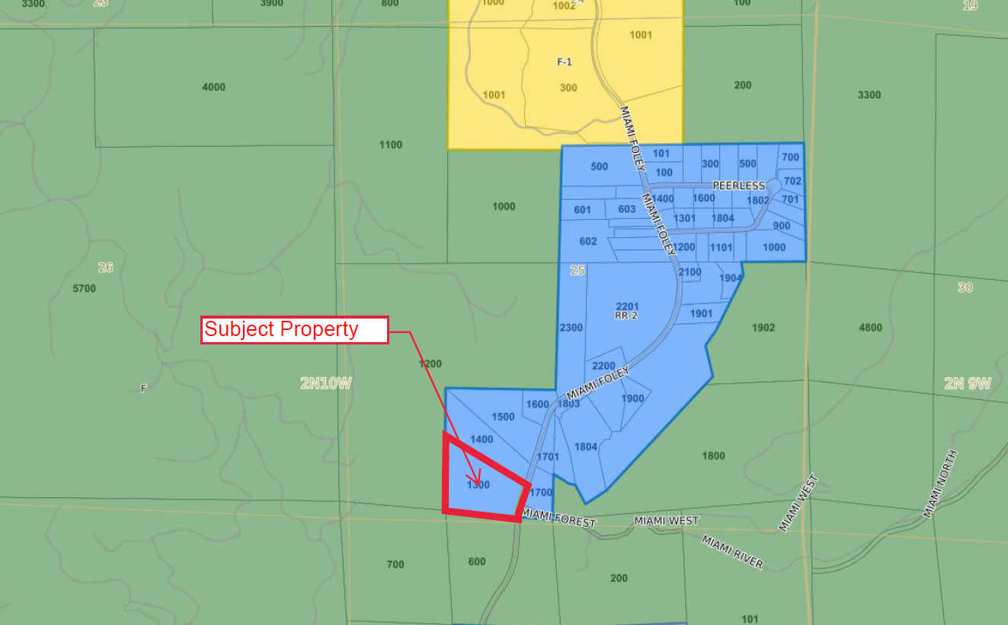
Zoning Map

Slide 5
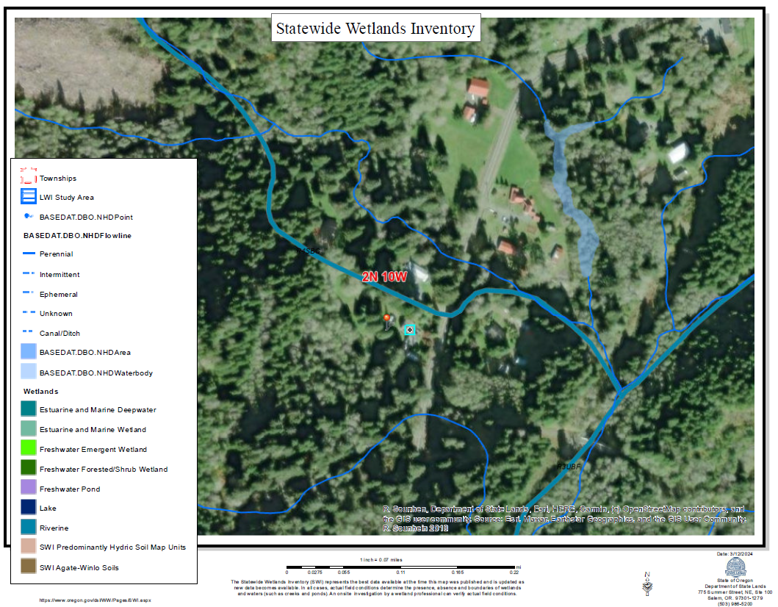
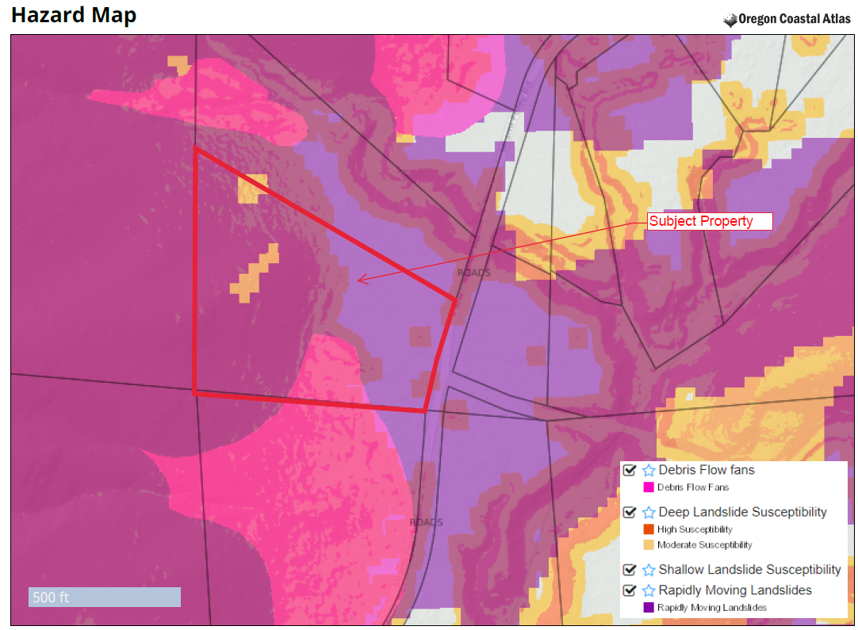
Property Maps

Slide 6
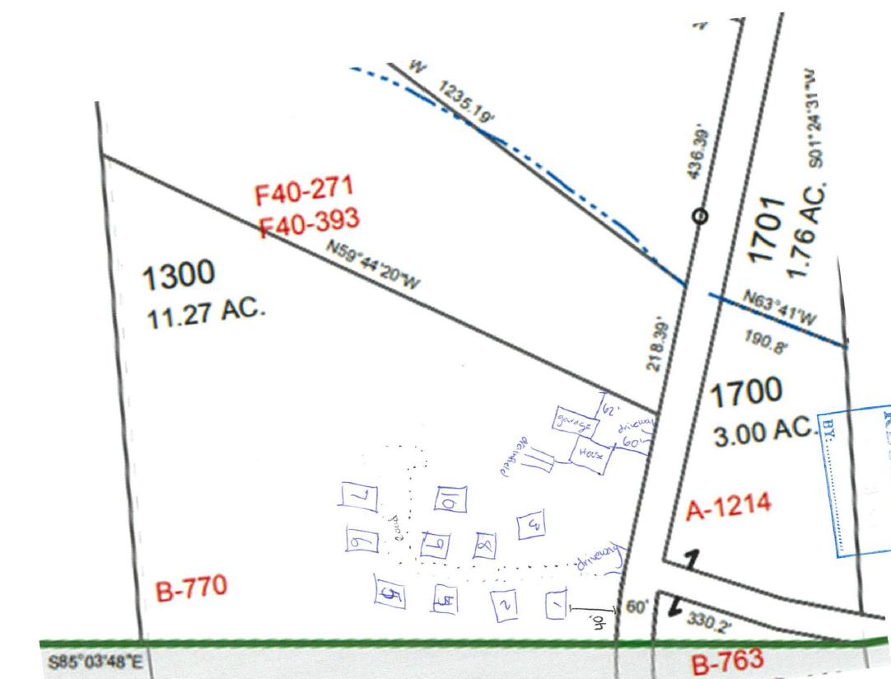
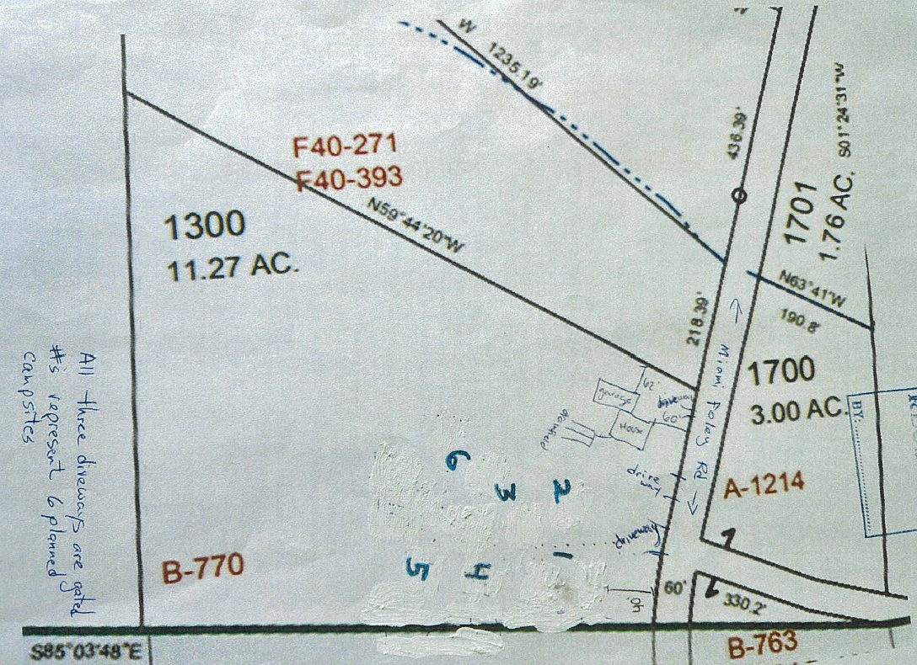
Site Plan provided by the Applicant
Original 10-site layout
Revised 6-site layout

Slide 7
Applicable Provisions
TCLUO Section 3.010: Rural Residential 2-Acre (RR-2)
TCLUO Section 5.030: Recreational Campgrounds Standards
TCLUO Section 3.555: Freshwater Wetlands Overlay
TCLUO Section 4.130: Development Requirements for Geologic Hazard Areas
TCLUO Section 4.140: Requirements for Protection of Water Quality and Streambank Stabilization
TCLUO Section 4.030: Off-street Parking and Off-Street Loading Requirements

Slide 8
Applicable Provisions
TCLUO Section 3.530: Recreational Campground Standards
Licensing requirements with Tillamook County Environmental Health & Building Codes Division

Slide 9
PRIMARY COMMENTS RECEIVED
Impacts to neighboring properties
Public Safety concerns
-Fire Suppression
Property Value Impacts

Slide 10
AGENCY RESPONSE
Tillamook County Environmental Health: Licensure requirements with their office.
Tillamook County Public Works: Road Approach permit requirements
Oregon Department of Fish and Wildlife: Maintain appropriate riparian setbacks.
Department of State Lands: No impacts to wetlands/riverine systems.
Garibaldi Fire District: Compliance with Oregon Fire Code.

Slide 11
Conditional Use Review Criteria
(1) The use is listed as a CONDITIONAL USE in the underlying zone, or in an applicable overlying zone.
(2) The use is consistent with the applicable goals and policies of the Comprehensive Plan.
(3) The parcel is suitable for the proposed use considering its size, shape, location, topography, existence of improvements and natural features.
(4) The proposed use will not alter the character of the surrounding area in a manner which substantially limits, impairs or prevents the use of surrounding properties for the permitted uses listed in the underlying zone.
(5) The proposed use will not have detrimental effect on existing solar energy systems, wind energy conversion systems or wind mills.
(6) The proposed use is timely, considering the adequacy of public facilities and services existing or planned for the area affected by the use

Slide 12
Recommended Conditions of Approval
1. The applicant/property owner shall obtain all required Federal, State, and Local permits and/or licenses and will comply with applicable rules and regulations.
2. The property owner shall obtain all necessary electrical, mechanical, and plumbing permits.
3. At the time of applying for Consolidated Zoning/Building Permit approval for the campground, Applicant/Property owner will be required to submit the following:
Approval for on-site sewage disposal permits from the Department of Community Development or Oregon Department of Environmental Quality, as necessary for onsite sanitation.
A letter from the Garibaldi Fire District confirming fire protection service to the proposed facilities.
A letter from the Tillamook County Public Works Department approving the road approach and internal roadway design.
4. If development is to be sited on slopes greater than 29%, a Geologic Hazard Report will be required as described in TCLUO 4.130. If such a report is required, a Geologic Hazard Report shall be submitted in conjunction with application for Consolidated Zoning/Building Permit approval for review and acceptance.
5. Applicant/Property Owner will maintain the minimum proposed vegetative buffers between the proposed area of development and the property boundaries. The site plan submitted for approval with application for Consolidated Zoning/Building permits will clearly show the vegetative buffers.
6. Development will comply with the requirements and standards of TCLUO 3.010 ‘Rural Residential 2-Acre (RR-2) Zone’ and 5.030 ‘Recreational Campground Standards’.

Slide 13
Recommended Conditions of Approval (CONT.)
7. Overnight temporary use of the campground by a camper or a camper’s vehicle shall not be for longer than six (6) months in any twelve (12) month period as required by TCLUO Section 5.030.
8. The applicant/property owner shall maintain an approved campground design from Tillamook County Environmental Health.
9. Development shall comply with riparian buffer and vegetation retention requirements of TCLUO Section 4.140: Requirements for Protection of Water Quality and Streambank Stabilization.
10. Signage shall comply with the requirements of TCLUO Section 4.020: Signs.
11. Development shall occur in the area as generally depicted on the submitted site plan and as described and shall not exceed 6 campsites and the supporting facilities, including the composting toilets.
12. Applicant/property owner shall submit a to-scale site plan indicating the proposed parking plan, subject to standards in TCLUO Section 4.030 ‘Off-Street Parking and Off-Street Loading Requirements’, including demonstration of a minimum one (1) parking space per guest accommodation.
13. The applicant/property owner shall obtain an approval for a Consolidated Zoning/Building permit for the construction of a roadside stand for produce grown on the premises.

