Slide 1
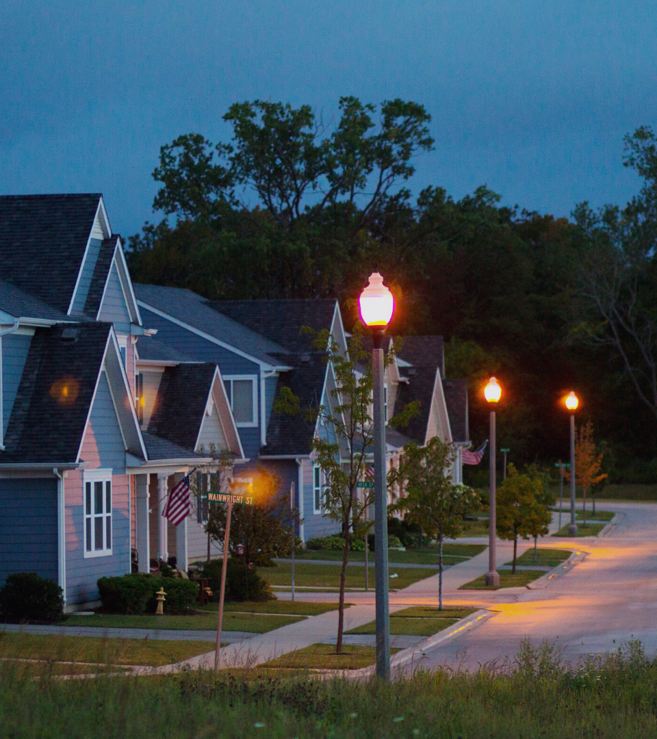
Disrupting the Oregon Housing Crisis Together
Sponsored by the YARG Foundation

Slide 2
Our Complex Problem
Oregon is in an affordable housing crisis. To date, approximately 30,000 individuals and families are housing insecure.
200,000 people in Oregon spend 50% or more of their income on rent – a proportion that threatens their security.
Disproportionately, these people are students, seniors and communities of color.
The problem is outpacing the current solutions.

Slide 3
Welcome to the Home Share Oregon Movement!!!
There are 1,500,000 spare bedrooms in owner-occupied homes in the State of Oregon. If only 2% of the people in these owner-occupied homes agree to Home Share, we could house 30,000 people at risk of homelessness, disrupting a continued increase in displacement.
Coastal communities and vacation destination cities across Oregon experience further impediments to affordable housing as transient housing or housing reserved solely for vacation rentals, compounds the problem.
Through technology and partnership, we can match this empty space with the people who need it most.
Communities have been sharing homes to save money for generations. Home Share Oregon represents the large-scale adoption of a time-tested solution.

Slide 4
Home Share Oregon Goals
Make Home Sharing the Cultural Norm ^{1. Attach the stigma.}
2. Break down barriers (scale) provide additional support to vulnerable populations.
3. Identify and advocate for public policies which unintentionally impede homesharing.

Slide 5
Education Campaign. Home sharing ROCKS!
^{Television} ^{Radio} ^{Print} ^{Earned Media} ^{Grassroots Organizing} Tabling, crowd canvassing, monthly web ex tutorials, direct client contact, home share support networks, rapid response housing providers
Notes:
Discuss this campaign. Current results of the education campaign

Slide 8
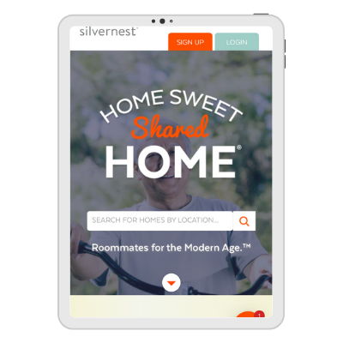
Scale: Breakdown barriers Powered by Technology
Home Share Oregon combines proven technology with a traditional social services model to deliver housing across the spectrum and provide a housing solution that scales.
Home Share Oregon uses the Silvernest platform to pair spare bedrooms with people who need them.
Silvernest empowers homeowners to generate rental income while generating affordable units for Oregonians.

Slide 9
Breaking Down Barriers to Entry
^{Background checks}
^{Renter and Homeowner insurance}
Compatibility matching for placements
^{Property management tools}
^{Rental agreements}
^{Payment gateway}
^{Client services}

Slide 10
Advancing initiatives which incentive home sharing

Slide 11
What you can do to help!
Become a part of the Home Share Movement! If you have a spare bedroom go to www.homeshareoregon.org and sign up today! Talk to your friends, family and co-workers about homesharing and encourage them to give it a try.
Sign up to volunteer! We need tablers, canvassers, and people who can provide support to other potential home sharers. Share your home share story. If you have homeshared In the past, share your testimonial so we may place it on our website.
Donate: No gift is too small, or too large!

Slide 12
Be a Part of the Solution. Questions?
^{Contact}
^{Tess Fields} Home Share Oregon, Executive Director
^{503-459.9157}
^{tess@homeshareoregon.org}
^{www.homeshareoregon.org}
^{@OregonShare}
facebook.com/groups/homeshareoregon

