Slide 1
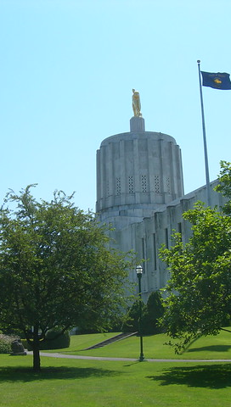
Tillamook County Commission Mtg
2024 Legislative Update
This Photo by Unknown Author is licensed under CC BY-NC-ND
May 2, 2024
Sean Edging, Senior Housing Planner

Slide 2
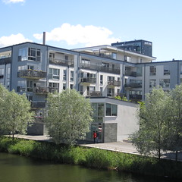
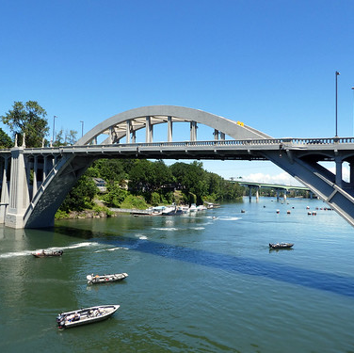


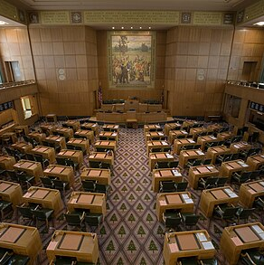
Key Legislation
This Photo by Unknown Author is licensed under CC BY-SA
This Photo by Unknown Author is licensed under CC BY-NC
This Photo by Unknown Author is licensed under CC BY-NC-ND
This Photo by Unknown Author is licensed under CC BY-SA
Housing and Urbanization
Infrastructure
Relevant But
Not Passed
Energy
Miscellaneous
SB 1537
HB 4063
SB 1564
HB 4026
HB 4134
SB 1530
HB 4080
HB 4015
SB 1576
HB 4023
HB 4046
HB 4090
HB 4155
HB 4099
HB 4048

Slide 3
Chief Sponsor: House Committee on Housing and Homelessness
Metro Unincorporated Urban Lands
Opting in to Amended Housing Development Regulations (Same as SB 1537)
Homebuyer Letter
Middle Housing Partitions
Single-Unit Housing Property Tax Exemption Approval
House Bill 2001 (2023) OHNA Technical Fixes
Housing and Urbanization
HB 4063: Housing Policy Omnibus Bill

Slide 4
SB 1564: Presumed Clear and Objective Model Housing Ordinances
Chief Sponsors: Sen. Anderson, Sen. Knopp & Rep. Breese-Iverson
Appropriation (DLCD): $550,000
Requires LCDC to adopt model housing ordinances for cities under 2,500, 2,500 – 25,000, and 25,000+ in population for various housing types by Jan 1, 2026
Allows cities to adopt by reference, either in whole or in part, model ordinances and have them be presumed clear and objective
Housing and Urbanization
SB 1564: Model Codes
HB 4026: UGB Referendum
HB 4026: Prohibition of Urban Growth Boundary Referendum
Chief Sponsor: House Committee on Rules
HB 4026 prohibits a local government from referring the decision to expand their urban growth boundary to a ballot vote
Backdated to January 1, 2023

Slide 5
HB 4134: Jurisdiction-Specific Infrastructure Funding for Housing
Chief Sponsors: Rep. Elmer, Rep. Gomberg & Rep.
Appropriates $7.1M to Business Oregon to administer grants to jurisdictions that are earmarked for infrastructure projects supporting housing development
Projects must be within a UGB and support at least 30% affordable housing
Infrastructure
SB 1530: Project-Specific Infrastructure Funding for Housing
HB 4134: Infrastructure for Affordable Housing
SB 1530: Direct Infrastructure Appropriations
Chief Sponsor: Senate Committee on Housing and Development
Appropriates $90M to Business Oregon to administer for specific infrastructure projects supporting housing development
Appropriates $1.5M to WRD to administer grants for water infrastructure projects

Slide 6
Chief Sponsor: Senate President Rob Wagner at the request of Governor Tina Kotek
Appropriation: $10,629,017
Positions (FTE): 28 (14.46 FTE)
Housing Accountability and Production Office
Opting in to Amended Housing Regulations
Attorney Fees for Needed Housing Challenges
Infrastructure Supporting Housing Production
Housing Project Revolving Loan Fund
Housing Land Use Adjustments
Limited Land Use Decisions
One-Time Site Additions to Urban Growth Boundaries
Housing and Urbanization
SB 1537: Governor
Kotek’s Housing Production Framework

Slide 7
Questions

