Slide 1
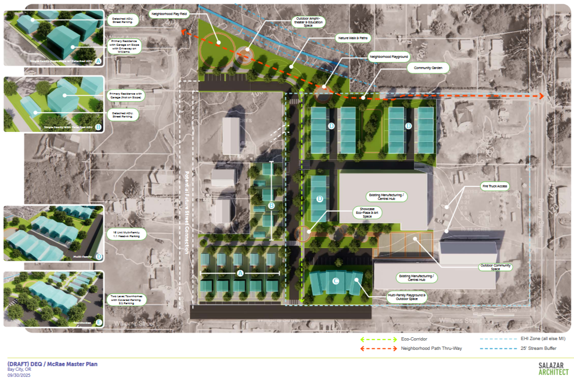
Alder Ridge
Ralph & Lisa McRae presenting

Slide 2
Thank You! Thank You! Thank You!
Thank you Tillamook Housing Commission for supporting this project, guiding us through the process, and creating a crucial bridge to move us from a dream to viable reality for us and our community.
Thank you DEQ Built Environment for the encouragement, clarity and support to see this project through the master plan and the innovative ways to create community.
Thank you to City of Bay City has been exceptional in their support of our transition from a manufacturing focused site to a multi-use, multi-value community resource.

Slide 3
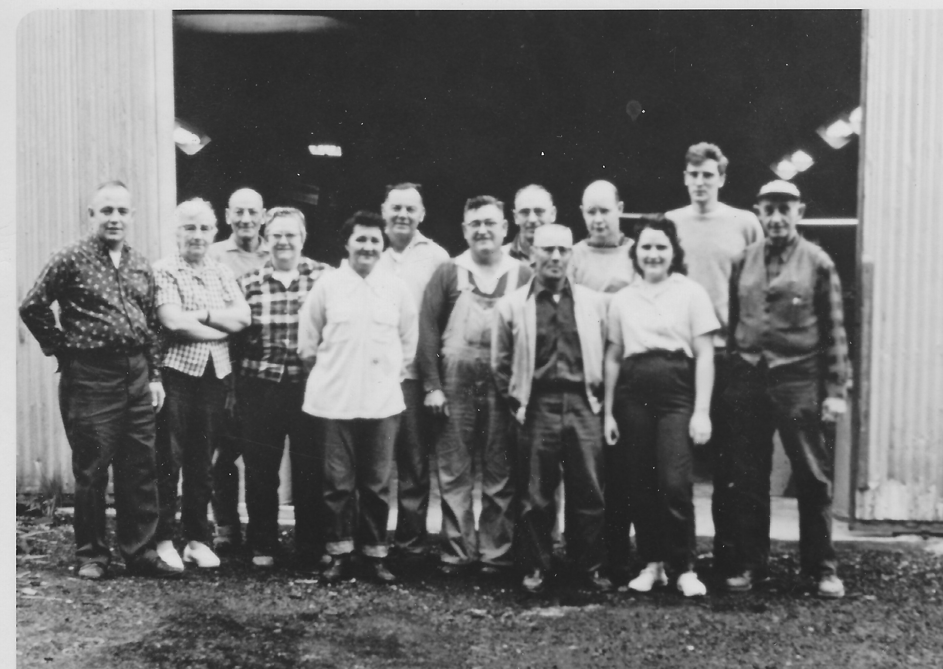
History
Legend has it…
The business that turned into “the brush factory” started in a garage in Garibaldi in 1955
Employed generations of Tillamook county residents
Gained traction because Grandma encouraged a conversation
Stopped producing handles 2019

Slide 4
Alder Ridge Goals
Community within a Community
Connection
Sustainable & Enduring
Multi-generational
Innovative
Entrepreneurial
Trades Enhancement
Technology
Notes:
Connection
Multi-generation

Slide 5
Updates October 2025
Geo Hazard - Completed
Survey - Completed
Removal of Trees - Completed
Community Engagement Session - Completed
Master Plan – very close to completion
Meeting with potential partners in process:
Mass Timber
Flat pack homes
Commissary Kitchens
CTE possibilities
NEXT
Civil Engineering
Ground Work
ID Housing Partner
All other Pre-Development Work

Slide 6
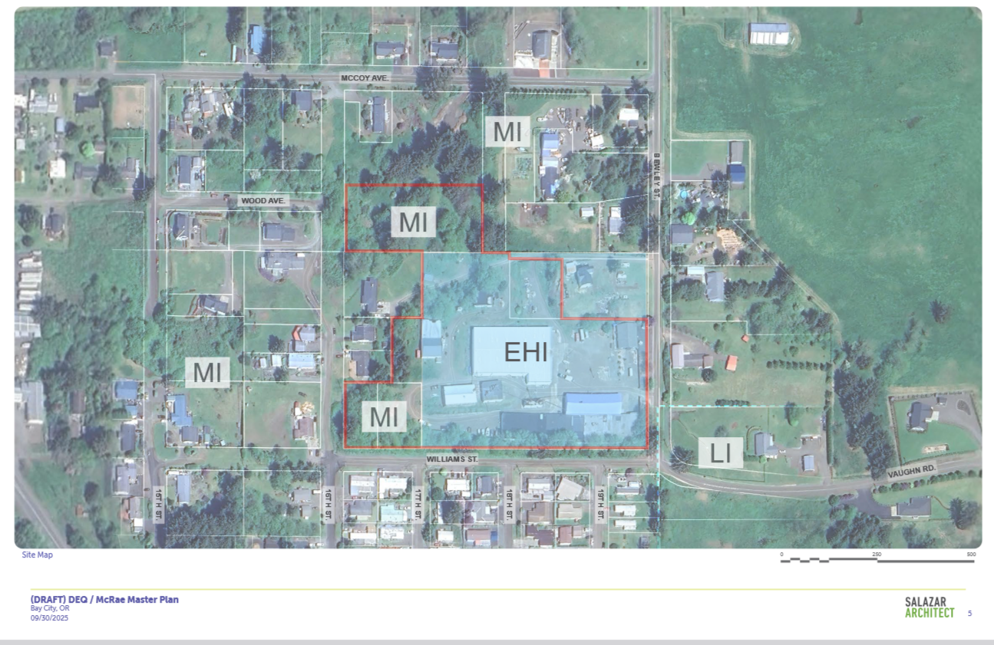
Project Map

Slide 7
Feedback from Community Engagement Top 5 of 20
Connects Nature & Design
Promotes Well Being
Place for all ages and abilities
Supports the Environment
Feel Safe & Secure

Slide 8
Notes:
Townhomes, single family homes with ADU’s , and a walkup apartment building

Slide 9
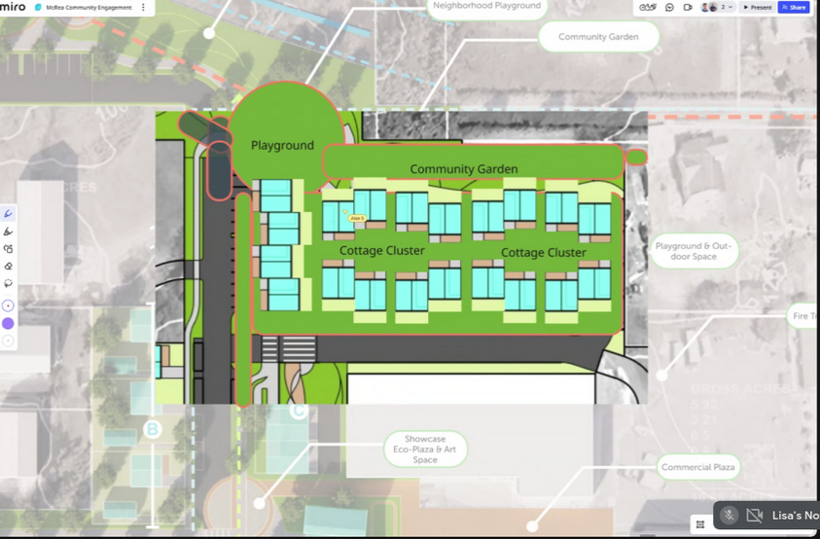
Notes:
We like cottage cluster as multiplier
We believe each cottage helps free up homes for larger families

Slide 10
Thank You for Your Continued Interest and Support
Ralph & Lisa McRae
Input?
Comments?
Thoughts?
Questions?

