Slide 1


Slide 2
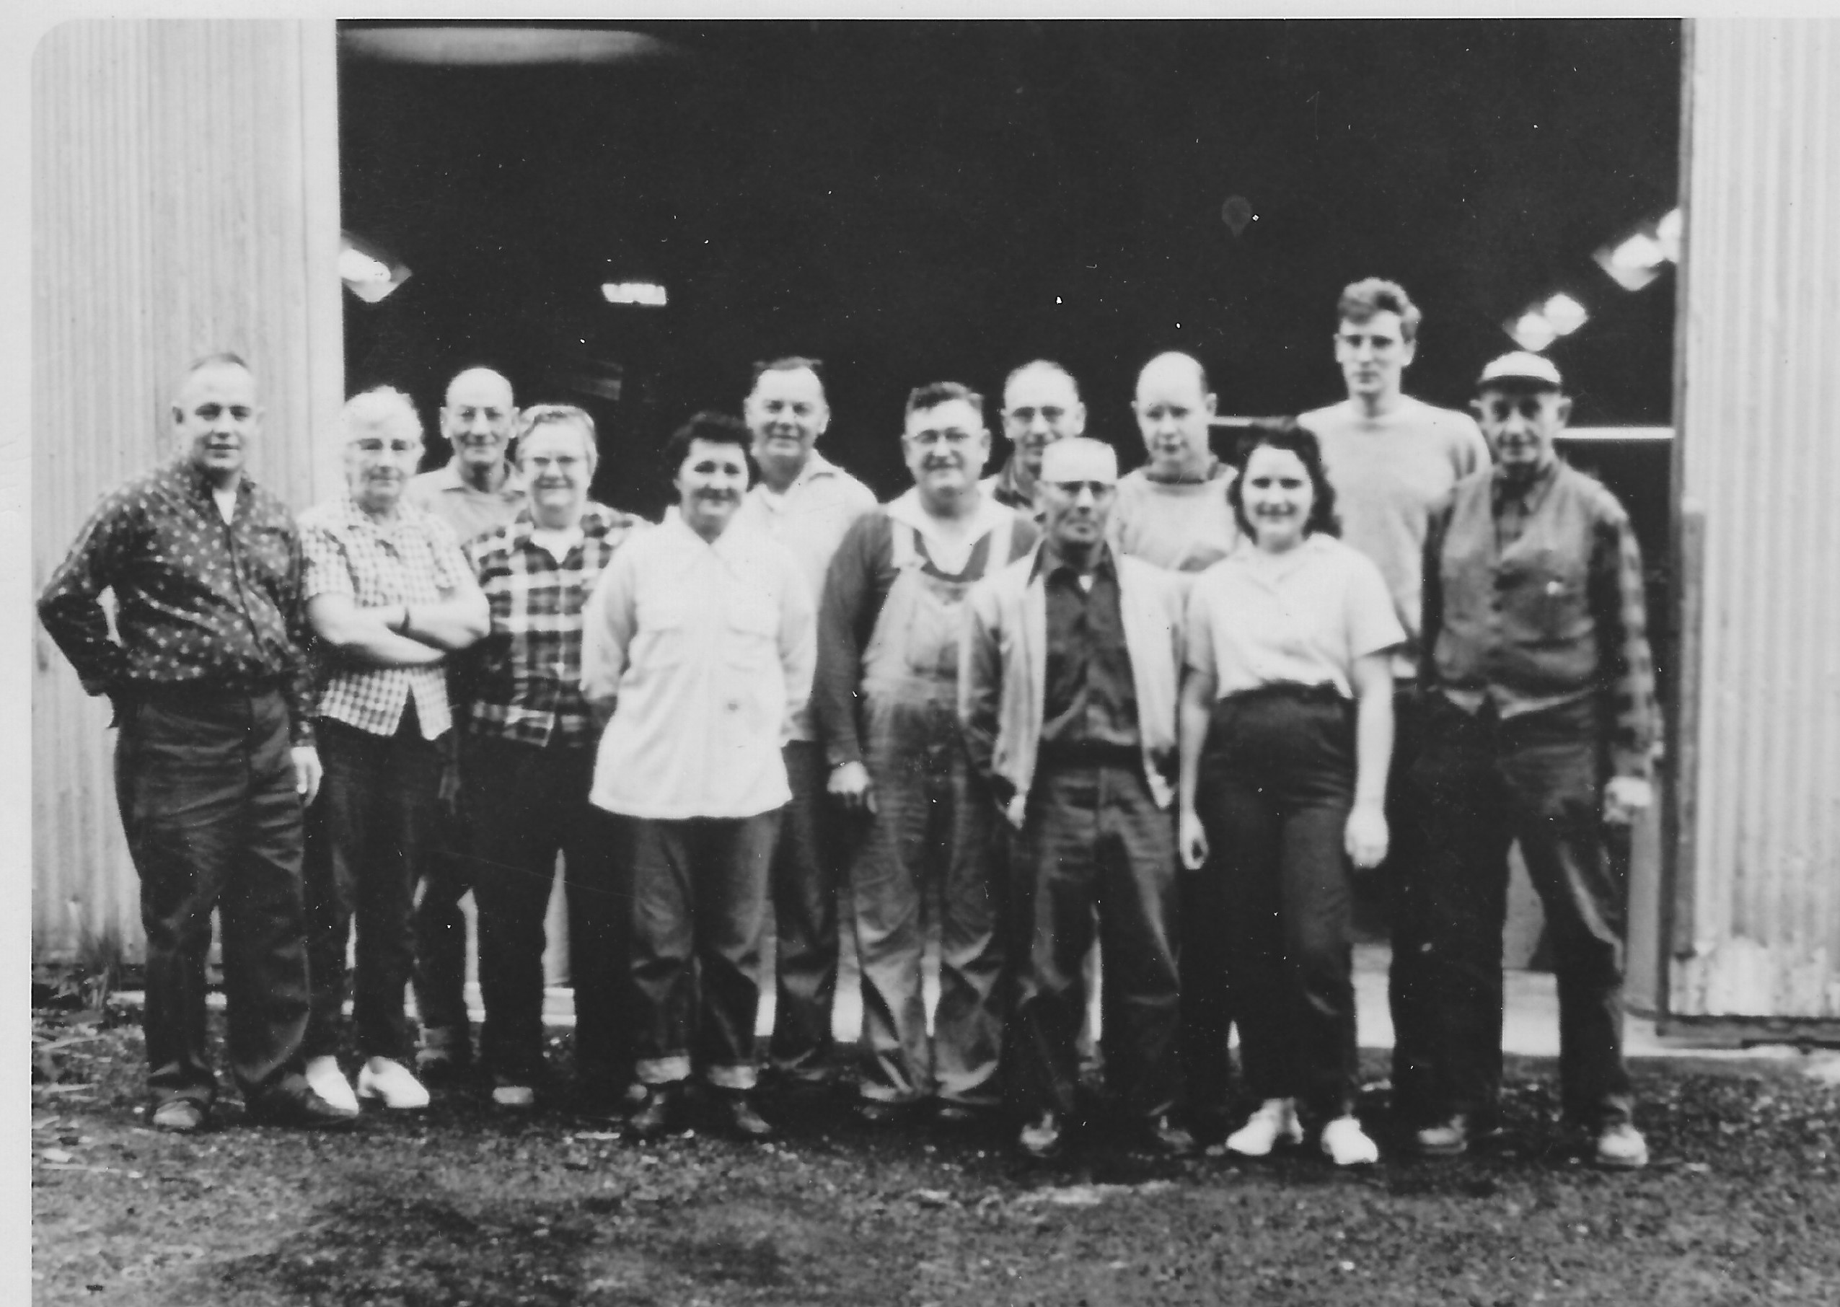
Background
This project is based on the transformation of property of our family business that started in 1955
Employed generations of Tillamook county residents
Notes:
For anyone not familiar with our story

Slide 3
Alder Ridge Goals
Community within a Community
Connection
Sustainable & Enduring
Multi-generational
Innovative
Entrepreneurial
Trades Enhancement
Technology Advancing
Notes:
Core Principles:
Creativity, Community, and Opportunity

Slide 4
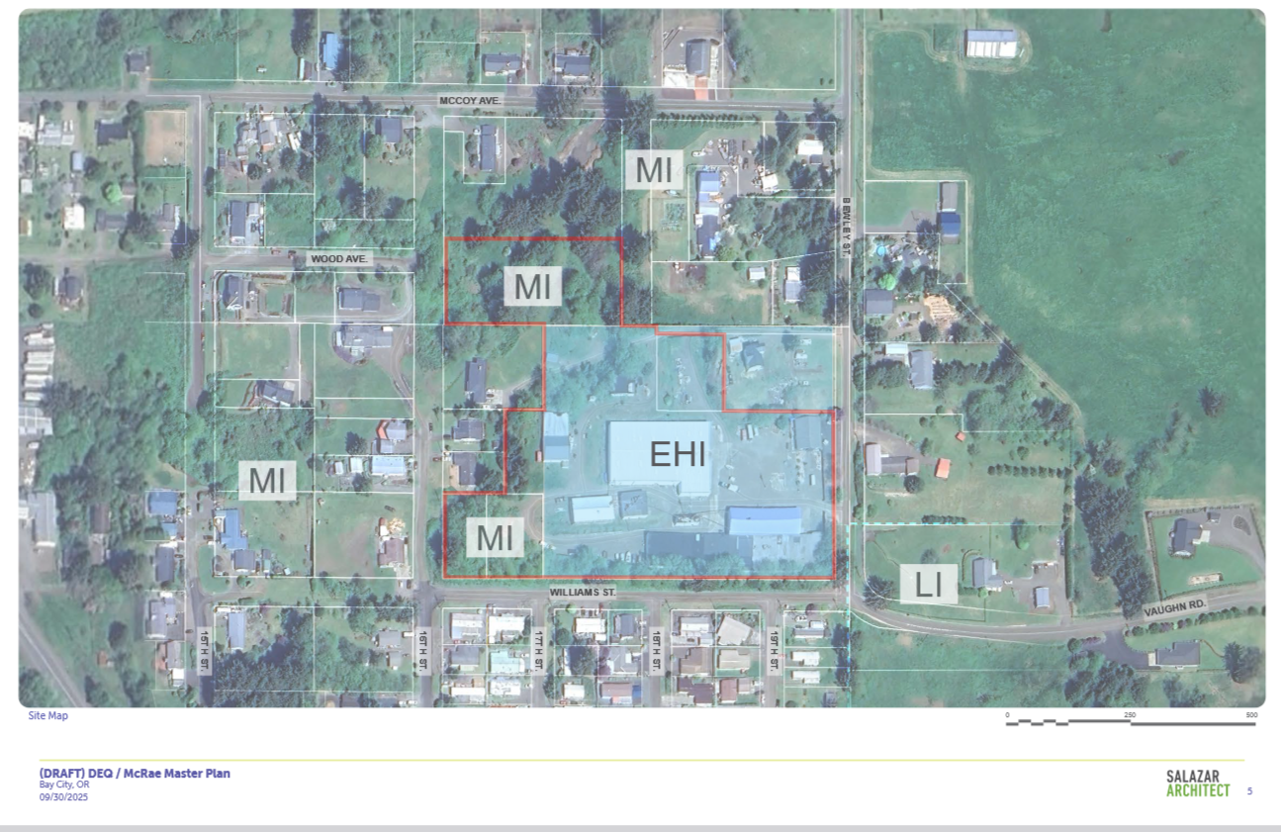
Project Map

Slide 5
Feedback from Community Engagement Top 5 of 20
Connects Nature & Design
Promotes Well Being
Place for all ages and abilities
Supports the Environment
Feel Safe & Secure
Notes:
As we mentioned in our October update, we had great turnout and feedback in our community engagement sponsored by OR DEQ last summer. The key themes that we are looking to incorporate into the project are:

Slide 6
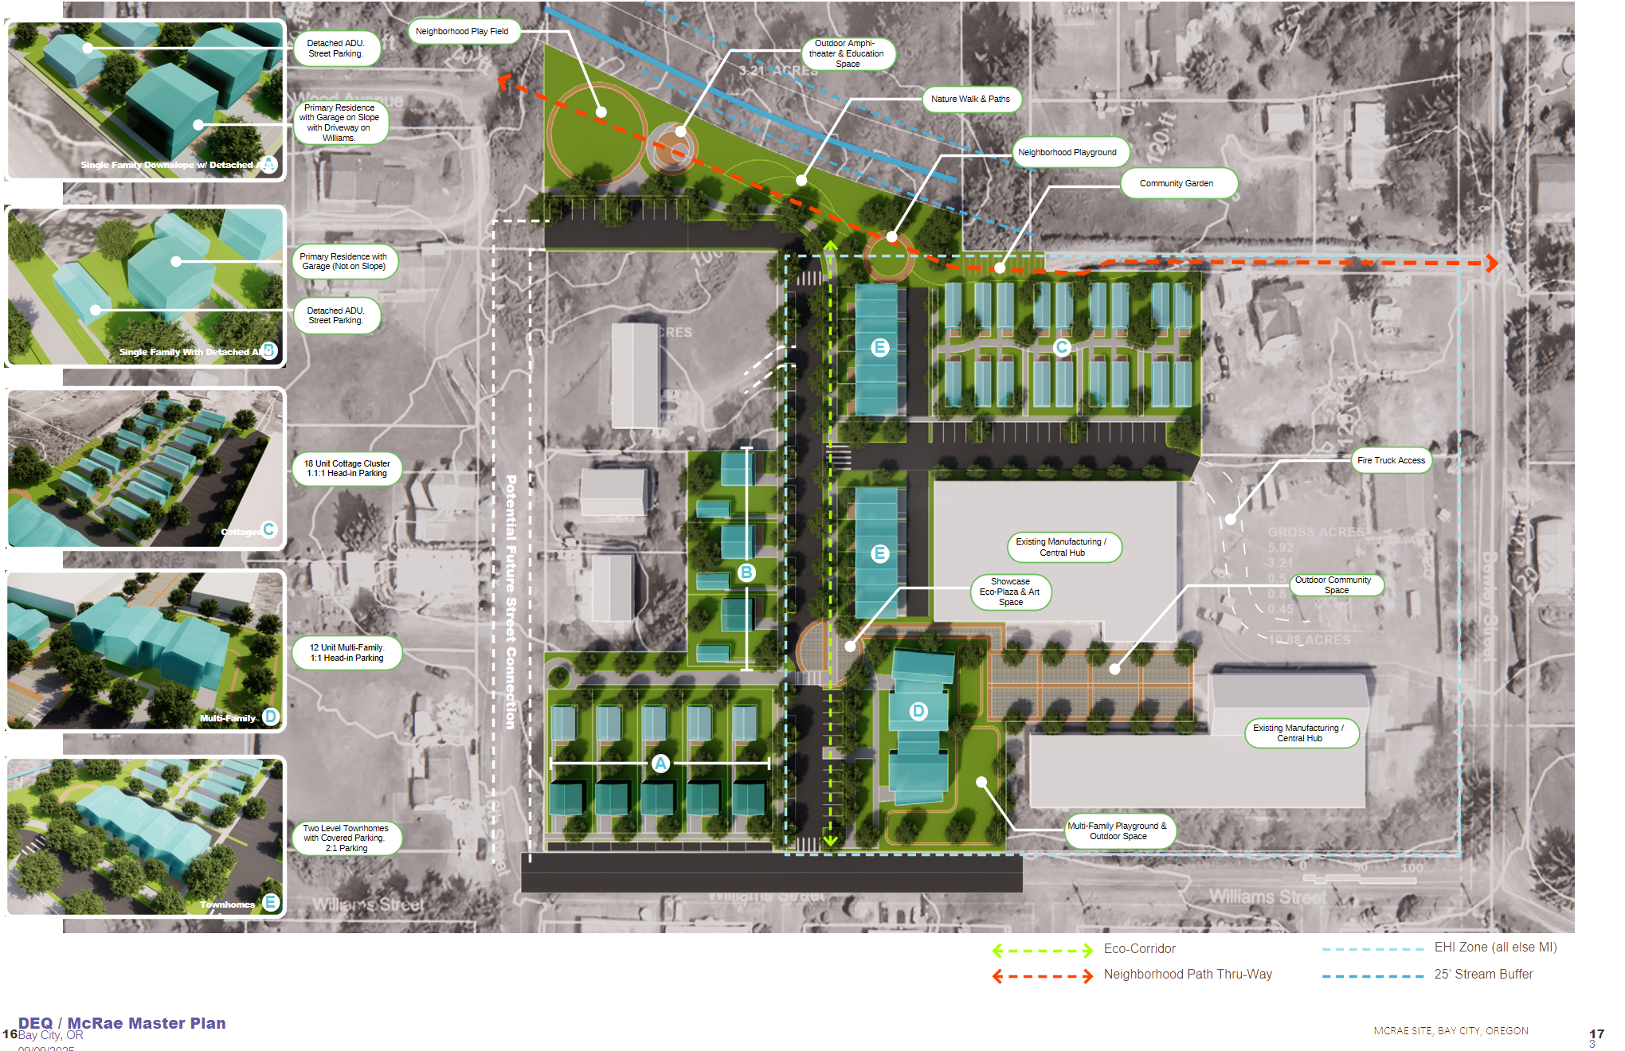
Preferred Concept

Slide 7
2026 Key Milestones
Land Entitlement
Housing Design
Building methodology
Infrastructure layout/installation
Partner Selection
Notes:
Cohesive design with individuality throughout
Modular, Flat panel, Stick built, Hybrid
Set

Slide 8
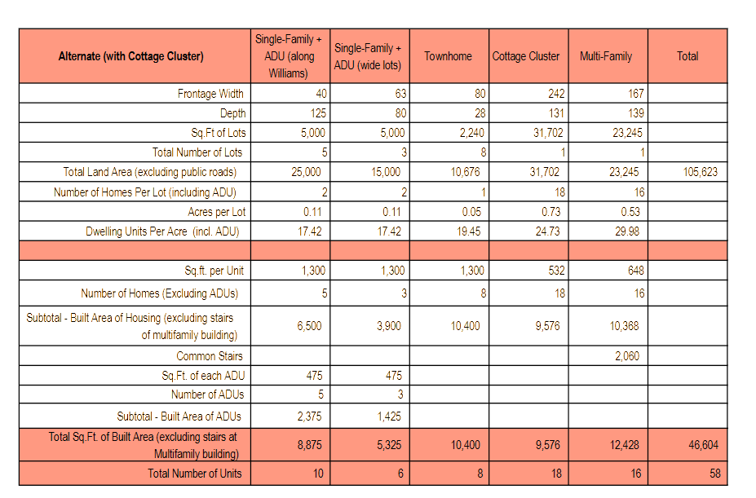
Plan Details

Slide 9
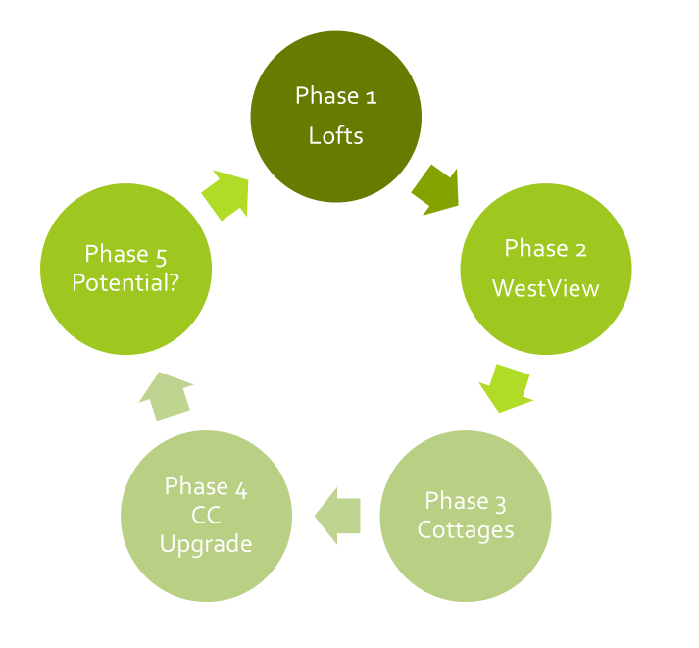
Current Phase Sequence
Lofts Multi-unit solution
West View Homes w/ADU
Senior-focused cottage cluster
Community Commercial Upgrade
Flex space/ Town Homes

Slide 10
Again, Many Thanks!
Thank you to Tillamook County Housing Commission, DEQ Built Environment Team, City of Bay City, and the many professionals, partners, and community members that have helped refine this vision and move this dream forward.
Lisa & Ralph McRae
Questions & Comments:
Notes:
Dream Big
Start Small
Act Fast

