Slide 1

Nehalem Workforce Housing Pilot
Mission-driven middle-income housing using modern prefab construction
Founder: Vishal Vishal
Investor Partner: Ben Tallman
Applying product execution + design thinking to housing

Slide 2


Mission | 01
Who We Are & Why This Matters
AFFHOMES LLC
CORE BELIEF
15+ years leading complex programs at Microsoft, Meta Samsung
Proven track record in product execution at scale
Deep expertise in design thinking and operational excellence
Middle-income housing should not compromise on quality!
Nehalem Workforce Housing Pilot

Slide 3

Problem | 02
The Problem: The Missing Middle
🚫
👨‍⚕️
🏗️
61-100% AMI Priced Out
Essential Workers Impacted
Economic Infrastructure
Working families earning $48K-$78K cannot afford new construction
Teachers, healthcare workers, local professionals struggle to find housing
Housing is critical infrastructure that enables community growth
Without workforce housing, communities cannot sustain essential services
Nehalem Workforce Housing Pilot

Slide 4

The Solution: Smarter, Scalable Housing
Solution | 03
LIT Homes Technology
The Opportunity
Prefabricated Modular Construction: Factory-built for consistent quality
Standardized, Repeatable Designs: Reduces risk, enables scalability
Energy-Efficient & Durable: Lower operating costs for tenants
Lower Risk
Consistent Quality
Faster Execution
Easier to Scale
Eliminates construction overrun risk
Nehalem Workforce Housing Pilot

Slide 5
Solution | 03
Nehalem Pilot Project
35770 12th STREET, NEHALEM OR
Project Details
Strategic Goals
Total Units: 4 Units
Unit Mix: 2×2BR + 2×1BR
Lot Size: 8,625 sq ft
Monthly Rent: ~ $1,400 - $1,600
Target AMI: 80-120%
Long-term Rental Pilot: Prove sustainable affordability model
Designed for Replication: Enables 10–20-unit expansion
County Partnership Model: Public-private collaboration
Nehalem Workforce Housing Pilot

Slide 6
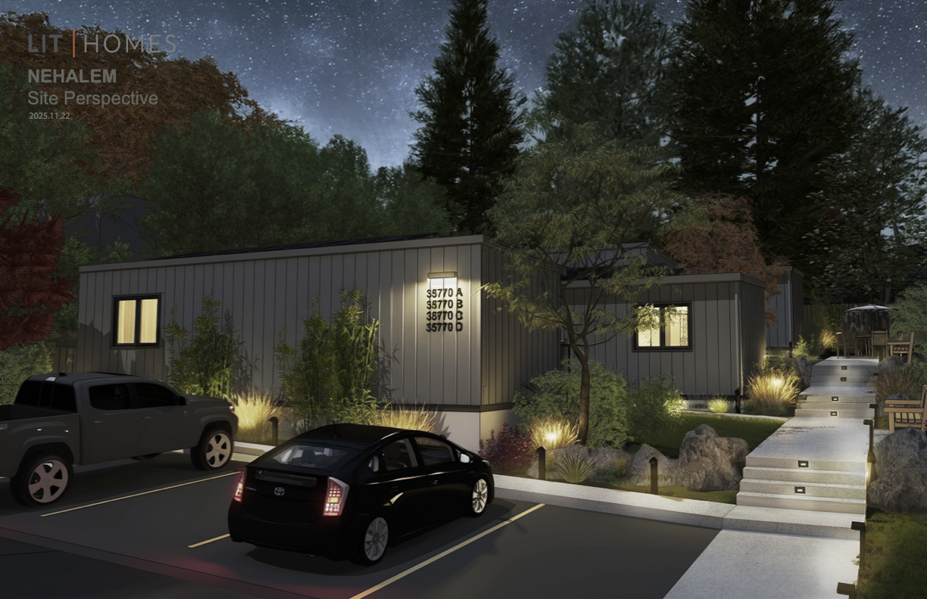
Solution | 03
Modern Design, Community Integration
CLUSTERED COMMUNITY
Contemporary design
Curbside Appeal
Sustainable
Uncompromised Quality
Native landscaping
Energy-efficient
8,625 sqft lot
LIT Homes
Q2 2026
Nehalem Workforce Housing Pilot

Slide 7
Design | 04
Nehalem Pilot Project Site Plan
35770 12th Street, Nehalem, Oregon
Nehalem Workforce Housing Pilot

Slide 8
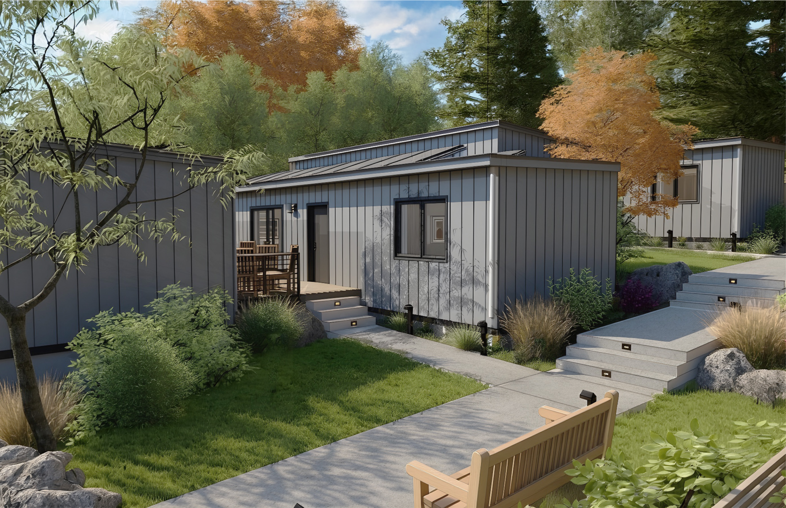
Design | 04
Vision
Contemporary Pacific Northwest aesthetic with sustainable materials
Nehalem Workforce Housing Pilot

Slide 9
Specifications | 05
Uncompromised Quality
Nehalem Workforce Housing Pilot

Slide 10
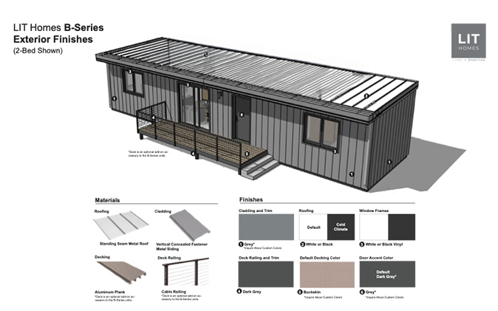
Specifications | 05
Coastal Weather Tested and Ready
Nehalem Workforce Housing Pilot

Slide 11
Financial Feasibility with County Partnership
Development Budget
Funding Sources
$1,530,057
Total Development Cost ($382,514 per unit)
Total Requested Grant: $1,00,000K (65.4%) | Developer: $530K (34.6%)
Annual NOI
Cap Rate
ROI With Grant
ROI Without
$44,688
2.9%
8.4%
2.9%
Nehalem Workforce Housing Pilot

Slide 12
Partnership for Sustainable Impact
🎯
📈
🏘️
Phase 1: Pilot
Phase 2: Expansion
Long-term Vision
4 units proving concept
Scale to 10-20 units
County-wide model
Q2 2026
2026 - 2029
Beyond
Why Partner with AFF Homes?
Proven Execution: 20 + years at scale
Mission-Driven: Quality for working families
Scalable Model: Rapid replication
Local Commitment: Long-term partnership
Let's build sustainable workforce housing together
Nehalem Workforce Housing Pilot

Slide 13
Appendix
Nehalem Workforce Housing Pilot

Slide 14
Proforma
PROJECT OVERVIEW
Total Development Cost | $1,530,057
Number of Units | 4
Cost per Unit | $382,514
Grant Request (Construction) | $1,000,000
Grant per Unit | $250,000
FINANCIAL SUMMARY
Annual Gross Rent | $67,200
Effective Gross Income (EGI) | $63,840
Operating Expenses | $19,152
Net Operating Income (NOI) | $44,688
RETURNS ANALYSIS
Cap Rate on Cost | 2.9%
Total Equity (After Grant) | $530,057
Equity per Partner | $265,029
ROI per Partner (Unlevered) | 8.4%
GRANT IMPACT
Leverage Ratio (Private:Public) | 0.53
ROI Without Grant | 2.9%
ROI Improvement | 5.5%
Founder: Vishal Vishal
Applying product execution + design thinking to housing
Nehalem Workforce Housing Pilot

