Slide 1
Health District Housing Strategy
Prepare District-owned property for redevelopment
Partner with housing developer
Create 30 – 36 “workforce” housing units for health care and other essential workers and visiting specialists
January 2026

Slide 2
Health District Background
Oregon’s smallest health district, small operating levy
District owns skilled nursing facility and FQHC health center/pharmacy
Facilities employ 80 + staff in north Tillamook County
Serving increasingly aging population, as well as economically disadvantaged population
District’s public profile now higher and more positive than it has been
Existing partnerships w/cities, county, Oregon foundations

Slide 3
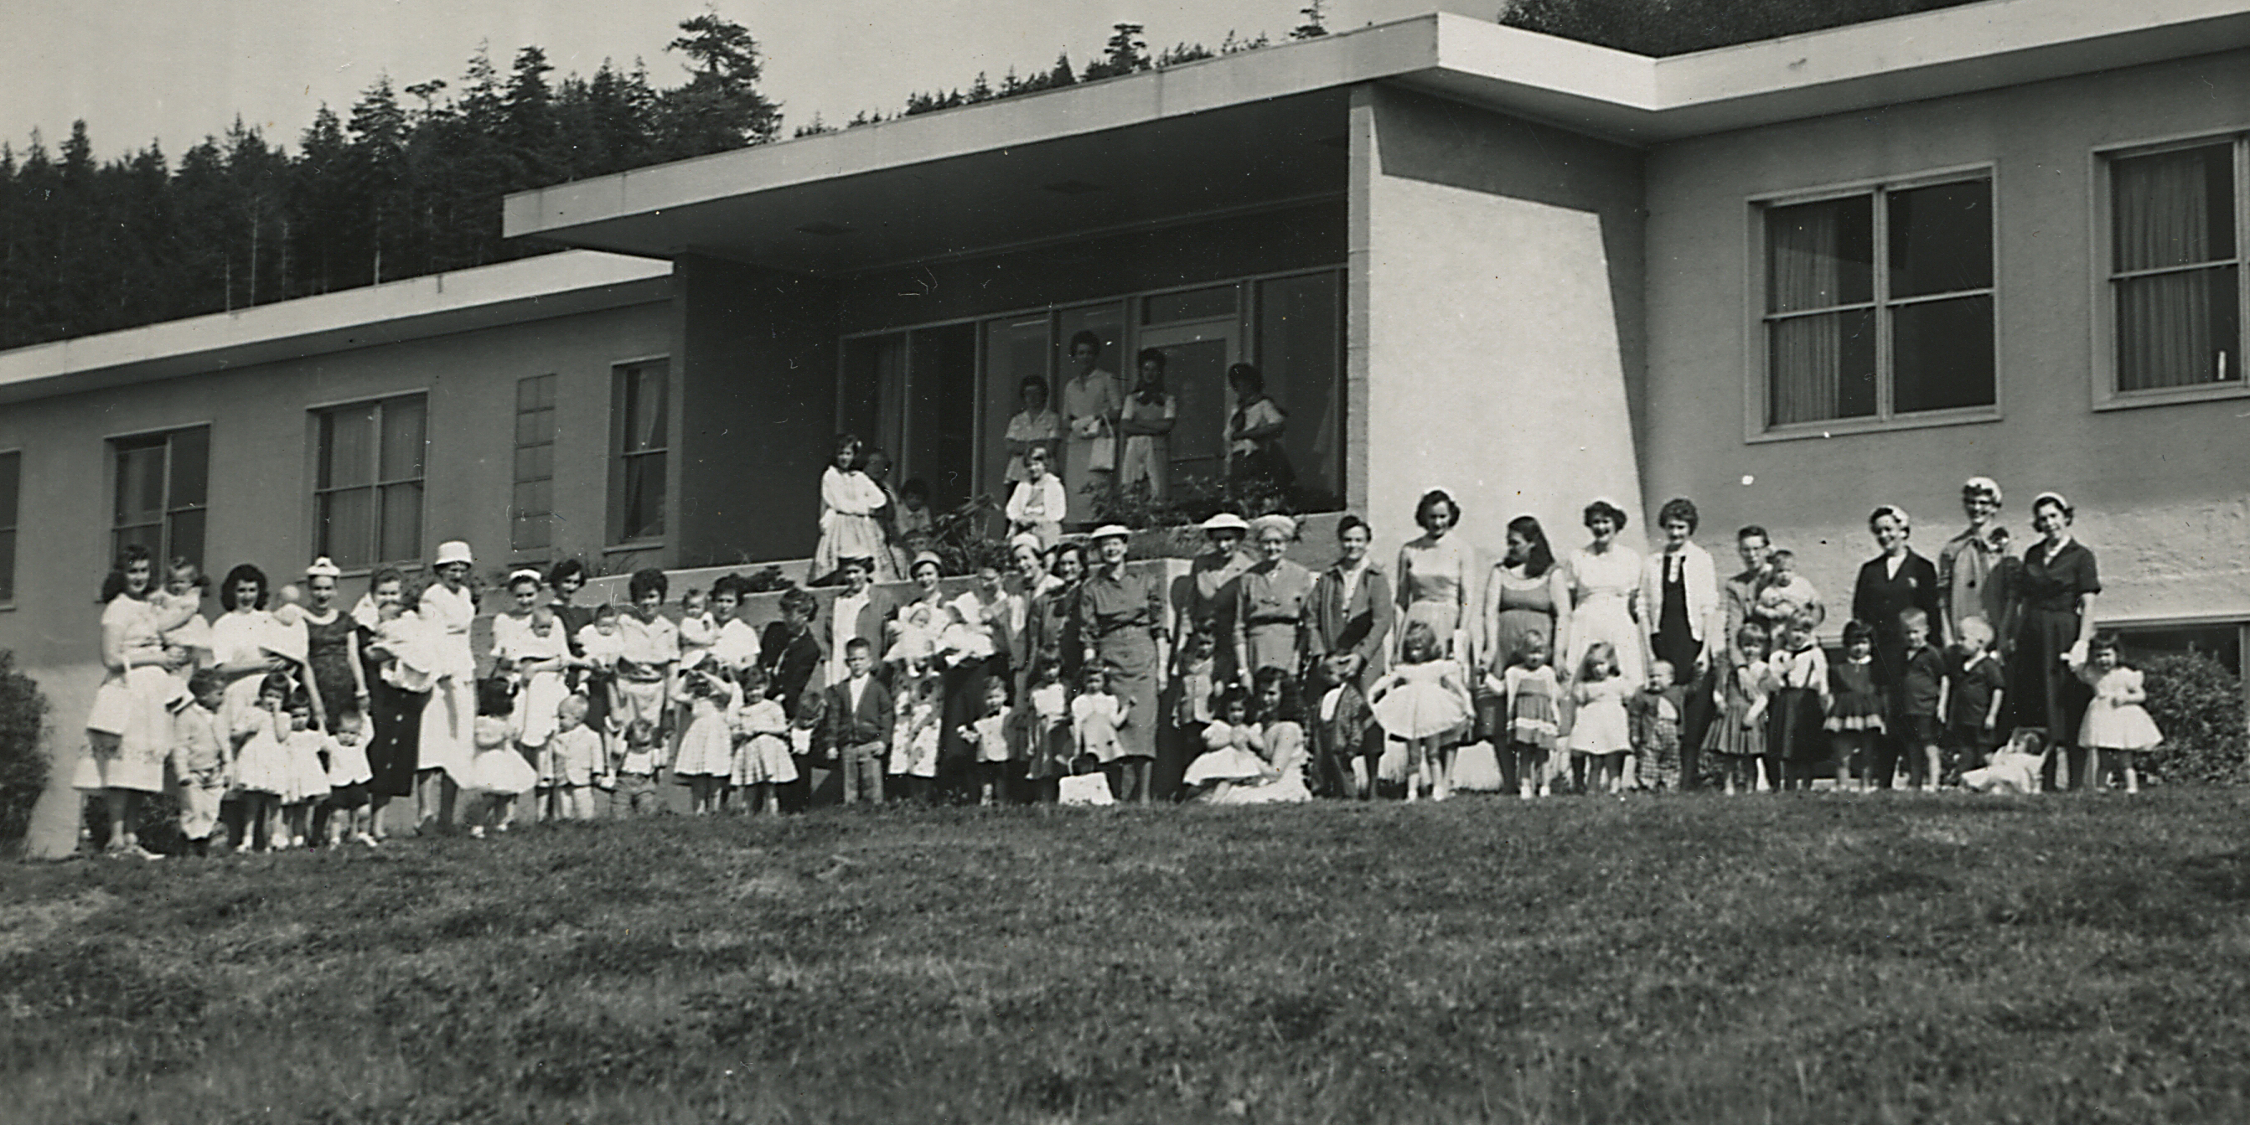
Health District Background
Rinehart Memorial Hospital in the 1950’s

Slide 4
Health District Housing Objectives

Slide 5
Housing Challenges
Demo cost of old hospital
Limited District expertise and staff

Slide 6
Housing Opportunities
District-owned property
Supportive community and county
Existing residential zoning

Slide 7
District Housing Objectives
Address medical staff recruiting/retention challenges related to available housing
Retain public ownership of property
Open to leasing/management arrangements
If possible, create a modest revenue stream for District

