Slide 1
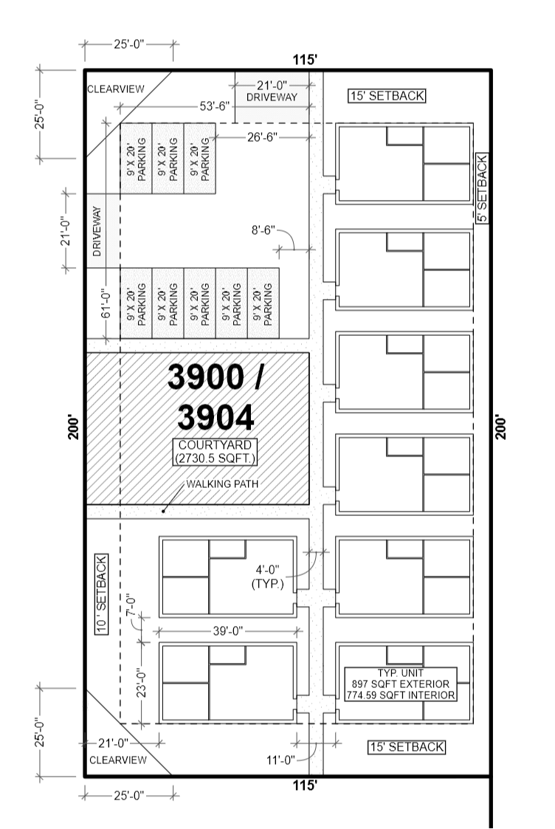
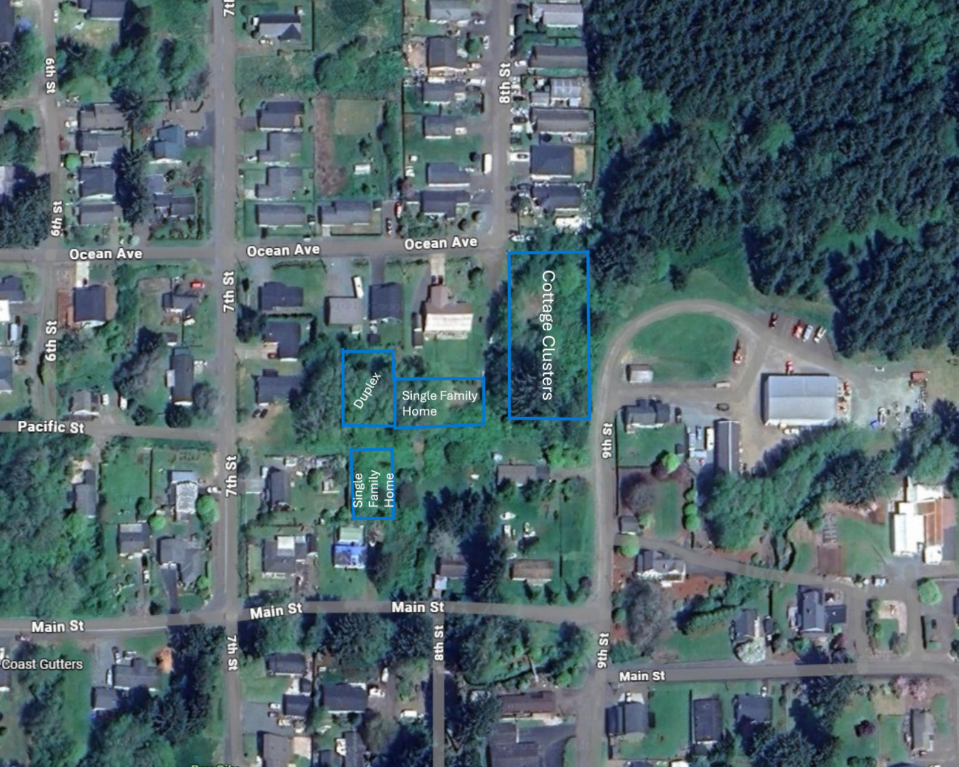
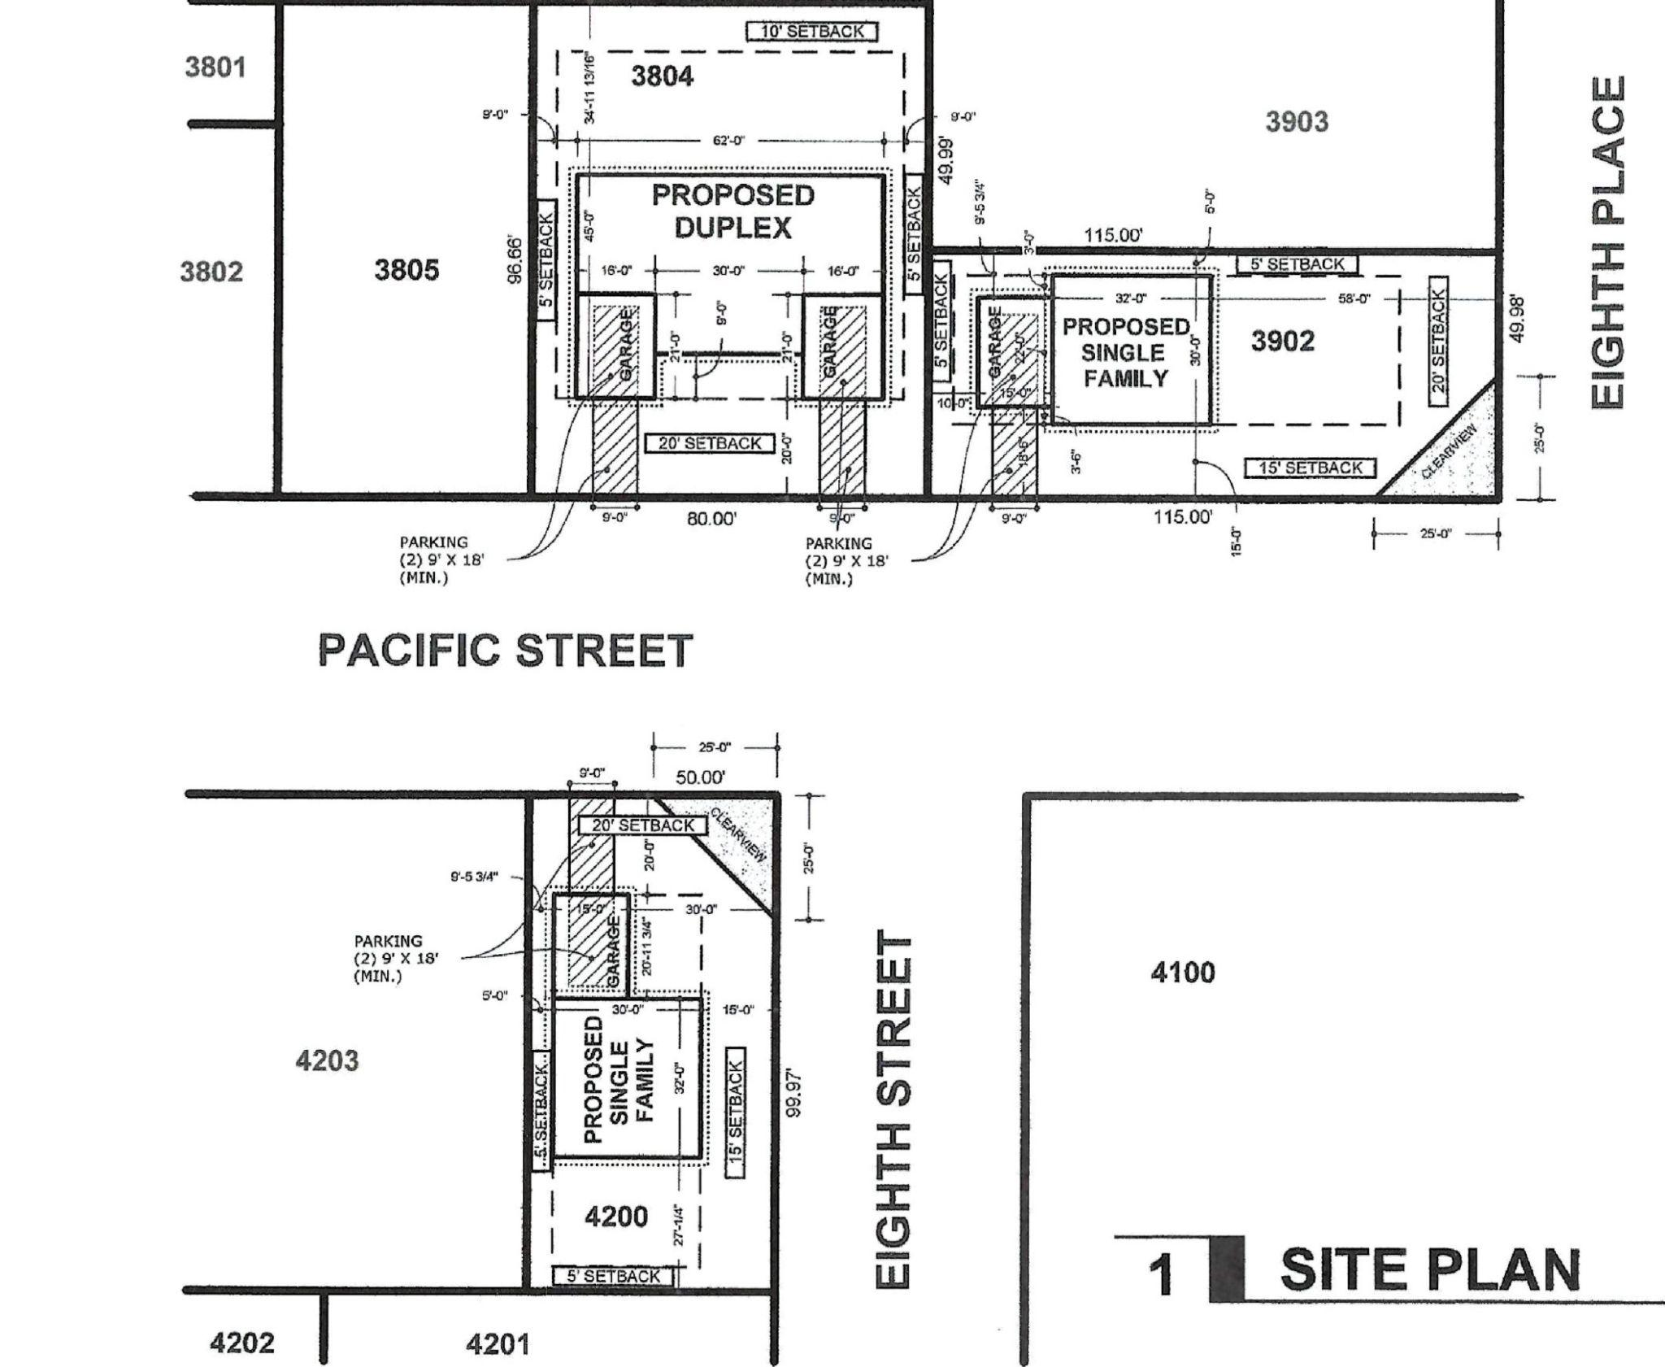
L-Property Future Home’s
Off of 8th & 7th
Pre-development Stage
Currently pre-Infrastructure

Slide 2
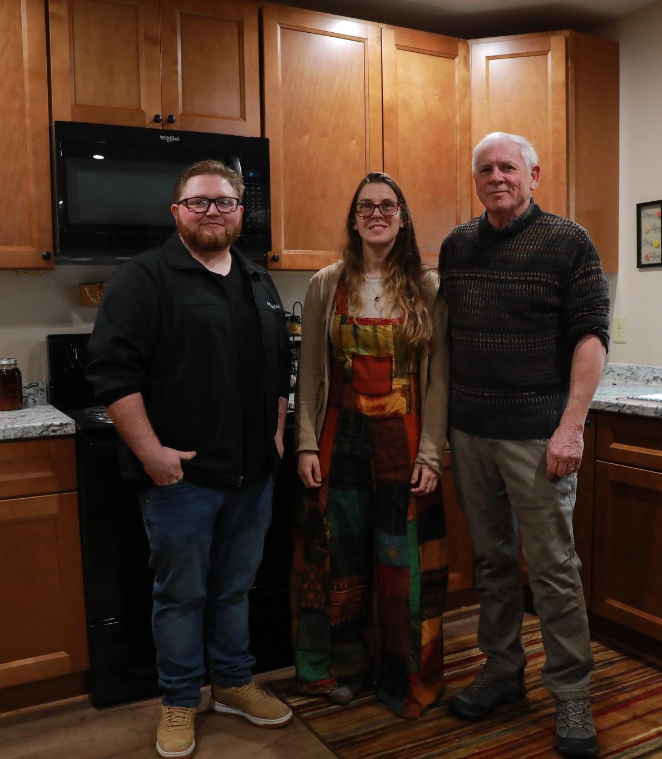
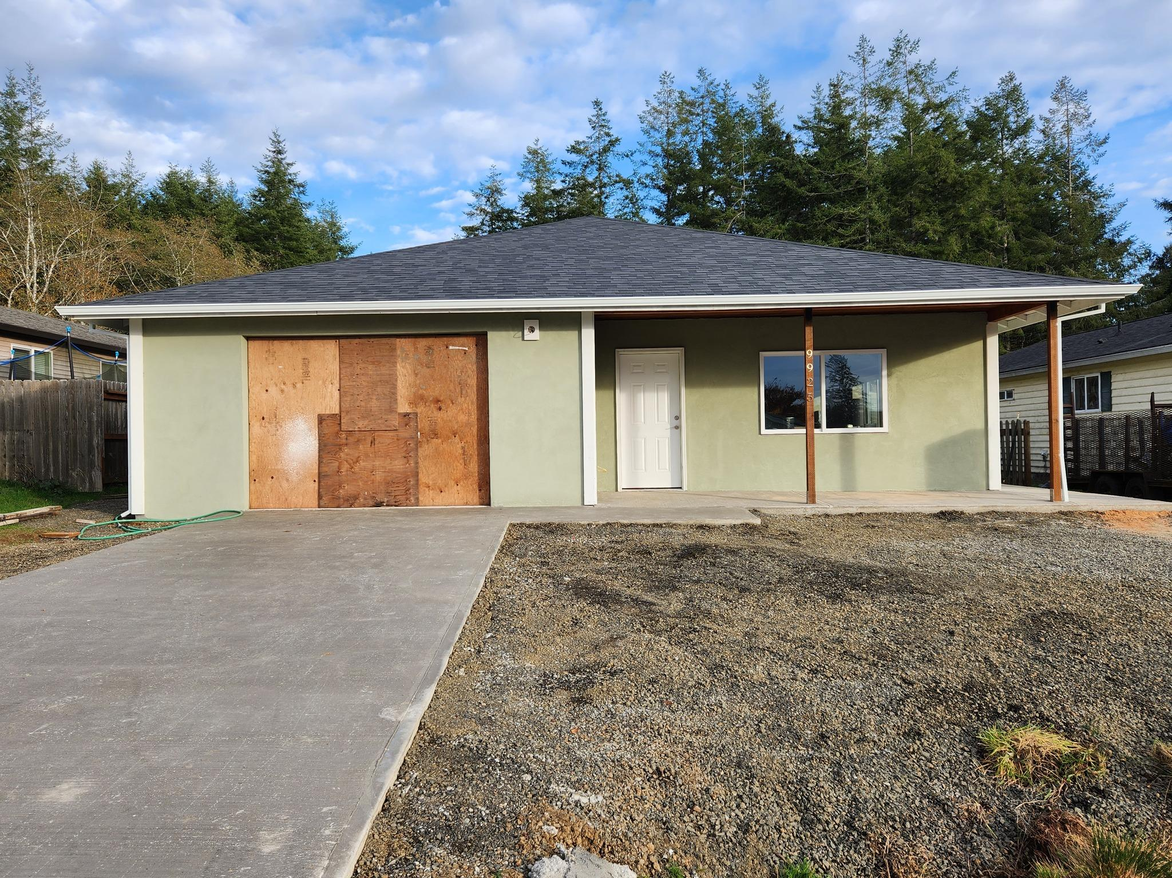
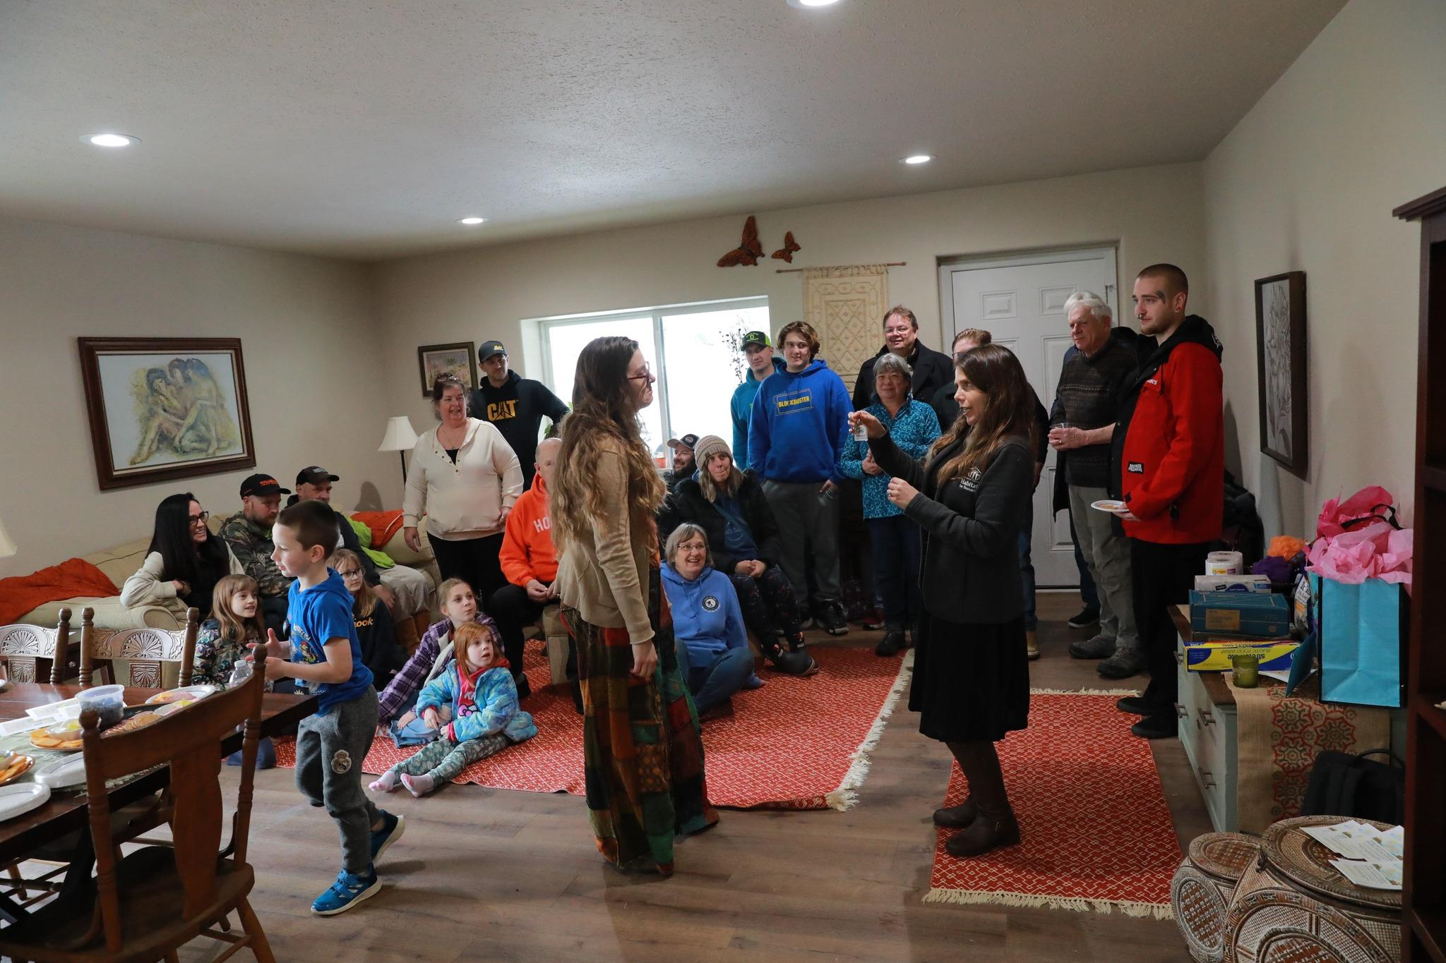
Past Habitat Project
Completed in 2023 for Single Mother of Four

Slide 3
Permanent Affordability
When a Habitat homeowner decides to sell, the home is resold at an affordable price to another low-income family.
This protects against rising housing costs, ensuring long-term affordability in our community.
While homeowners still build some equity, the resale price is restricted to keep the home within reach of future families.
Why it Matters
Our mission is to provide lasting affordability, so more families can benefit from homeownership without being priced out of the market.
Homes remain affordable
Resale restrictions limit price appreciation
Similar to Land Trusts.

Slide 4
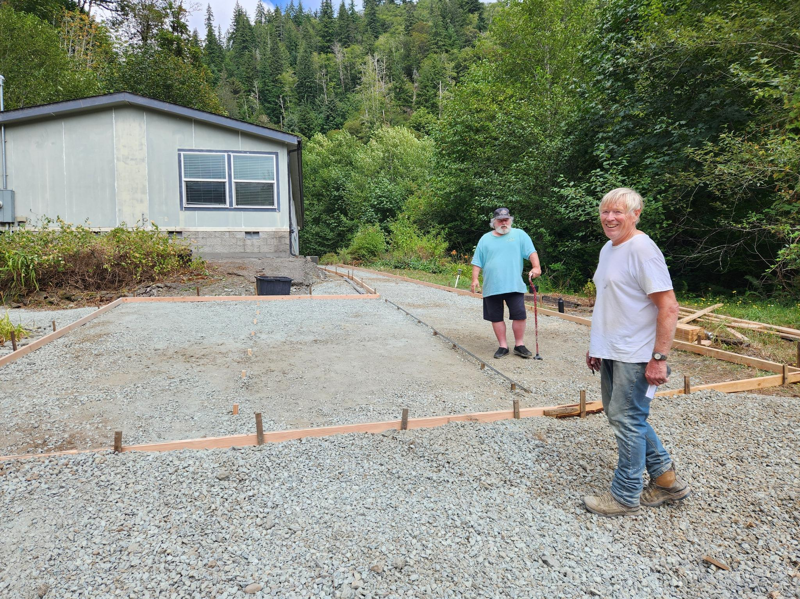
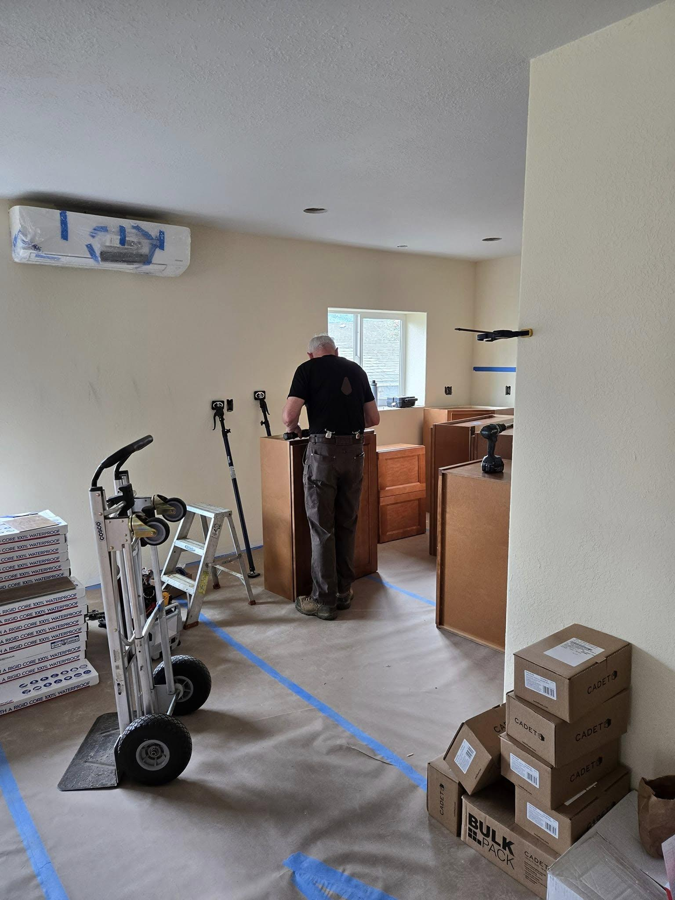
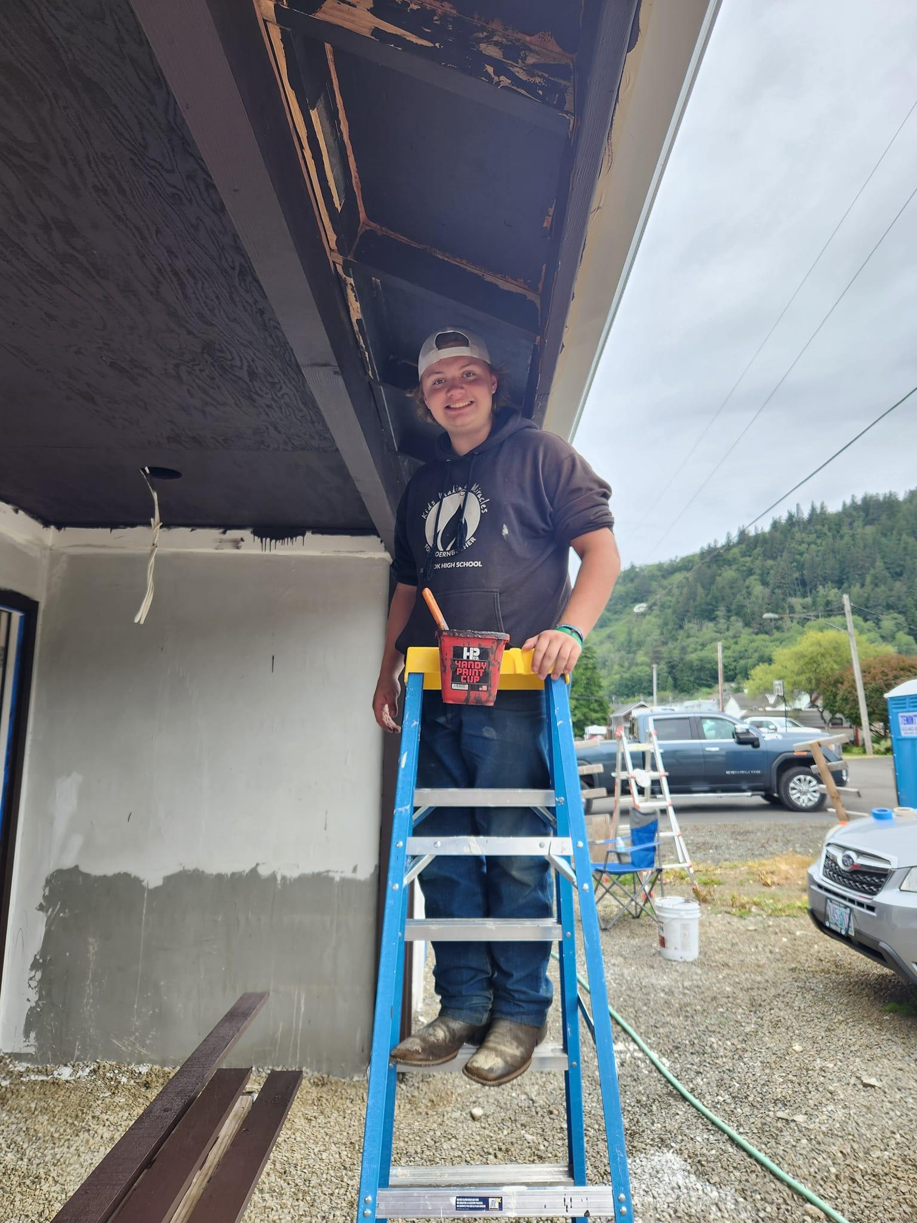
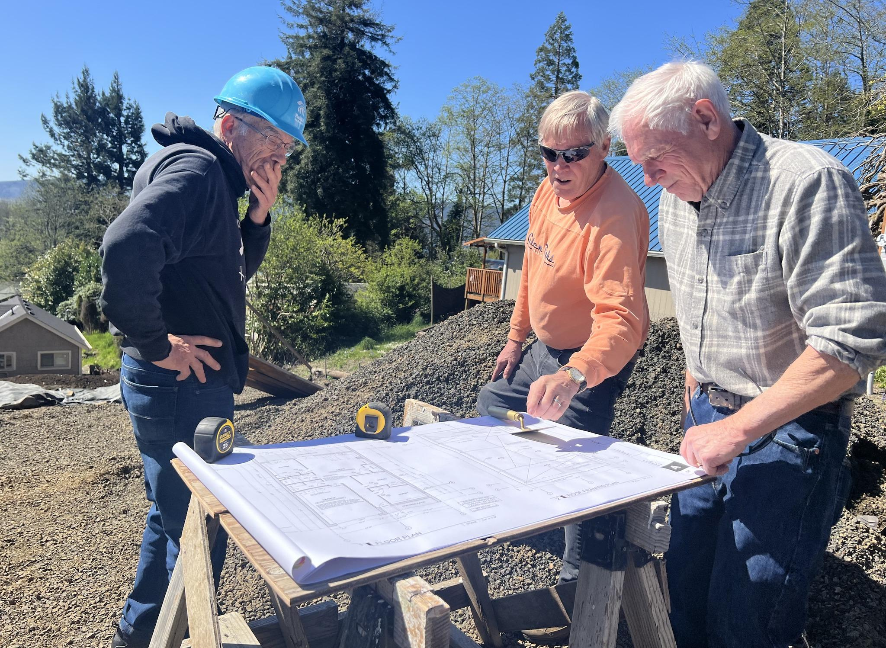
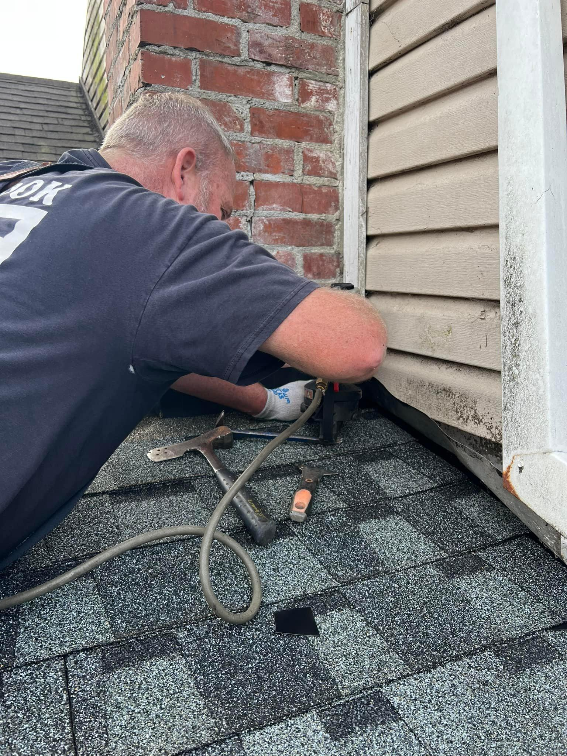
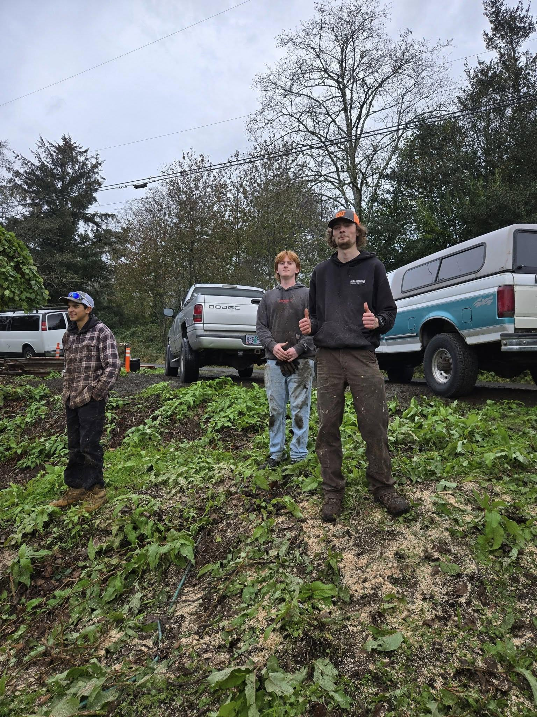
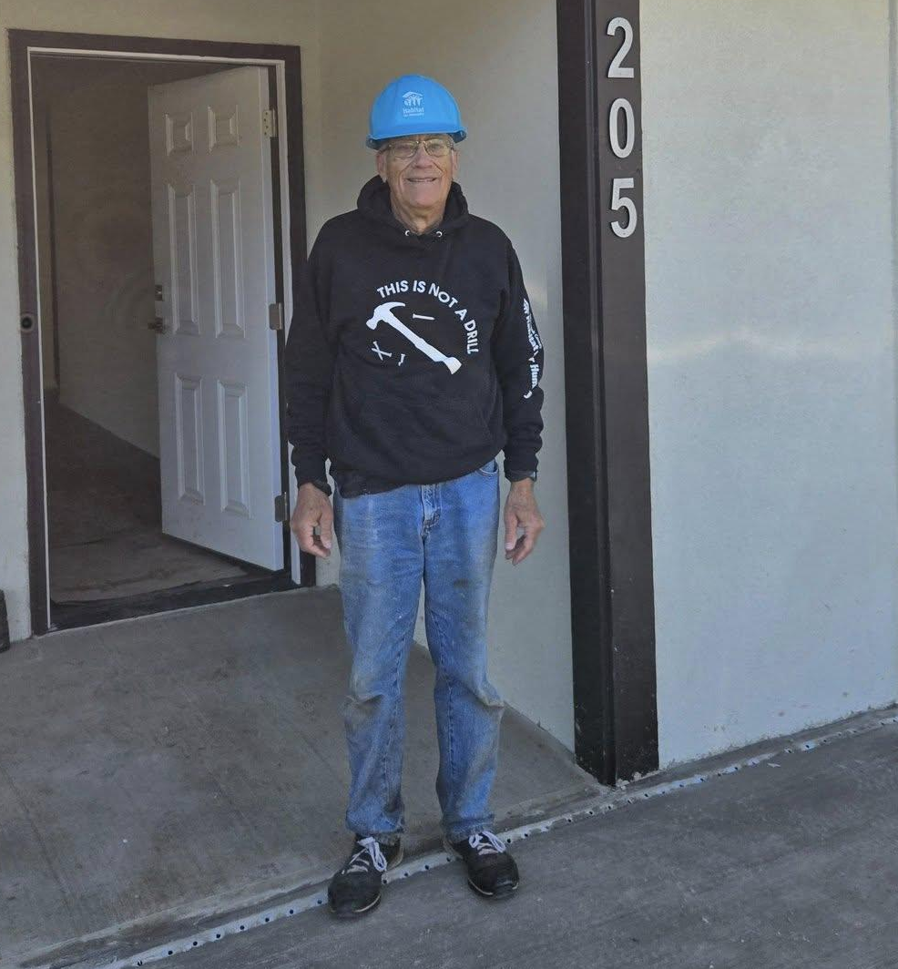
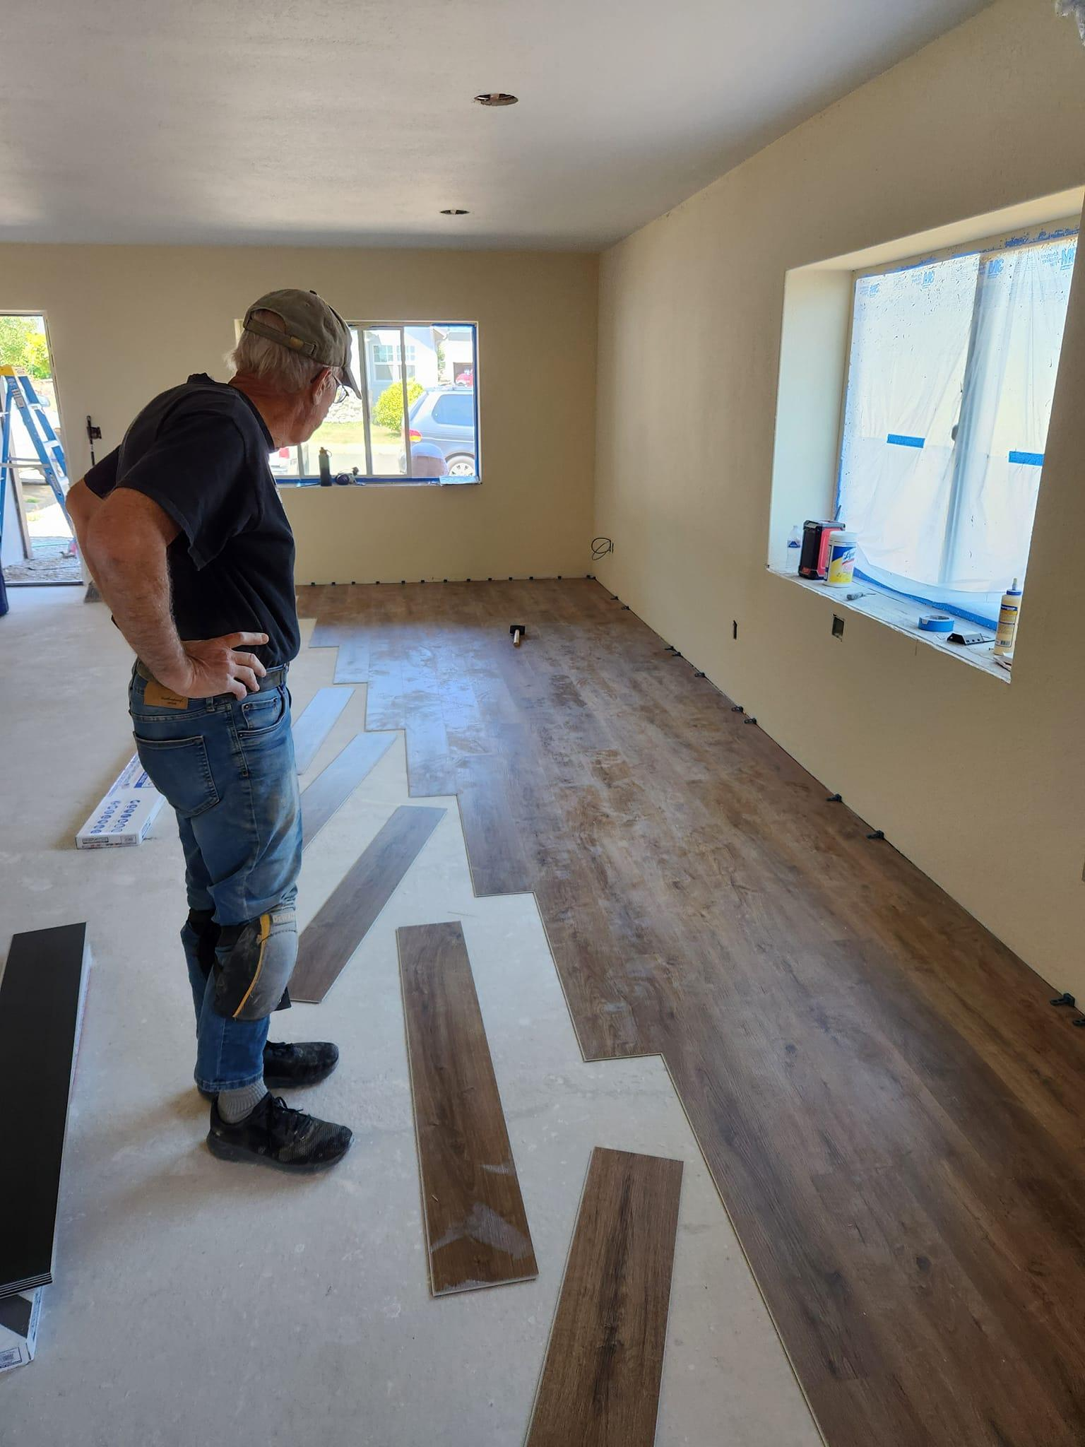
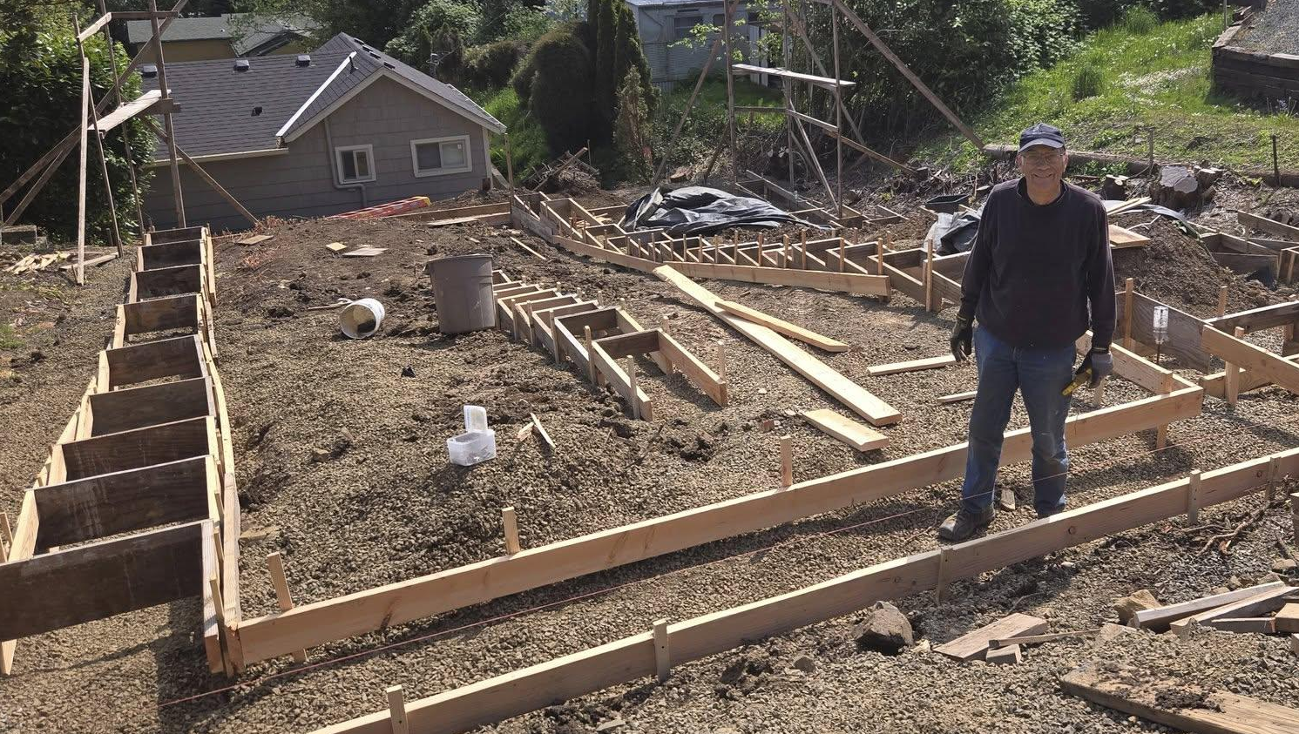
Volunteers & Community Impact

