Slide 1
Tillamook County Onsite Wastewater Division
Christian Chiola
Environmental Program Manager

Slide 2
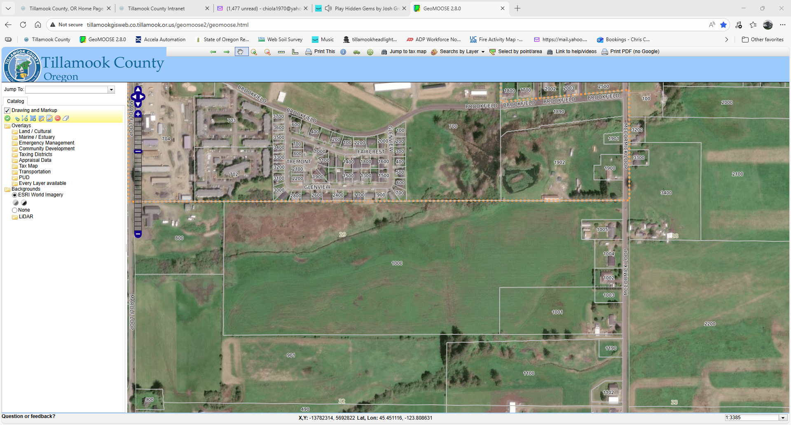
East Tillamook Property Potential residential development

Slide 3
East Tillamook property soil conditions
Medial loams
Moderately drained
Shallow water table (25-35 inches)
Season high water table possible up to 17 inches

Slide 4
East Tillamook Property onsite wastewater treatment basics
Local jurisdiction on parcels discharging less than 2500 gallons per day
State review and permitting for systems above 2500 g/day
A 2-bedroom dwelling discharges 300 gallons per day
A 4-bedroom dwelling discharges 450 gallons per day
8 2-bedroom dwellings would discharge 2400 gallons per day

Slide 5
East Tillamook Property onsite wastewater treatment basics
Primary treatment of sewage is in a septic tank
Advanced treatment reduces the level of contaminants such as BOD (biological oxygen demand, nitrogen and phosphorus
Discharged and dispersed in a drainfield for final treatment

Slide 6
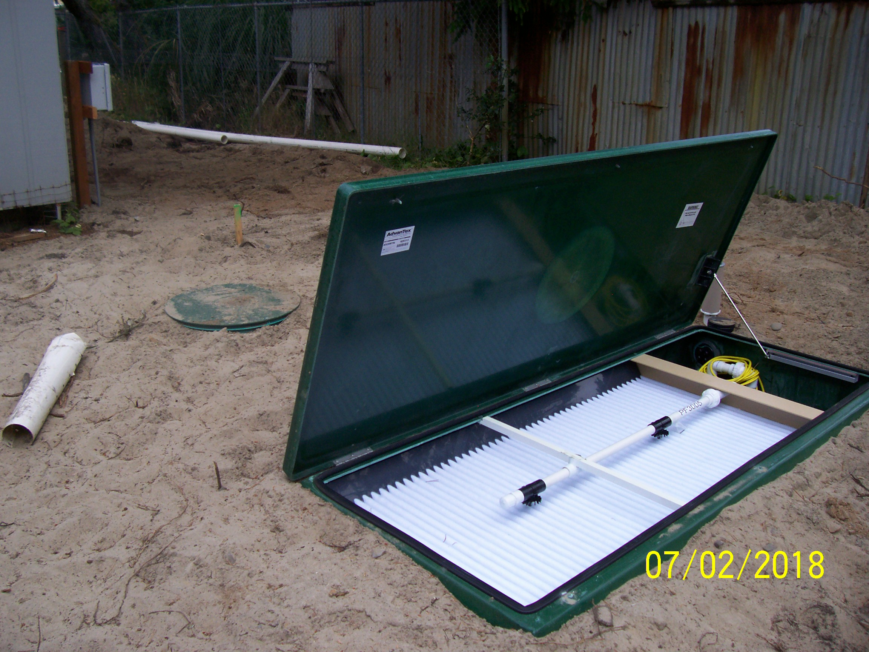
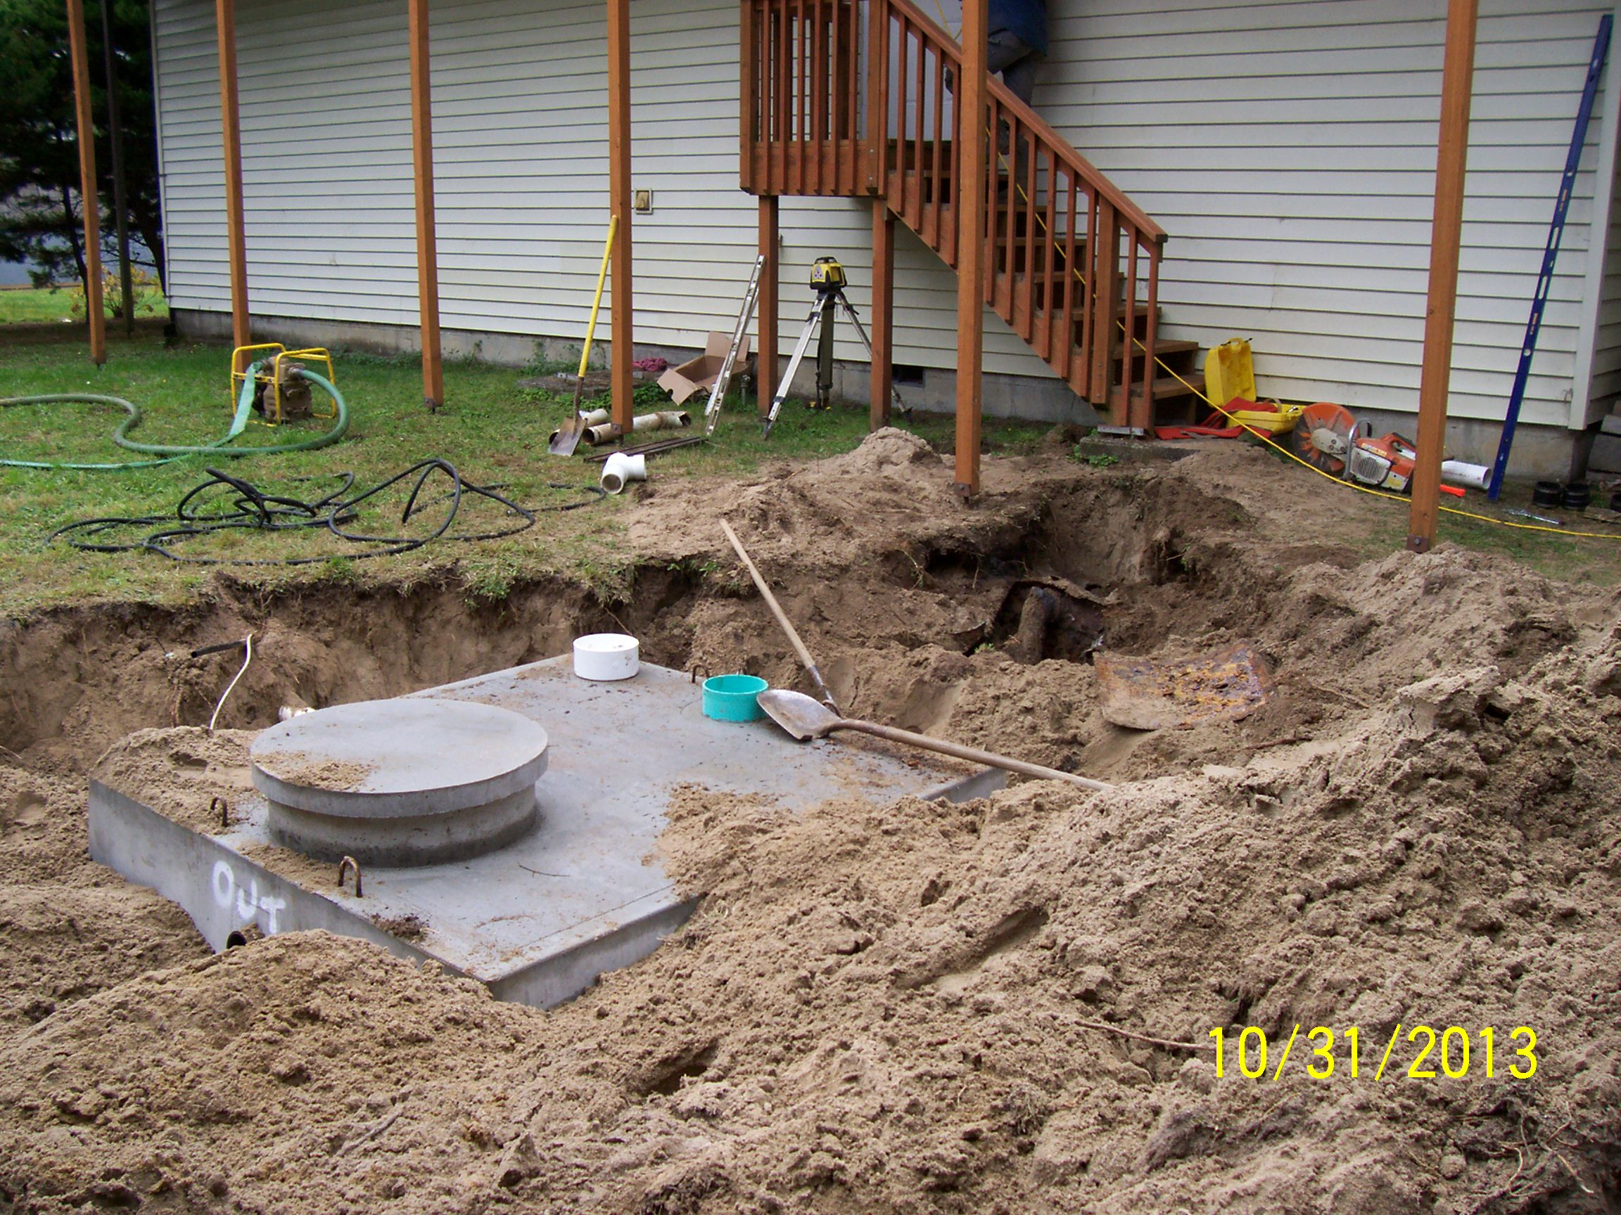
East Tillamook Property Septic tank and Treatment pod

Slide 7
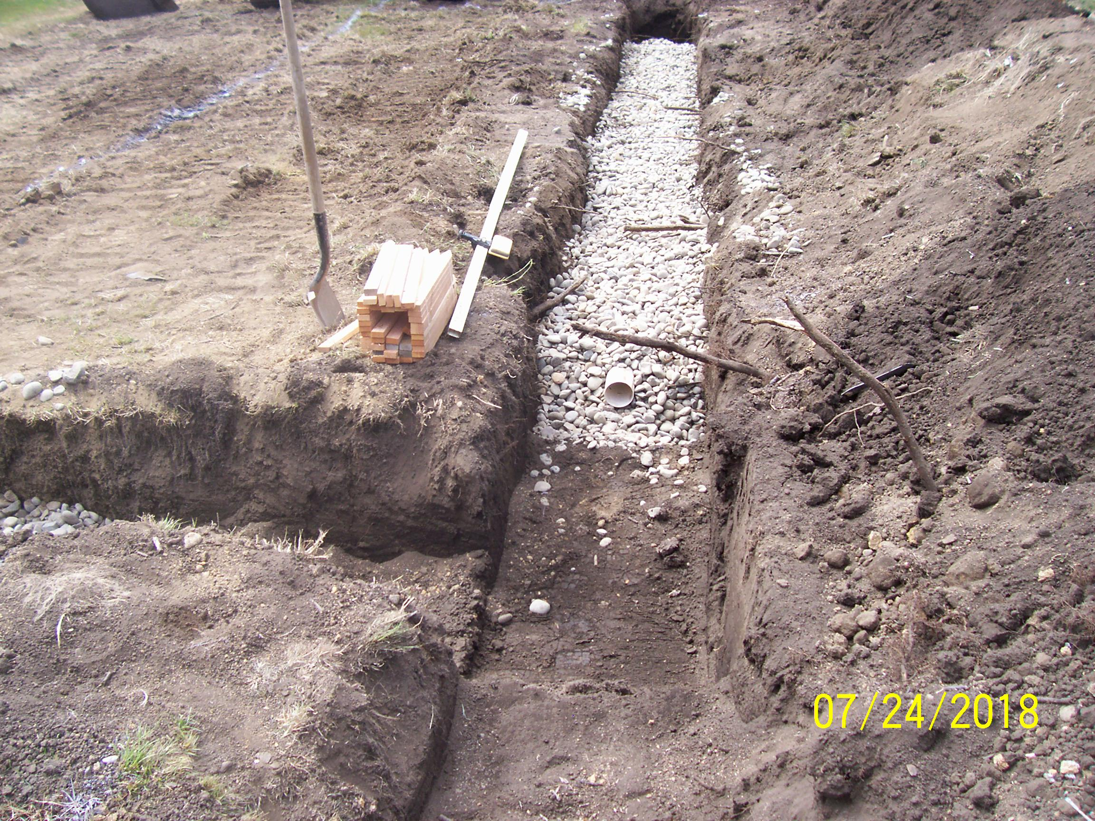
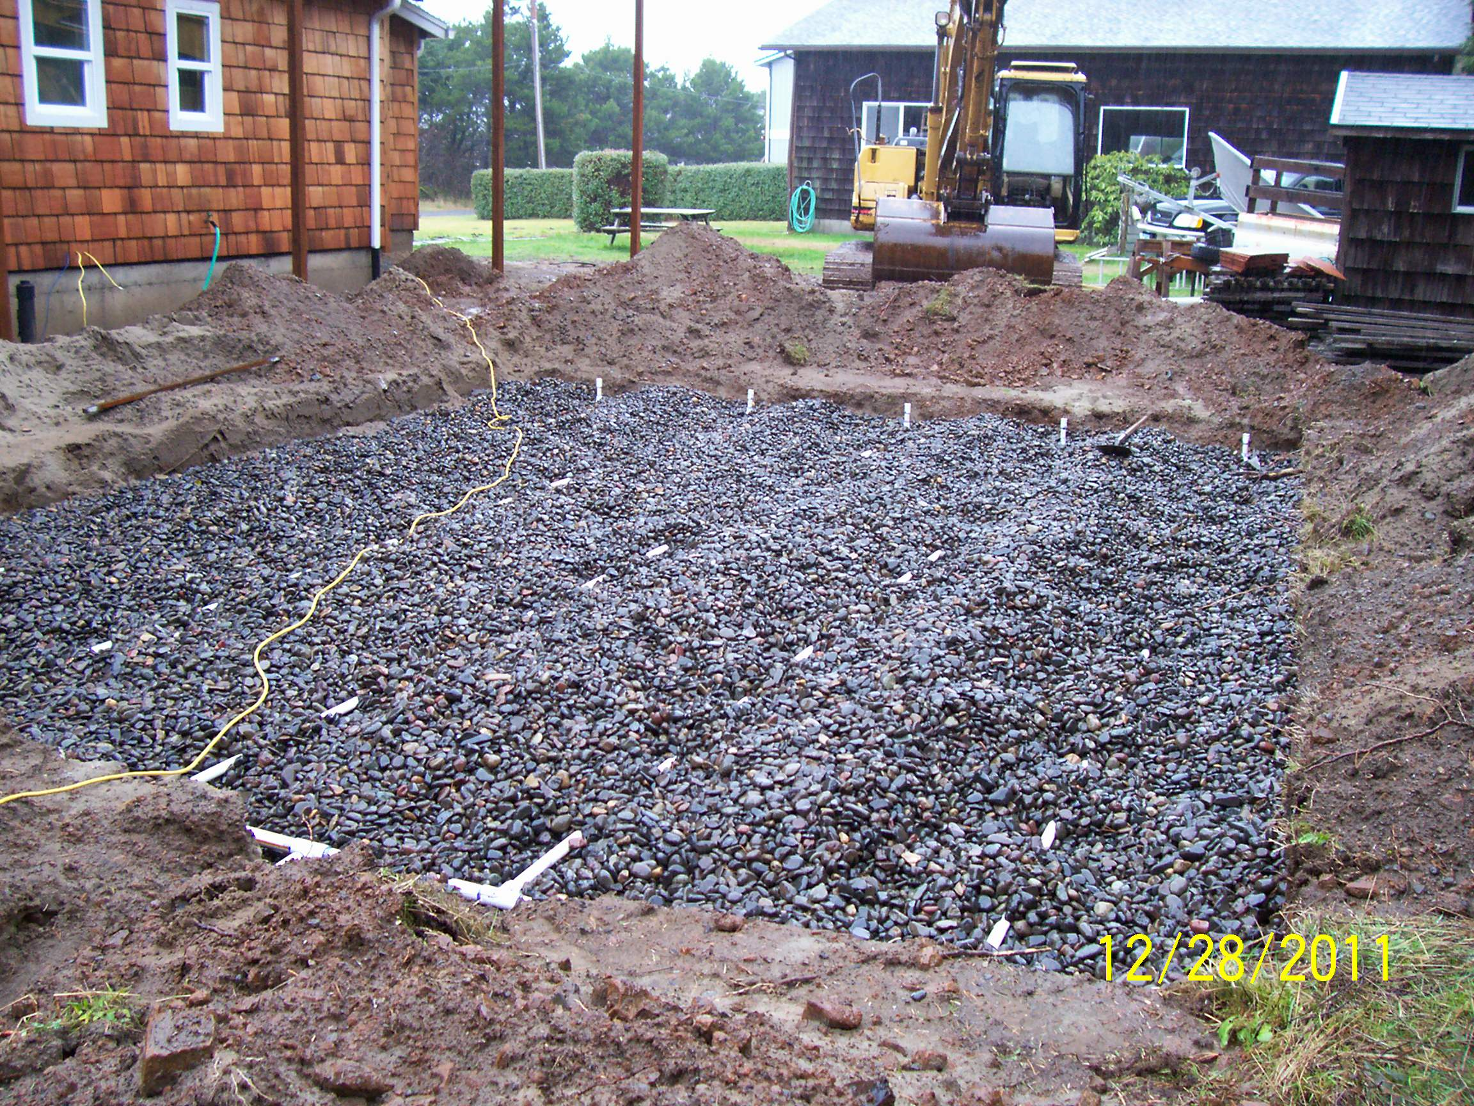
East Tillamook Property Drainfield examples

Slide 8
East Tillamook Property System requirements
Each 8-unit cluster would require up to 4 septic tanks and up to 2 treatment pods each depending on sizing and capacity of units
Each cluster would require up to 800 linear feet of drainfield trenches

Slide 9
East TillamookProperty Example site plan

Slide 10
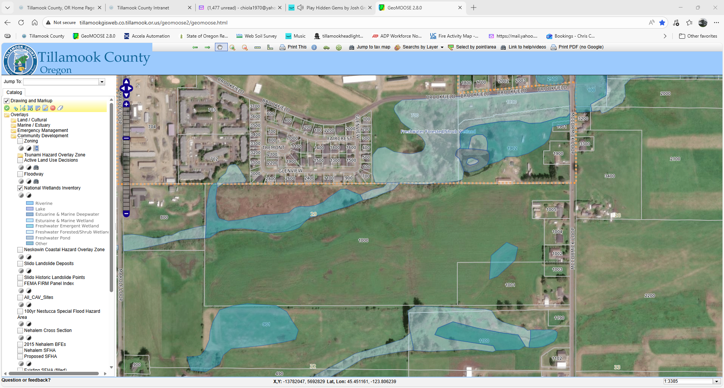
East Tillamook Property Wetlands map

Slide 11
East Tillamook Property Setbacks
Setbacks from surface waters to septic tanks, treatment units and drainfields is 50 feet
Setbacks to drinking water sources is 100 feet

Slide 12
Brownfields assessment Grant
FY2025 Brownfields Community-Wide Assessment Cooperative Agreement for $500,000 to provide funding to inventory, assess and conduct clean-up planning for community development projects.

Slide 13
Brownfields Assessment Grant
100% EPA Funded
Phase I and Phase II Environmental Assessments
Site-Specific clean-up plans
Provide outlets and funding sources for develeopment

Slide 14
Brownfields assessment Grant
Beaver Elementary School re-development
2 other mixed-use projects in Beaver
Port of Garibaldi processing facilities redevelopment
Beals Alley in Tillamook
Other sites as identified

